Slide 1
Progress in backreaction
Syksy Räsänen
University of Helsinki
Department of Physics and
The Helsinki Institute of Physics

Slide 2
Looking for a factor of 2
Homogeneous and isotropic models which have ordinary matter and gravity disagree with cosmological observations by a factor of 2.
This could be due to the known breakdown of homogeneity and isotropy related to structure formation.
There have been many studies of the effects of inhomogeneity over the years, and several things are now understood better.
This brief review outlines my bias about the field.

Slide 3
First light
1962: The effect of inhomogeneities on averages is first analysed. (Shirokov and Fisher)
1983: The issue is discussed in detail under the name fitting problem. (Ellis)
Studies in the observational cosmology program and questions about the foundations of the FRW model followed.
Point of view: how can we do cosmology with as few model assumptions as possible?

Slide 4
The justification of the FRW model did not become a mainstream issue, likely because until the 90s the observations were not very precise.
There were various (often flawed) calculations of the effect of fluctuations on the average expansion rate, called backreaction.
1995: Backreaction is rigorously shown to reduce to a boundary term in Newtonian gravity. (Buchert and Ehlers)
1999: Backreaction is shown not to reduce to a boundary term in GR. (Buchert)
Result: a universe which contains structures is in general not described by a FRW model on average.

Slide 5
The backreaction conjecture
With the advent of better SN and CMB observations in 1998+, the limit of validity of the Standard CDM model was reached: the predicted distance and expansion rate are too small by a factor of 2.
It was suggested that inhomogeneities could be the reason. (Buchert, Wetterich, Schwarz, SR)
A new period, with a more narrow focus: Assuming that the early universe is nearly-FRW in the manner motivated by inflation, what happens as the local symmetry breaks due to structure formation?

Slide 6
Devil in the details
2003: The expansion rate is calculated using proper variables at (first order)², getting a 10⁻⁵ effect. (SR)
2004: The calculation is done correctly (i.e. at second order), confirming the magnitude. (Kolb et al)
2005: It is claimed that superhorizon perturbations lead to acceleration. (Kolb et al)
2005: It is shown that superhorizon perturbations cannot lead to acceleration. (Geshnizjani et al, Flanagan et al, Hirata and Seljak, SR)
2006: It is shown how subhorizon fluctuations can lead to acceleration. (Kai et al, SR, Chuang et al, Paranjape and Singh)

Slide 7
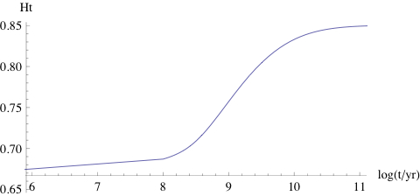
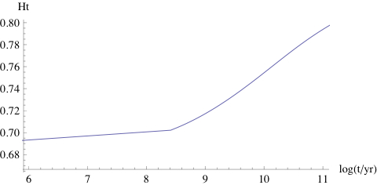
2008: It is shown how the magnitude of the change in the expansion rate and the10 billion year timing emerge from the physics of structure formation. (SR)
Ht as a function of time (with t_{eq}=50 000 yr)

Slide 8
Light in the middle
Until recently, light propagation studies have evolved mostly separately from backreaction.
2007: It is pointed out that the FRW metric can be tested by comparing distance and expansion rate. (Clarkson et al)
2008-2009: Relation between distance and average expansion rate is derived in the non-FRW case with statistical homogeneity and isotropy. (SR)
It seems that if the average expansion rate is close to FRW, the light observables are close to FRW. (Although the matter is not entirely clear.)
Notes:
-Swiss Cheese

Slide 9
Slightly perturbed
Inhomogeneities can lead to acceleration, and deviations are of the order of the observed signal.
But do the deviations cancel in the average?
This is a question of the large-scale balance between fast and slow regions.
In Newtonian gravity, but not in GR, there is a cancellation due to conservation of energy.
2010: A new perturbation formalism adapted to cosmology is presented, in which backreaction is small if the metric is close to FRW. (Green and Wald)
2011: It is shown that backreaction is small in ordinary perturbation theory to all orders. (SR)

Slide 10
Status report
If backreaction is significant, then:
The universe cannot be described in terms of a linearly perturbed FRW metric: understanding the breakdown.
Non-Newtonian aspects of gravity are important at the homogeneity scale: understanding the Newtonian limit.
It seems that light propagation can to first order be treated in terms of the average expansion rate, but:
This should be established rigorously.
Corrections should be calculated (CMB, weak lensing).
Whether backreaction is important remains an unresolved issue, with several open lines of inquiry.

Slide 11
Consider a stabilised region on a spatially flat dust background:

