Slide 1
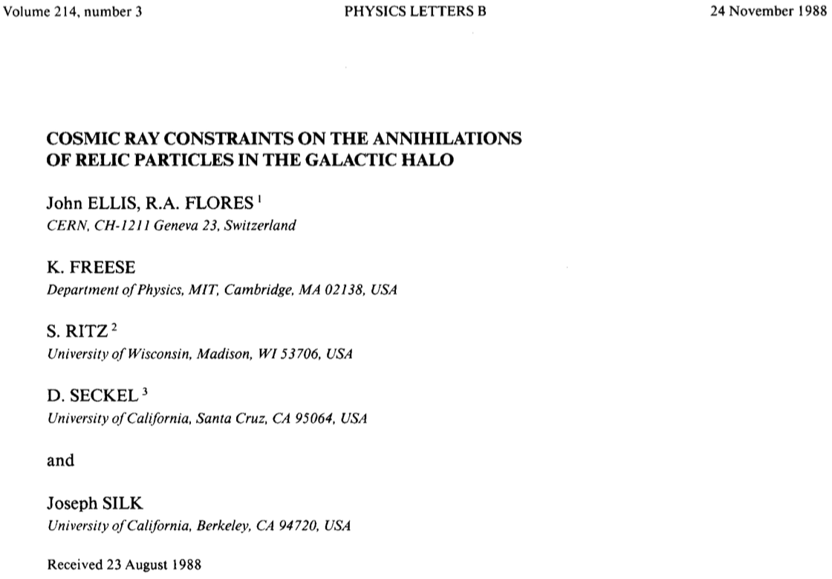

Particle Candidates for Dark Matter
(Still) Supersymmetry
(Still) H- and Z-portal models
(Not so) Simplified Z’ models
(GW-inspired) Crazy ideas
John Ellis
Time for desperation creative thinking

Slide 2
What lies beyond the Standard Model?
Supersymmetry
New motivations
From LHC Run 1
Stabilize electroweak vacuum
Successful prediction for Higgs mass
  Should be < 130 GeV in simple models
Successful predictions for couplings
  Should be within few % of SM values
Naturalness, GUTs, string, …, dark matter

Slide 3
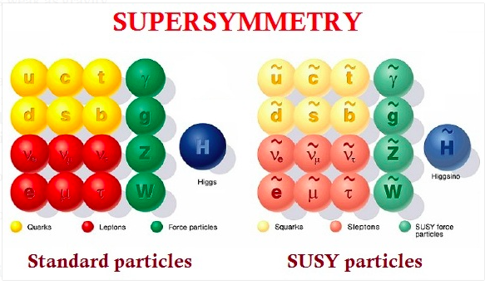
Minimal Supersymmetric Extension of the Standard Model

Slide 4
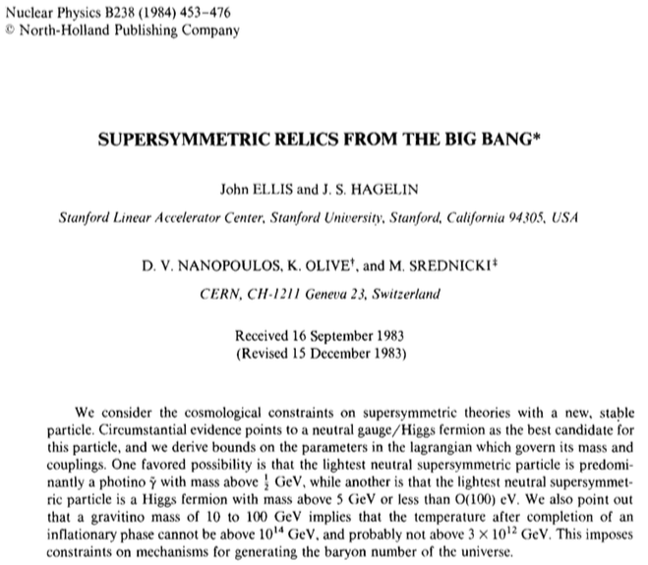
Personal Bias

Slide 5
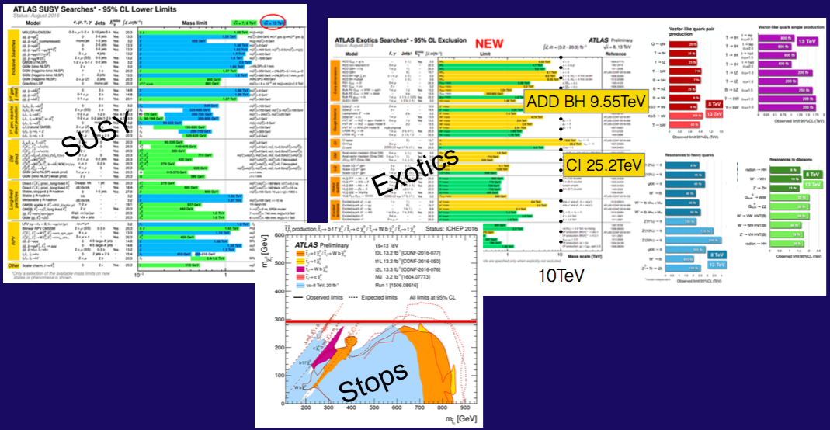
Nothing (yet) at the LHC
No supersymmetry
Nothing else, either
More of same?
Unexplored nooks?
Novel signatures?

Slide 6
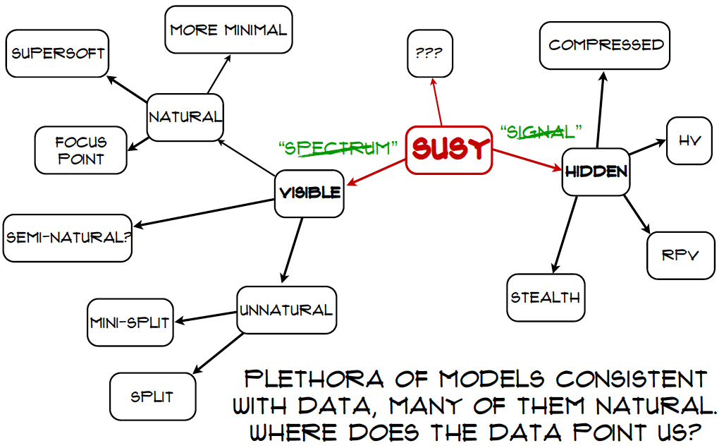

Craig@LHCP

Slide 7
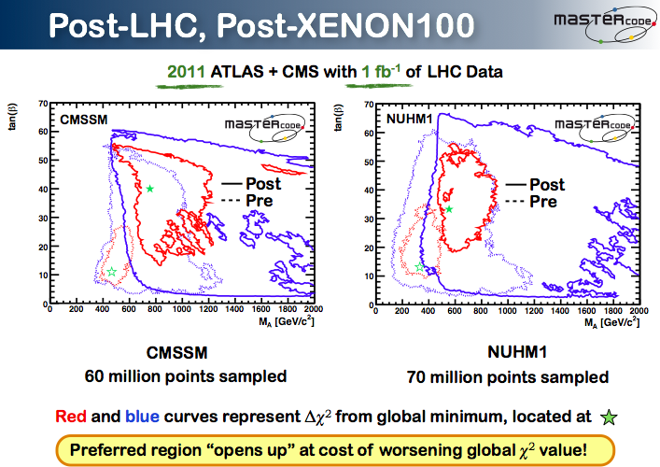

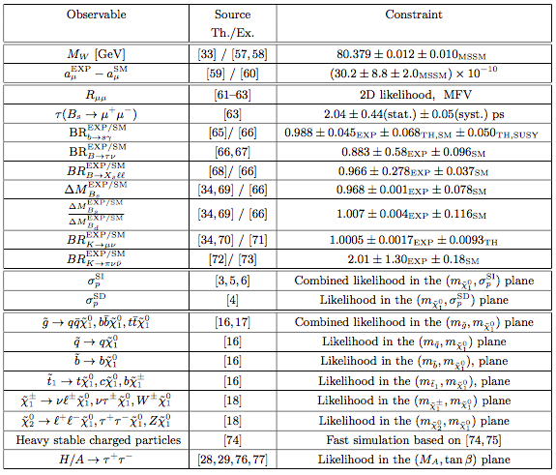
Inputs to Global Fits for New Physics
Electroweak
observables
Flavour
observables:
Interpretation
requires
lattice inputs
Dark Matter
LHC
observables

Slide 8
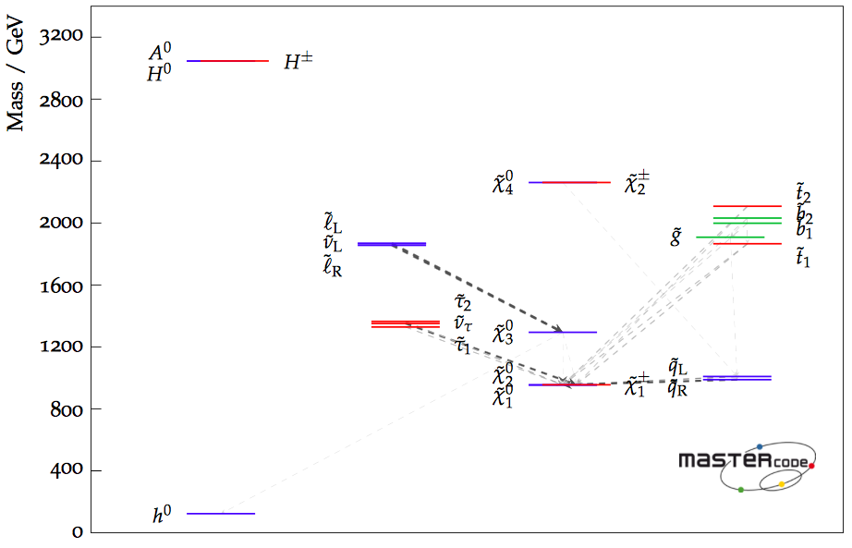
Best-Fit Sparticle Spectrum
Phenomenological MSSM (no assumptions on mass parameters)
Fit without g_{μ}-2
Accessible
to LHC
Bagnaschi, Sakurai, JE et al, arXiv:1710.11091

Slide 9
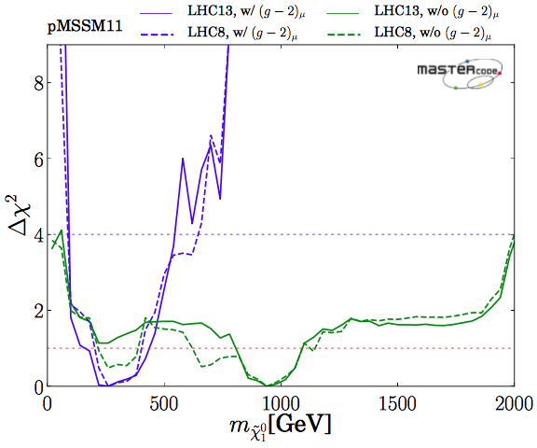
Likelihood for LSP Mass
Phenomenological
MSSM
(no assumptions
on mass parameters)
With g_{μ}-2
Without g_{μ}-2
Bagnaschi et al, arXiv:1710.11091

Slide 10
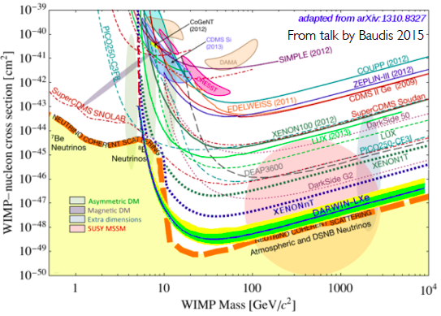
Direct Dark Matter Searches
Compilation of present and future sensitivities
SUSY
models
Neutrino
“floor”

Slide 11
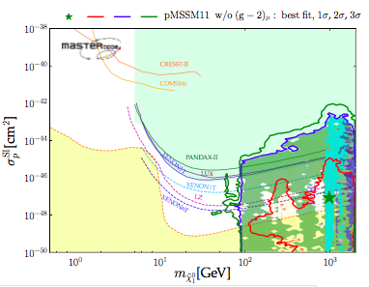
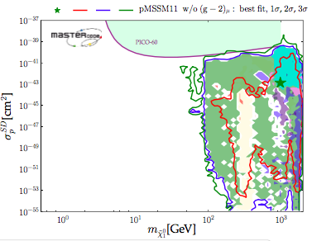

Direct Dark Matter Searches
Phenomenological MSSM
Spin-independent scattering cross-section
close to PandaX upper limit?
Spin-dependent scattering: Strongest limit from PICO-60 prospects for PICO-500
Bagnaschi, Sakurai, JE et al, arXiv:1710.11091

Slide 12
H- and Z-Portal Models are not dead yet
Dropping ideology
Consider spin-0, -1/2, -1 DM coupled to Standard Model via Higgs or Z boson
All available collider, DM search constraints
Bayesian & frequentist statistical analyses
JE, Fowlie, Marzola & Raidal, arXiv:1711.09912

Slide 13
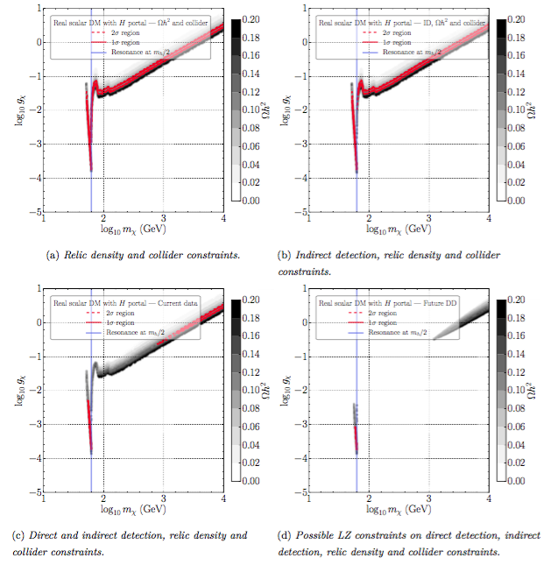
Higgs coupled to
Spin-0 DM
Relic density
+ collider
Also indirect
DM search
Red = 1-, 2-σ regions
Grey = relic density
On- and off-shell cases both allowed
Also direct
DM search
Possible future
direct
DM search
JE, Fowlie, Marzola &
Raidal, arXiv:1711.09912

Slide 14
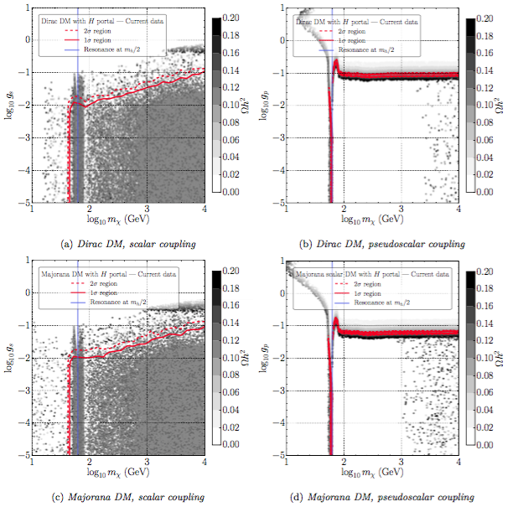
Higgs coupled to
Spin-½ DM
Dirac fermion
Scalar coupling
Dirac fermion
Pseudoscalar
Red = 1-, 2-σ regions
Grey = relic density
On- and off-shell cases both allowed
Majorana fermion
Scalar coupling
Majorana fermion
Pseudoscalar
JE, Fowlie, Marzola &
Raidal, arXiv:1711.09912

Slide 15
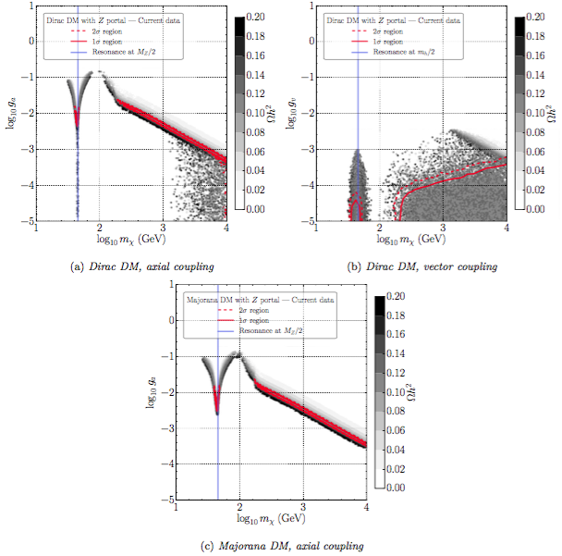
Z Boson coupled to
Spin-½ DM
Dirac fermion
Vector coupling
Dirac fermion
Axial coupling
Red = 1-, 2-σ regions
Grey = relic density
On- and off-shell cases both allowed
Majorana fermion
Axial coupling
JE, Fowlie, Marzola &
Raidal, arXiv:1711.09912

Slide 16
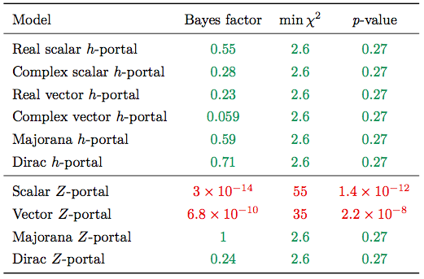
Summary of Results
OK
Strongly
disfavoured
OK
JE, Fowlie, Marzola & Raidal, arXiv:1711.09912

Slide 17
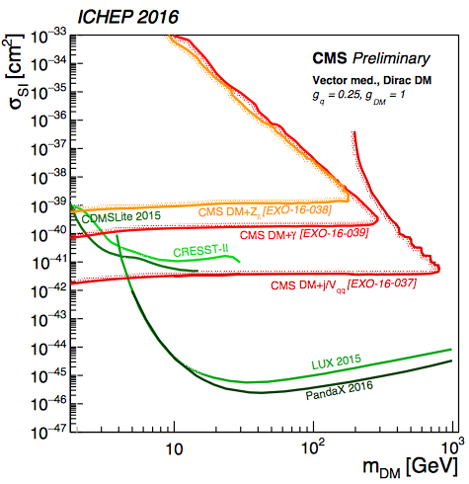
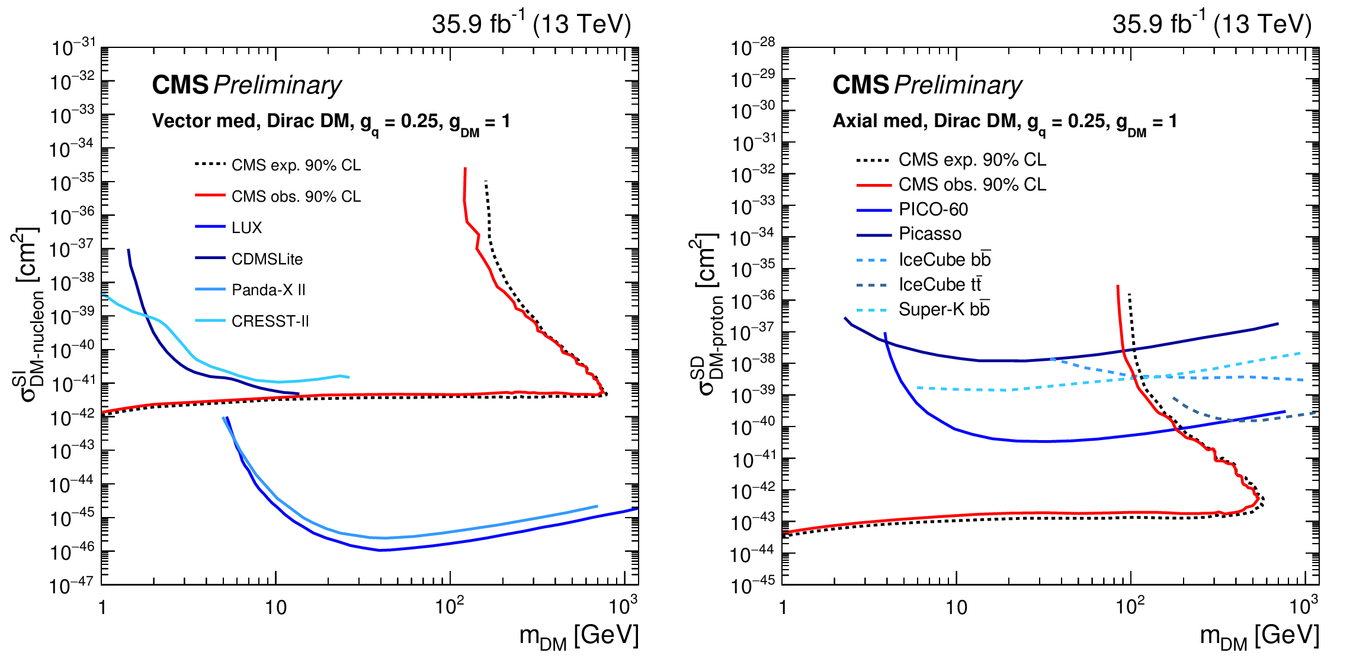
Simplified Dark Matter Models
Z’ mediators ….
Compilation of sensitivities to annihilations via Z’
LHC loses for vector, except small m_{DM}
LHC wins for axial, except large m_{DM}
LHC
DM search
DM search
LHC
Model dependence

Slide 18
Anomaly-Free Z’ Models are not so Simple
Implications for
“Simplified” Dark Matter Models
Interpretations of flavour anomaies
JE, Fairbairn & Tunney, arXiv:1704.03850, 1705.03447

Slide 19
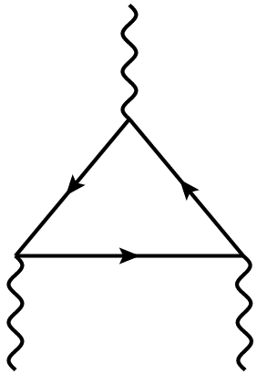
Simplified Dark Matter Models
Involve bosonic mediator particles of spin 0 or 1
The latter are gauge bosons of some U(1)’ with vector and/or axial-vector couplings
Consistency of theory requires cancellation of anomalous triangle diagrams
Standard Model has
quark-lepton cancellation
Should be re-examined in models with extra fermions and/or gauge bosons
JE, Fairbairn & Tunney, arXiv:1704.03850

Slide 20
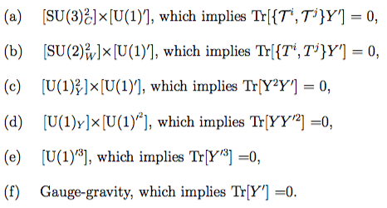
Anomaly Cancellation Conditions
Colour/U(1)’:
SU(2)_{W}/U(1)’:
U(1)_{Y}²/U(1)’:
U(1)_{Y}/U(1)’²:
U(1)’³:
Gravity/U(1)’::
Non-trivial set of constraints
JE, Fairbairn & Tunney, arXiv:1704.03850, 1705.03447

Slide 21
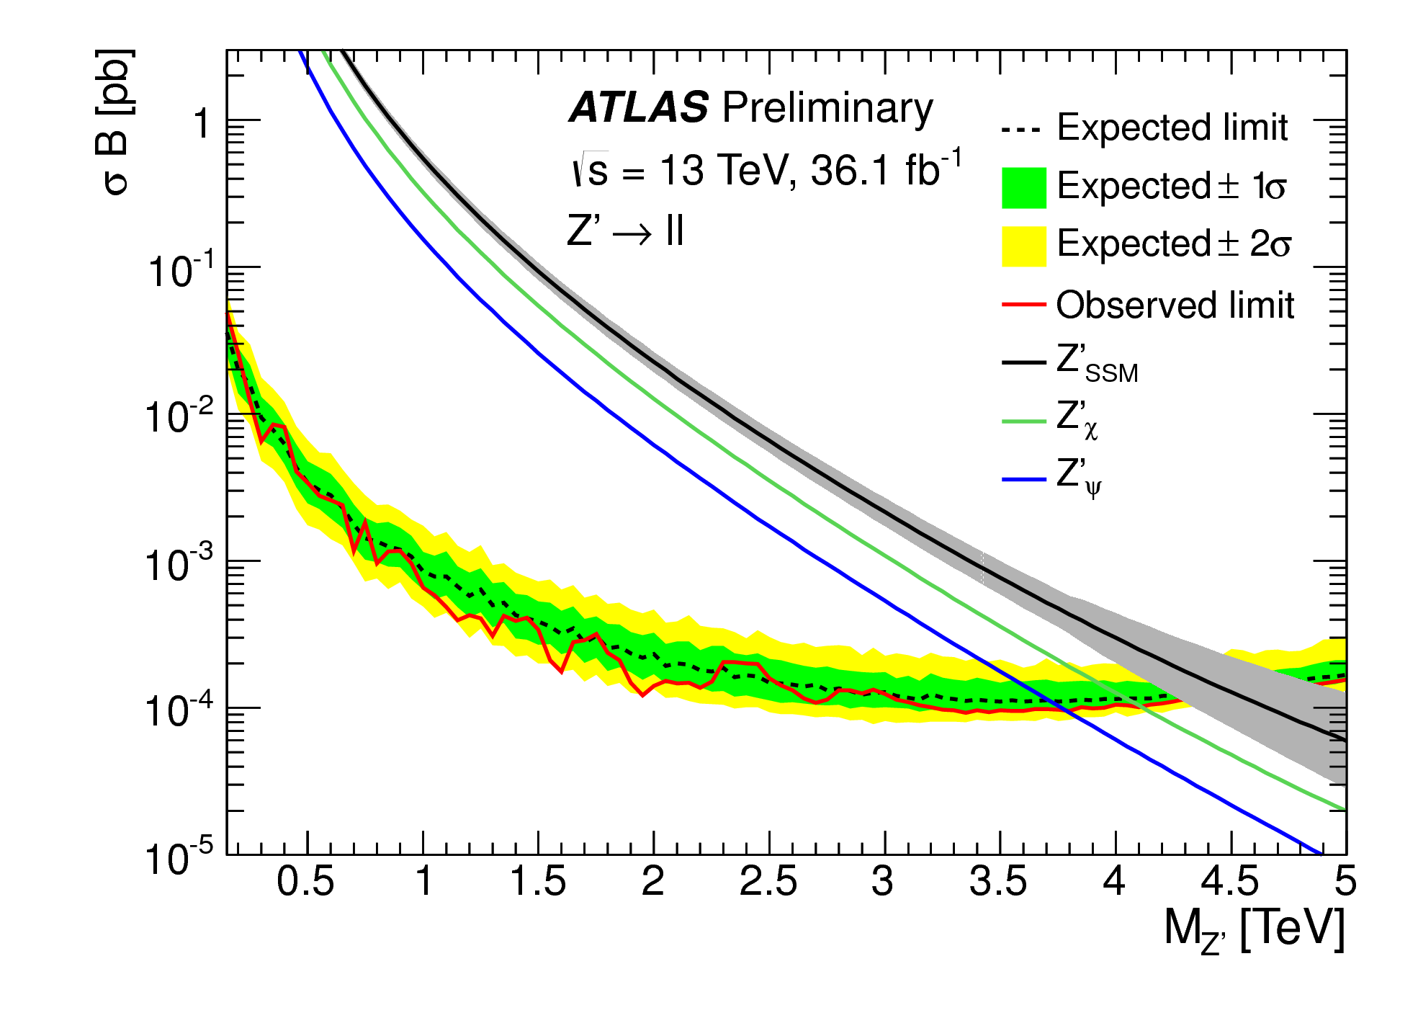
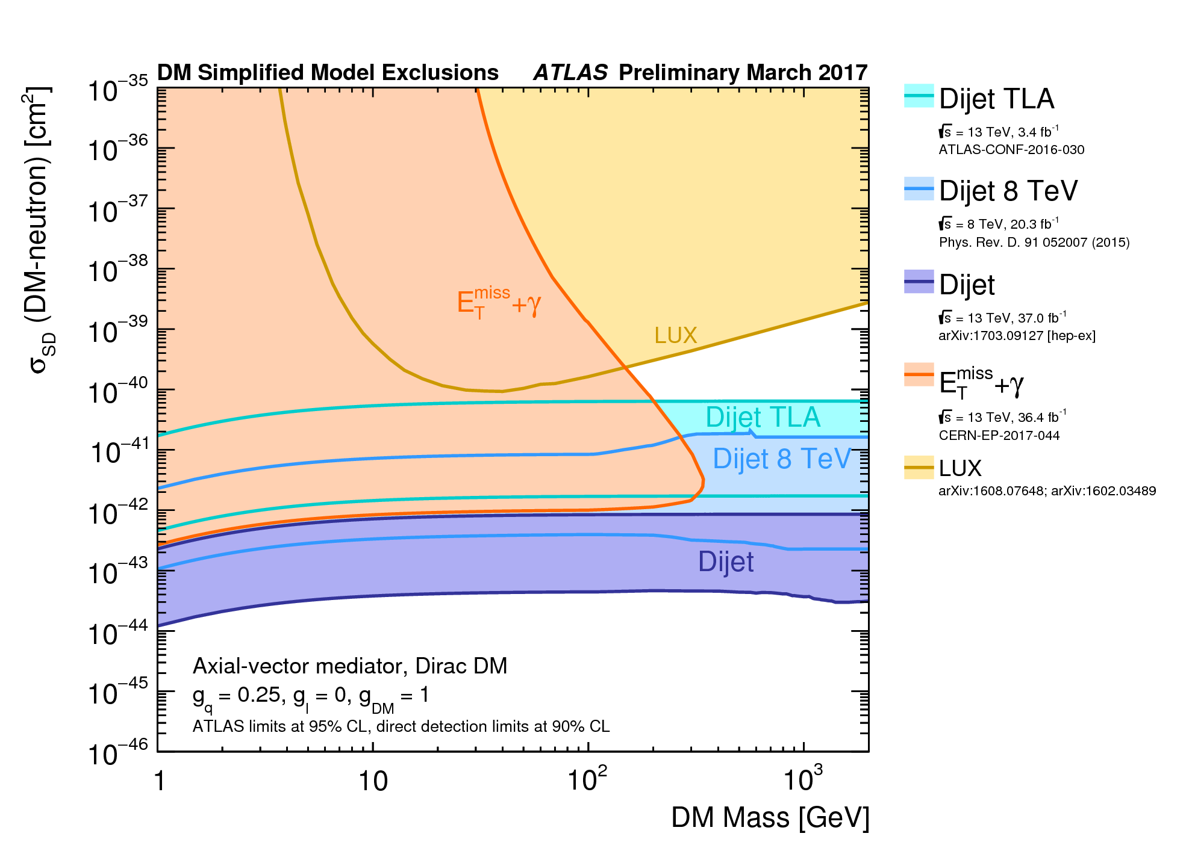
Simplified Dark Matter Models
Mass of Z’ boson > about 3 TeV if produced by 1st generation quarks and decays to leptons
Impact reduced if leptophobic
Impact of direct DM searches reduced if
  DM particle has axial Z’ coupling
  DM particle has axial nuclear coupling
  DM particle decouples from 1st/2nd generation
What anomaly-free U(1)’ models compatible with these desiderata?

Slide 22
Anomaly-Free Dark Matter Models are not so Simple
If a single DM fermion and generation-independent U(1)’ charges for SM particles:
  The SM leptons must have non-zero U(1)’ charges
  The DM particle has vector U(1)’ coupling
If DM fermion has axial coupling:
  Must have 2nd ‘dark’ fermion
  Z’ still leptophilic
Leptophobic models need DM particle + ≥ 2 other dark particles with different U(1)’ charges
Interesting experimental signatures?
JE, Fairbairn & Tunney, arXiv:1704.03850

Slide 23
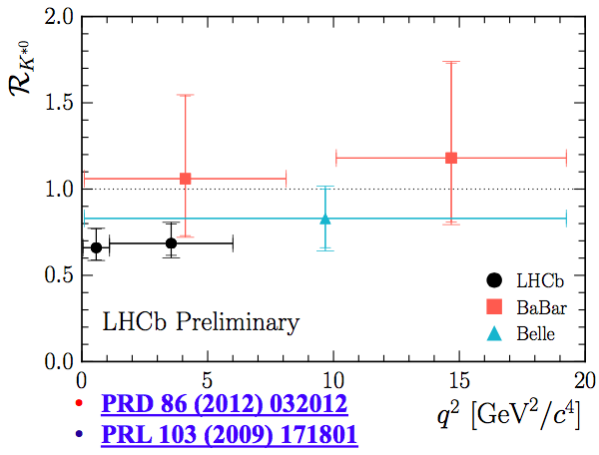
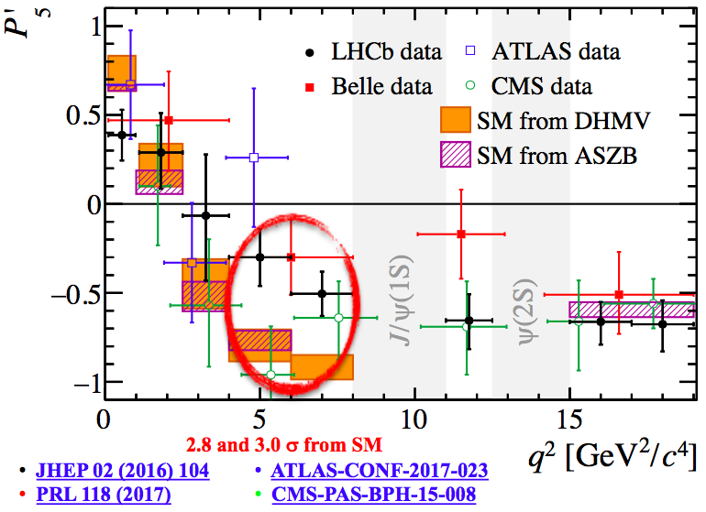
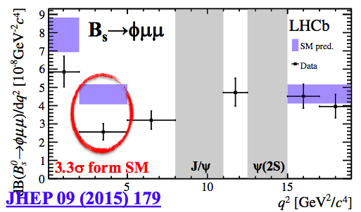
Flavour Anomalies in B➔K^{(*)}μ⁺μ⁻, B_{s}➔ϕμ⁺μ⁻
Apparent violation of μ-e universality in B➔K^{(*)}μ⁺μ⁻
Anomalous angular distribution in B➔K*μ⁺μ⁻
Anomalous q² distribution in B_{s}➔ϕμ⁺μ⁻ decay

Slide 24
Possible Z’ Interpretations
Coupling to muons, not electrons (LEP), tau?
Prefer vector-like coupling to muons
Coupling to LH charge – 1/3 quarks
Prefer universal couplings to 1st/2nd generation quarks (FCNC)
Different coupling to 3rd generation quarks to get bs flavour change
Non-zero couplings of RH charge 2/3 quarks?
Additional ‘dark’ sector or heavy vector-like lepton?
JE, Fairbairn & Tunney, arXiv:1705.03447

Slide 25
Possible Experimental Signatures
2 ‘dark’ SM-singlet fermions?
  Decays of heavier mass eigenstate
  Z’ coupling to muons not vector-like
  Strong LHC dilepton constraint
  No DM candidate with axial coupling
If RH quark charges and one DM fermion?
  Models with vector-like muon, axial Z’ DM couplings
  Models without 1st/2nd generation couplings have weaker LHC constraint,
Models with extra leptons, no DM?
  LHC constraint weakened by small branching ratio?
  May not have vector-like muon coupling
JE, Fairbairn & Tunney, arXiv:1705.03447

Slide 26
Search for Dark Matter in NS-NS Mergers?
Crazy ideas for dark matter signatures
JE, Hektor, Hütsi, Kannike, Marzola, Raidal & Vaskonen, arXiv:1710.05540

Slide 27
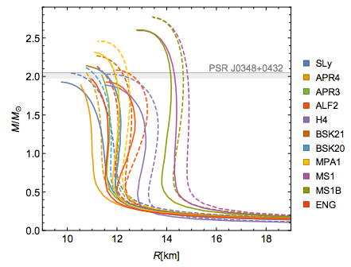
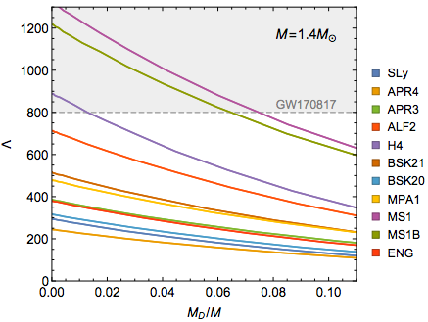
What Happens before the Merger?
DM in NS can modify effective equation of state
Change radius, tidal deformability
Smaller
radius
Smaller
deformability
JE, Hektor, Hütsi, Kannike, Marzola, Raidal & Vaskonen, in preparation

Slide 28
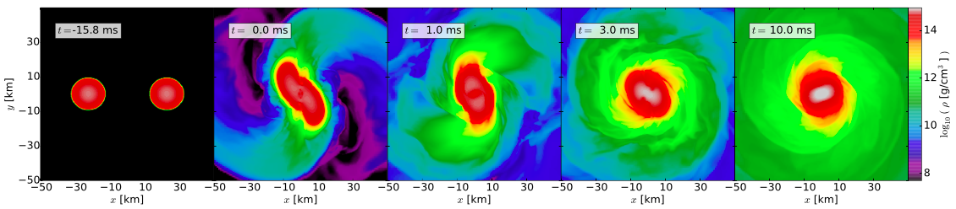
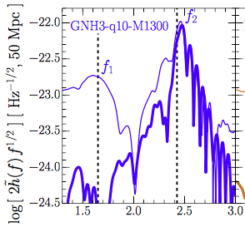
What Happens after the Merger?
NS cores orbit and oscillate radially
Characteristic spectrum of frequencies in GW emissions
Frequency peaks at stationary points in oscillations
Weakens
in few ms
Takami, Rezzolla & Baiotti, arXiv:1403.56720, 1412.3240

Slide 29
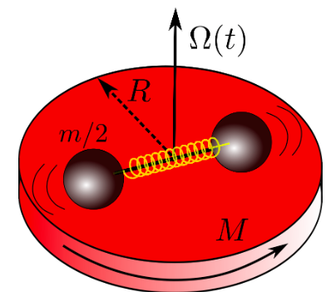
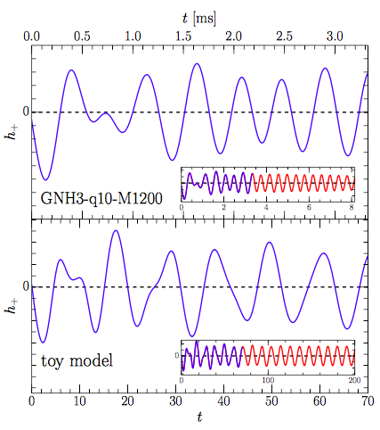
Toy Mechanical Model
Neutron cores oscillate and rotate inside disc
Captures surprisingly well major features of strain fluctuations
Takami, Rezzolla & Baiotti, arXiv:1403.56720, 1412.3240

Slide 30
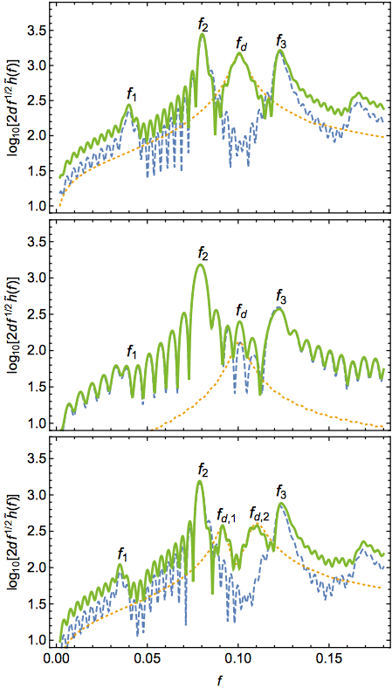
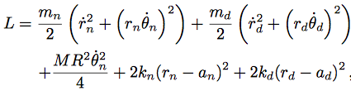
Including Dark Matter
DM
Two pairs of oscillating cores
Reproduce results when no DM
Weakens in few ms
2 peaks if unequal DM core masses
EHHKMRV, arXiv:1710.05540

Slide 31
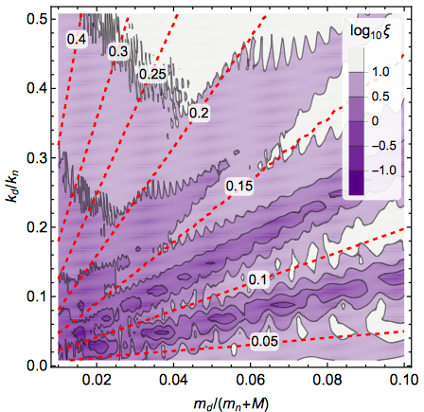
Possible Strength of DM Signal
Depends on DM fraction, dynamical parameters
EHHKMRV, arXiv:1710.05540

Slide 32

Summary
Supersymmetry is still alive:
  Many variants
  Not much change from LHC Run 1
A fortiori, other WIMP scenarios also possible
  Connected to Standard Model via H or Z
  Couple via Z’: extra signatures
Open season for crazy ideas
Not dead yet

Slide 33
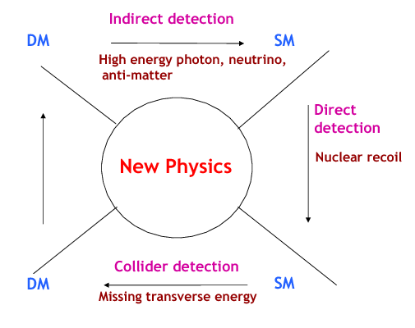
Searches for WIMP Dark Matter
Annihilation
to particles ➔
in cosmic rays
Dark Matter
Standard Model
Annihilation
in the early ➔
Universe
Production
⬅ at particle
colliders
⬆
Direct dark matter detection
Dark Matter
Standard Model

Slide 34
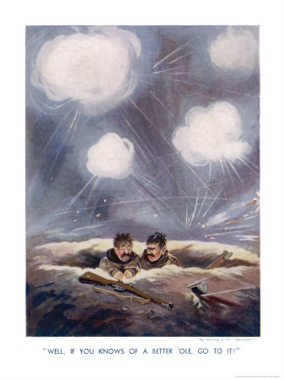
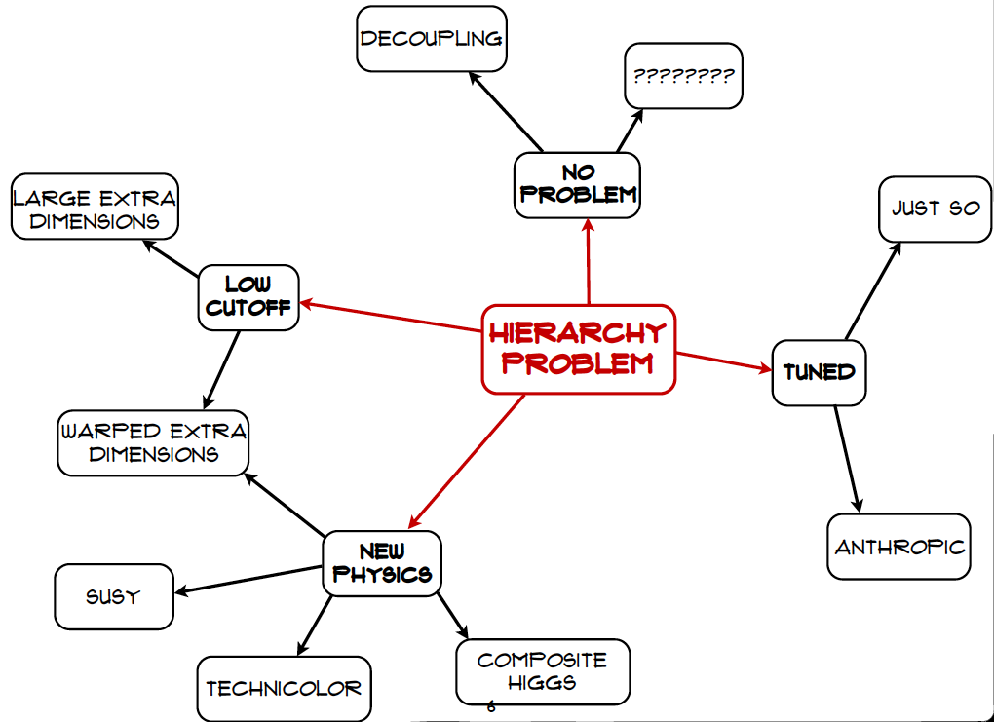
Craig@LHCP
If you know of a better hole, go to it

Slide 35
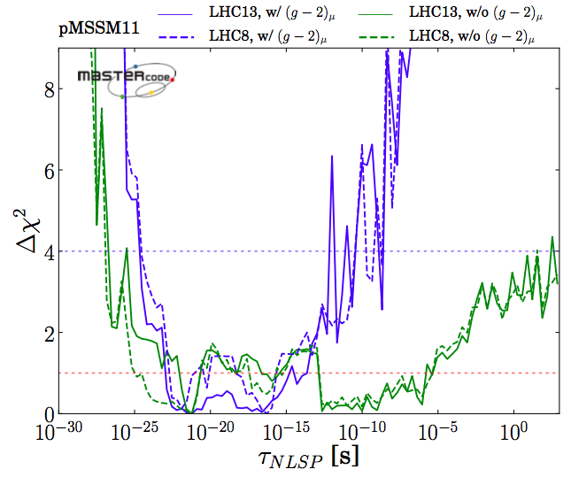
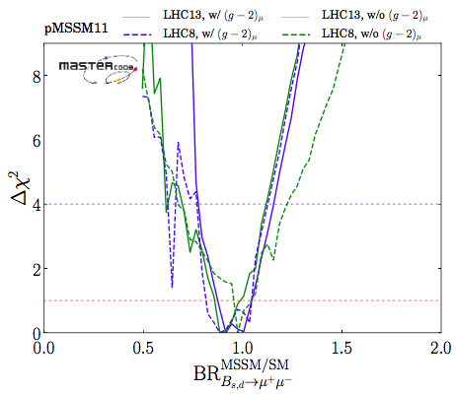
Other Possible LHC Signatures
Phenomenological MSSM
Long-lived sparticle?
B_{s,d} ➔ μ⁺μ⁻ decay < SM?
Bagnaschi, Sakurai, JE et al, arXiv:1710.11091

Slide 36


Minimal Supersymmetric Extension of Standard Model (MSSM)
Double up the known particles:
Two Higgs doublets
- 5 physical Higgs bosons:
- 3 neutral, 2 charged
Lightest neutral supersymmetric Higgs looks like the single Higgs in the Standard Model

Slide 37
Lightest Supersymmetric Particle
Stable in many models because of conservation of R parity:
R = (-1) ^{2S –L + 3B}
where S = spin, L = lepton #, B = baryon #
Particles have R = +1, sparticles R = -1:
Sparticles produced in pairs
Heavier sparticles → lighter sparticles
Lightest supersymmetric particle (LSP) stable

Slide 38
Lightest Sparticle as Dark Matter?
No strong or electromagnetic interactions
Otherwise would bind to matter
Detectable as anomalous heavy nucleus
Possible weakly-interacting scandidates
Sneutrino
(Excluded by LEP, direct searches)
Lightest neutralino χ (partner of Z, H, γ)
Gravitino
(nightmare for detection)

Slide 39






Benchmark Anomaly-Free DM Models
Single DM particle χ, free parameters: ,
Axial coupling for DM particle χ:
Leptophobic model + SM doublet A, singlets B,C
Strong LHC, DM scattering constraints, specific pattern of couplings
Strong LHC constraints, restricted pattern of couplings, 2nd `dark’ fermion
Weaker LHC constraints, restricted couplings, new doublet, 2 `dark’ fermions
JE, Fairbairn & Tunney, arXiv:1704.03850

Slide 40
Simplified Dark Matter Models
Z’ mediator models
Present sensitivities for different Z’ mediator bosons
Complementarity between LHC and direct searches
LHC
DM search
DM search
LHC
Model dependence

Slide 41
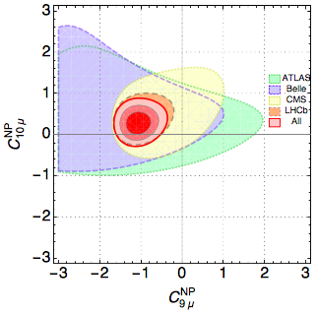
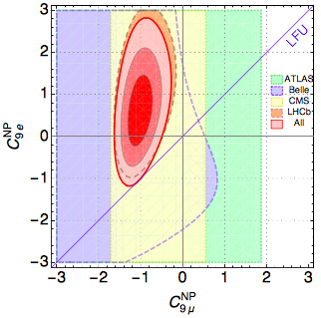
Flavour Anomalies in B➔K^{(*)}μ⁺μ⁻
Extra contribution to coefficient of
No evidence for extra contribution to
or operators with electrons
Difficult to explain with SUSY
B. Capdevila, A. Crivellin, S. Descotes-Genon, J. Matias and J. Virto, arXiv:1704.05340

Slide 42
Flavourful Z’ Models are not so Simple
If only SM particles, all quark U(1)’ charges zero
Same if only one DM particle
If 2 ‘dark’ fermions, models with OK?
  No DM candidate with axial coupling
If RH quark charges and one DM fermion
  Solutions [A, B, C] with vector-like muon coupling
  [A] also axial DM fermion
  Also models [D] without 1st/2nd generation couplings
  These have Also OK?
Models with extra leptons, no DM
JE, Fairbairn & Tunney, arXiv:1705.03447

Slide 43
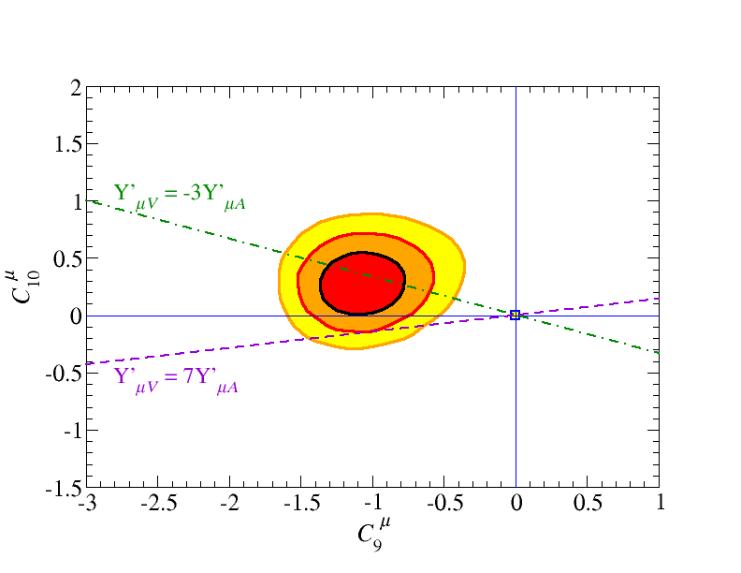
Comparison of Models to
Global Analysis of Flavour Anomalies
RH 2/3 quarks
Single DM fermion
Model [D]
RH 2/3 quarks
Single DM fermion
Models [A, B, C]
LH quarks only
2 dark fermions
Dot-dashed line:
Dashed line:
OK with data?
JE, Fairbairn & Tunney, arXiv:1705.03447

