Slide 1
BEYOND THE HORIZON How extensive is the “physical reality” that’s within the remit of science?
Notes:
Even the conservative accept that this real extends beyond where we can observe.

Slide 2
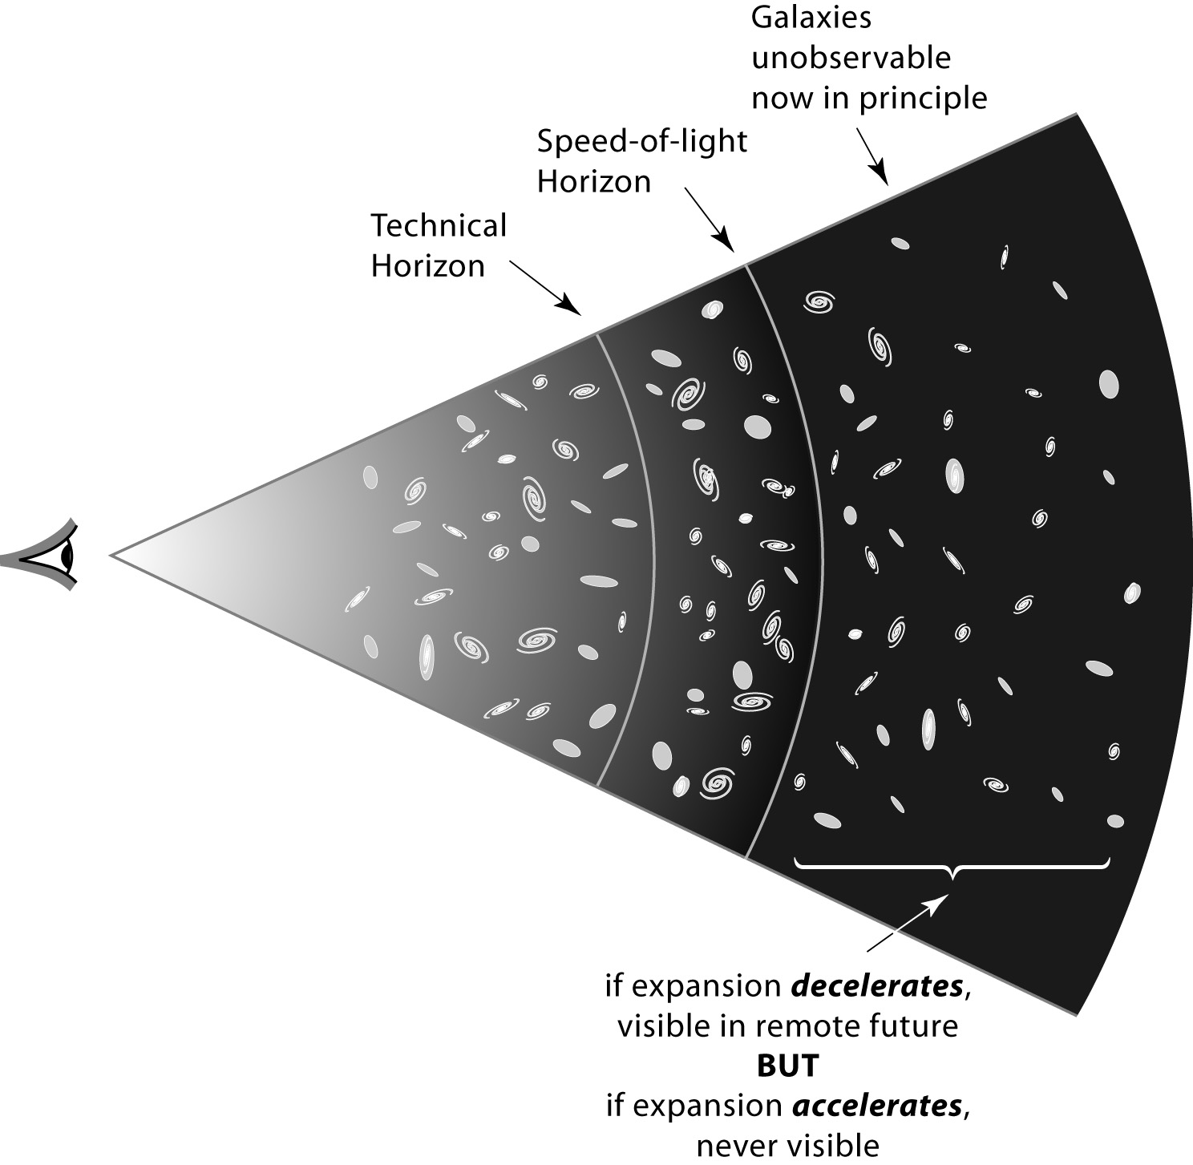
Notes:
So there are galaxies that are unobservable in principle, ever.
How many?

Slide 3
HOW MUCH LIES BEYOND OUR HORIZON (10¹⁰ 1.y distant)?
Cannot be sure of anything beyond present causal horizon.
Moreover, topology could be complex or 'kaleidoscopic'.
But lack of discernible gradients (in CMB or galaxy counts) across Hubble scale suggest that our universe extends for > 10¹⁵ l.y
and space could extend > 10¹⁰⁰ l.y
or even >>>>>>
(replicas!)
Moreover, this immensity could be the aftermath of just
one big bang out of many (eternal inflation, braneworlds, etc)
Notes:
Other big bangs --- cartoon

Slide 4
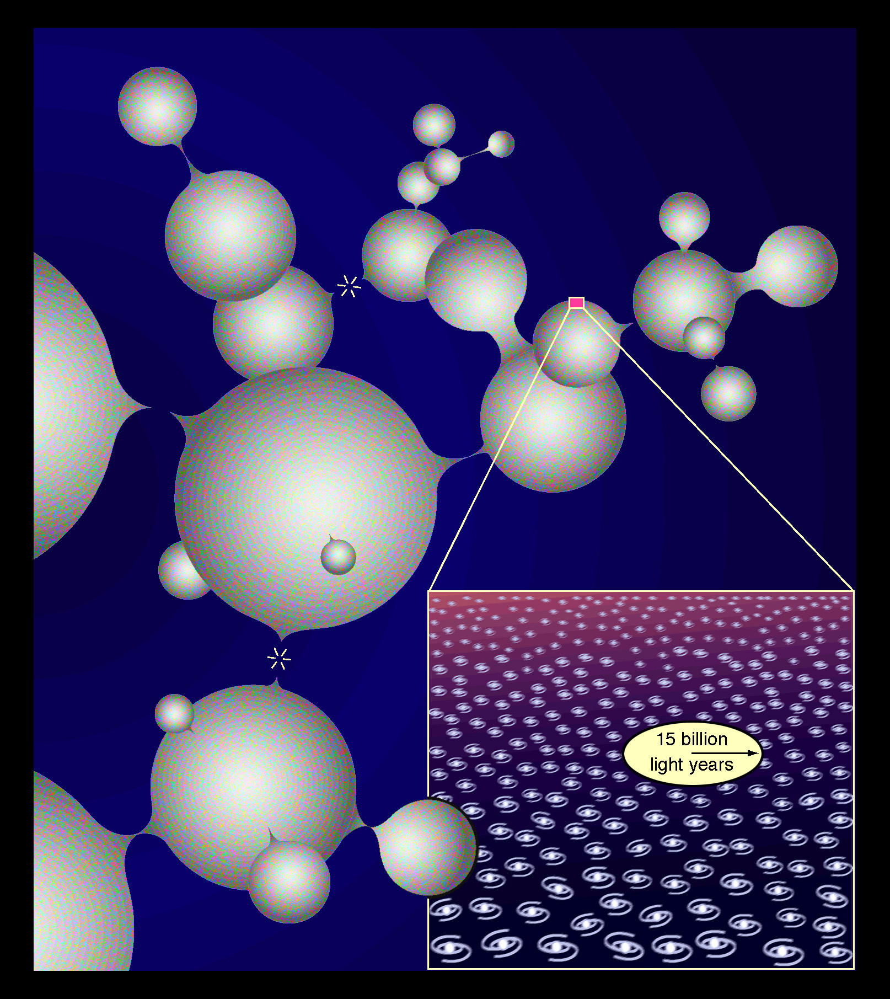
Notes:
Why is their reality status of these less than that of parts of the aftermath of ‘our’ big bang that are for ever unobservable.

Slide 5
THE BIG QUESTION The physical laws and basic numbers are constant within our horizon.
BUT COULD THEY BE DIFFERENT IN OTHER DOMAINS IF THESE ARE FAR MORE EXTENSIVE ??
Notes:
There are of course theories that suggest this
Parochial bylaws in our cosmic patch.

Slide 6
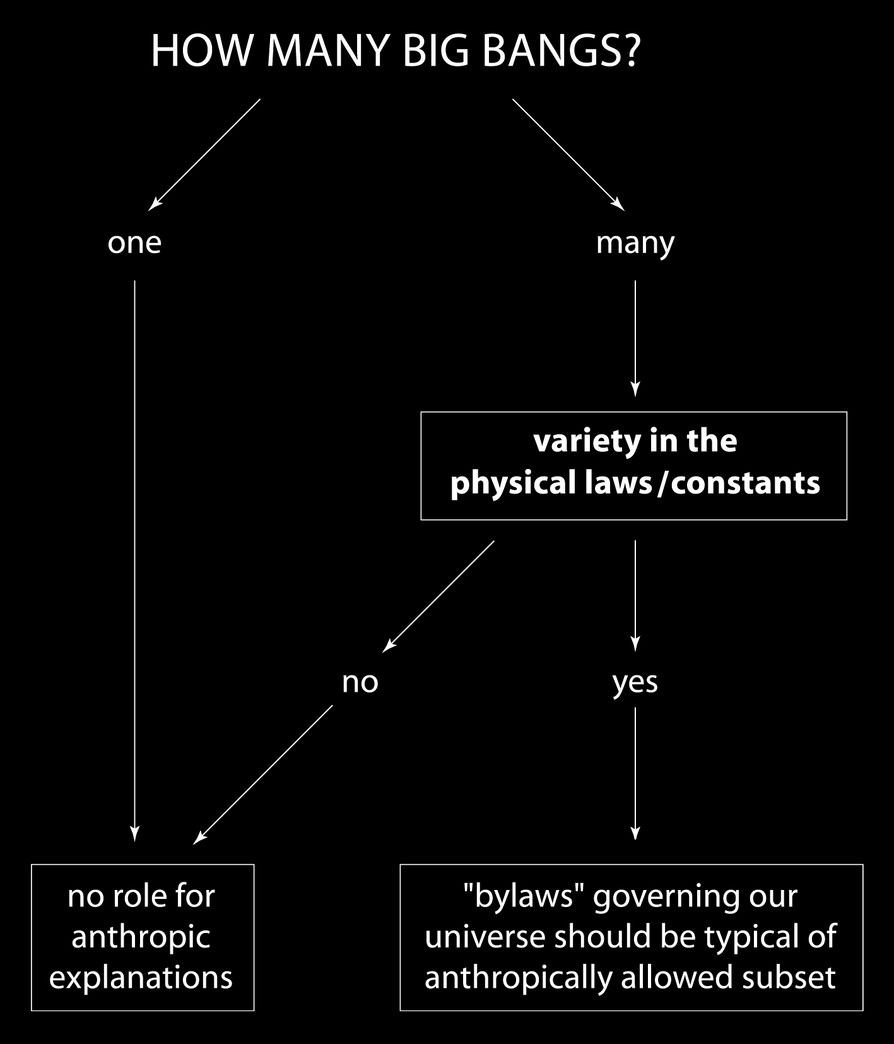
Notes:
This is a decision tree – which some people think is a research programme for 21st century
Controversial – many people focus only on left-hand side.

Slide 7
What range of laws and constants allow interesting complexity?
(A crucial part of the ‘anthropic programme’. But for those allergic to this it’s an exercise in ‘counterfactual history’ -- interesting irrespective of ‘philosophical’ preconceptions.)
(+ a good check on computer models)
Notes:
I will sketch what our universe would be like if some basic numbers had different value.
Changing one at a time – not very fine tuned.
Counterfactual – if Brits had lost Waterloo
What about G?

Slide 8
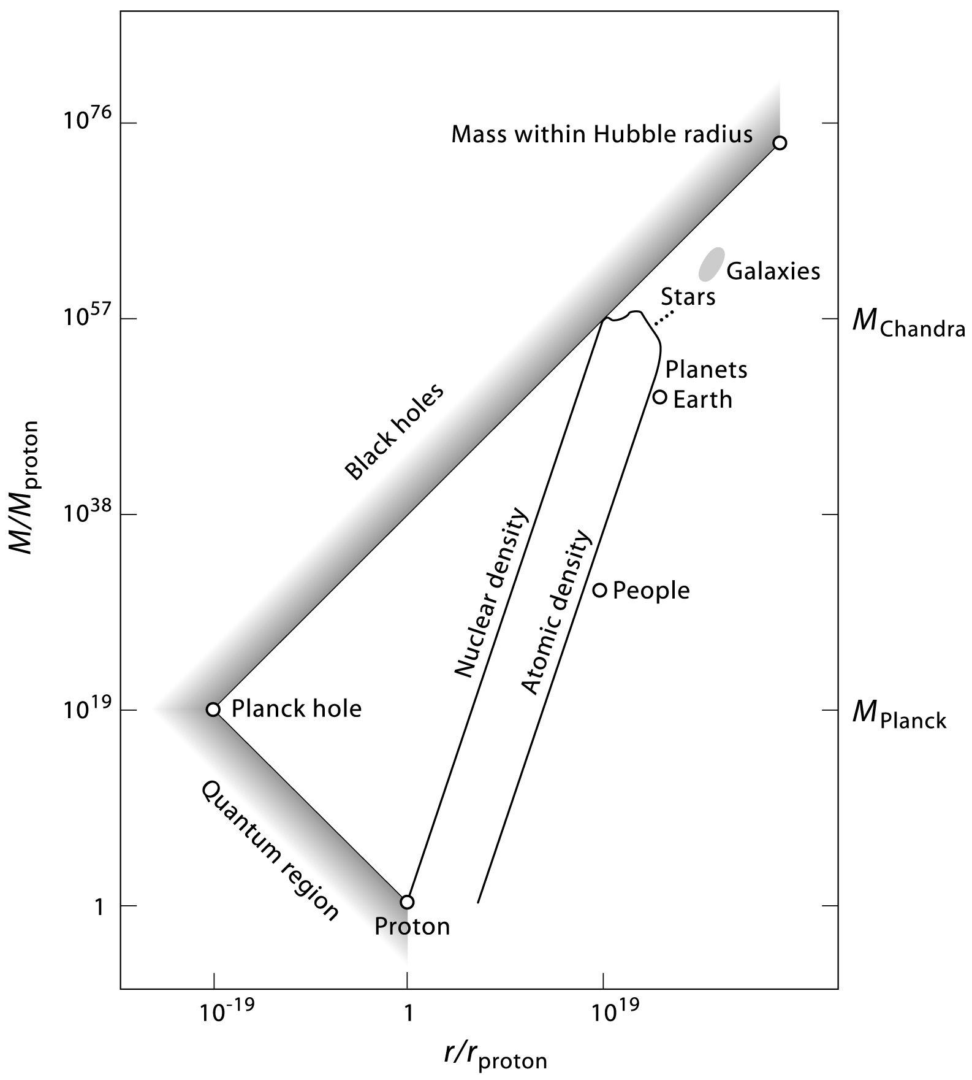
Notes:
Carr and Rees Pedagogical diagram.
BH size of proton weights 10^38 protons
Solid objects on line of slope 3.

Slide 9
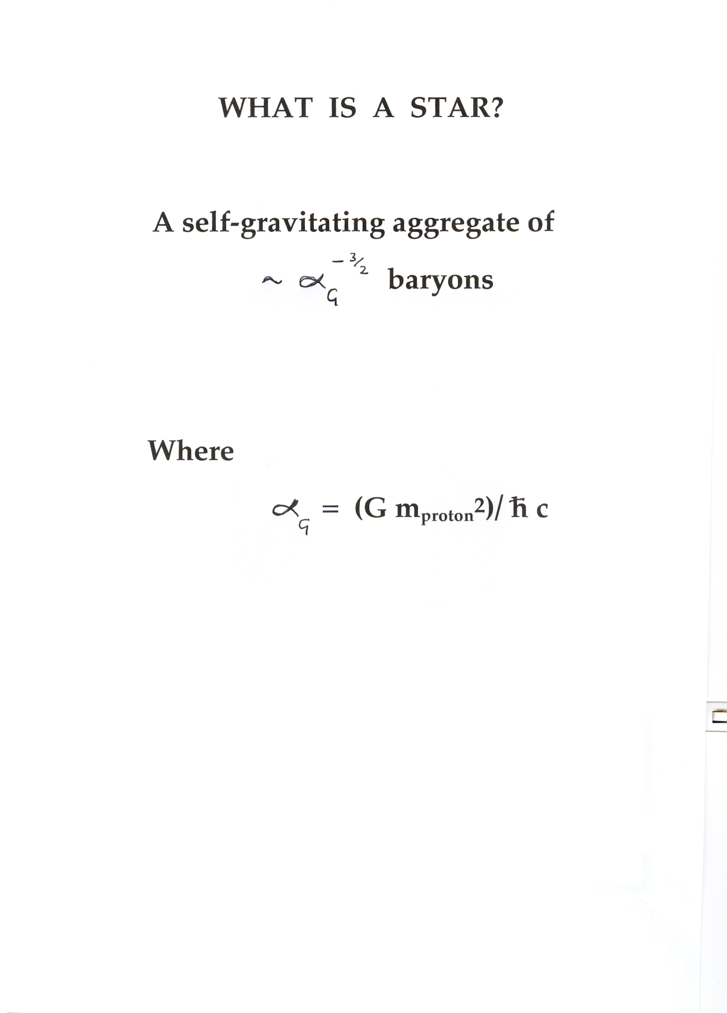
Notes:
Definition of a star for hard core theorist.

Slide 10
Different G?
What if (Gm^2 /hc) were different?

Slide 11
Notes:
Shape same
High G – small speeded up universe.
But what if G were 100 times weaker.?

Slide 12
Notes:
Magnified version of the interesting part of the previous M-R diagram.
Moves up.
Gross properties the same (Fred Adams in particular)

Slide 13
SO ‘STARS’ CAN EXIST FOR A WIDE RANGE OF G. BUT HOW DO COSMOLOGICAL MODELS DIFFER IF G IS DIFFERENT?
SCALING OF GALAXIES THE SAME AS FOR STARS

Slide 14
Prerequisites for complex cosmos
Gravity -- but the weaker the better (At least one very large number in physics)

Slide 15
Prerequisites for complex cosmos
Gravity -- but weaker the better (at least one very large number in physics)
Fluctuations (‘seeds’ for structure formation)

Slide 16
A fundamental(?) number
The characteristic amplitude (Q) of fluctuations in the early universe.

Slide 17
Notes:
10^ -5

Slide 18
FLUCTUATION AMPLITUDE
Bound Systems* with Gravitational
Binding Energy
(Virial Velocity )
Max Non-:Linear Scale
Q^{1/2} x (Hubble Radius).
*Formation of Bound System Requires Expansion
Factor of >~ Q⁻¹ After System Enters Horizon.
Notes:
Maxx Tegmark and I considered hypothetical universes with different Q

Slide 19
AN ANAEMIC UNIVERSE (Q = 10⁻⁶)
Small loosely-bound galaxies form later than in our universe; star formation is still possible, but processed material is likely to be expelled from shallow potential wells. There may be no second-generation stars containing heavy elements, and so no planetary systems at all.
If Q were significantly lower than 10⁻⁶, then gas would be unable to cool with a Hubble time.*
In a Λ-dominated universe, isolated clumps could survive for an infinite time without merging into a larger scale of hierarchy. So eventually, for any Q > 10⁻⁸, a ‘star’ could form – but by that time there would be merely one minihalo within the entire event horizon!

Slide 20
POSSIBLE UNIVERSE WITH Q = 10⁻⁴
*perhaps more interesting than ours!
Masses >~ 10¹⁴ M condense at 3.10⁸ yrs into huge disc galaxies with orbital velocity ~2000 km/sec (gas would cool efficiently via Compton cooling, leading probably to efficient star formation).
These would, after 10¹⁰ yrs, be in clusters of
>~ 10¹⁶ M.
There would be a larger range of non-linear scales than in our actual universe. Only possible ‘disfavouring’ feature is that stellar systems may be too packed together to permit unperturbed planetary orbits.

Slide 21
UNIVERSE WITH Q > 10⁻³
Monster overdensities (up to 10¹⁸ M) condense out early enough that they trap the CMB radiation, and collapse as radiation-pressure-dominated hypermassive objects unable to fragment*. This leads to universe of vast holes, clustered on scales up to several percent of Hubble radius (and probably pervaded by intense ‘hard’ radiation).
It isn’t obvious that much baryonic material would ever go into stars. (If so they would be in very compact highly bound systems.)
*This does not require pre-combination collapse. Collapse at (say) 10⁷ years would lead to sufficient partial reionization (via strong shocks) to recouple the baryons and CMB.
Notes:
Range of 100 -- 1000

Slide 22
Constraints on lambda
Positive: mustn’t dominate until ‘galaxies’ have formed (limit is ~10 times actual value)
Negative: mustn’t cause recollapse too soon.

Slide 23
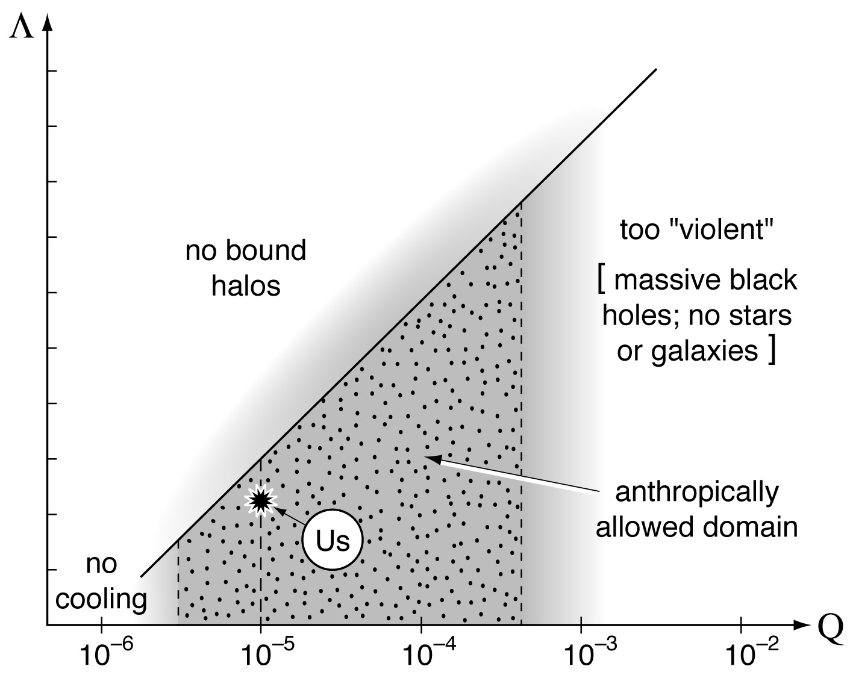
Figure 2. This shows in a two-dimensional parameter space Λ and Q. The upper and lower limits to Q are discussed by Tegmark and Rees (1998). The upper limit to Λ stems from the requirement that galactic-mass bound systems should form before the universe enters its accelerating de Sitter phase. Our universe (obviously) lies in the anthropically-allowed domain. But we cannot say whether it is at a typical location within that domain without a specific model for the probability distributions of Q and Λ in the ensemble.
Notes:
Livio and Rees
Hugher Q allows higher lambda

Slide 24
Prerequisites for complex cosmos
Gravity -- but weaker the better (at least one very large number in physics)
Initial fluctuations (characteristic amplitude Q)
Baryons (and dark matter)

Slide 25
Notes:
What if the ‘pie’ is differently split.
More dark matter compared to baryons. Leave everything the same and jackup dark matter so its 50 or 500 times baryon density

Slide 26
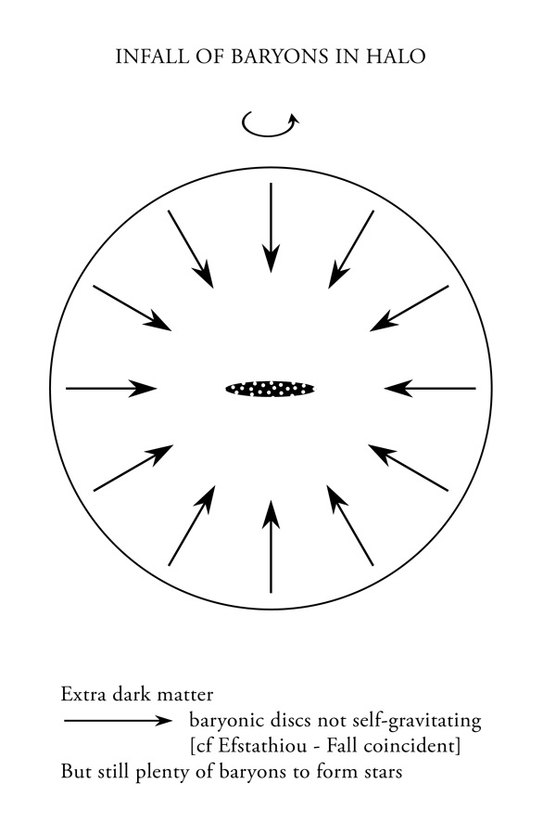
Notes:
Gas with typical ang mom forms a marginally self gravitation disc
Still enugh to form stars

Slide 27
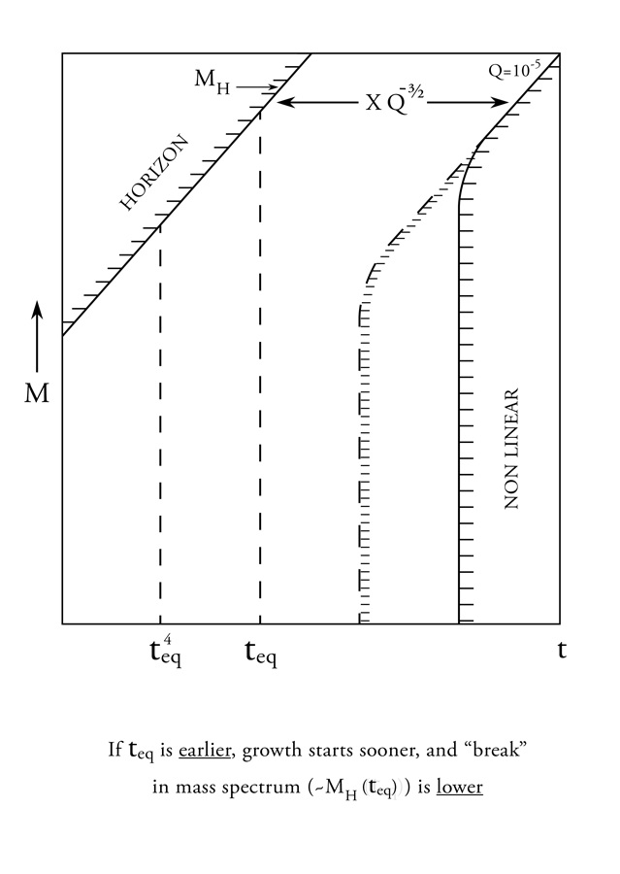
Notes:
Growth is enhanced
In CDM growth starts at t (eq)
Stars earlier. Turnover in CDM spectrum moves to lower mass

Slide 28
For higher DM density (leaving baryon/photon ratio unchanged), growth starts earlier, so bound systems form even for lower values of Q than in actual universe. (But baryon fraction in halos is lower)

Slide 29
For higher lambda, anthropic range requires higher Q For higher DM density, anthropic range allows lower Q

Slide 30
Prerequisites for complex cosmos
Gravity -- but weaker the better (at least one very large number in physics)
Fluctuations (‘seeds’ for structure formation)
Baryons and dark matter
Chemistry and nuclear fusion – a ‘periodic table’

Slide 31
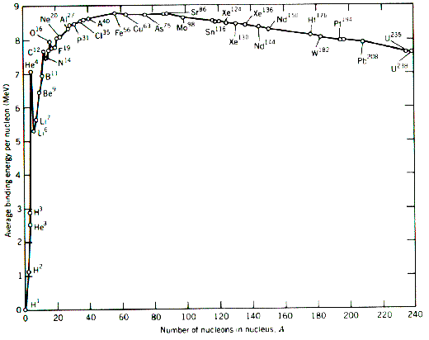
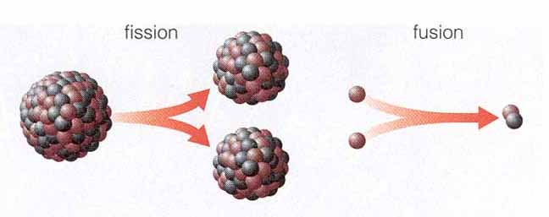
Semi-empirical mass formula (von Weizsäcker 1935, …):
How do these numbers depend on (α,Λ_{QCD},m_{u},m_{d})?
Homeork:

Slide 32
A ‘Nuclear-free Universe’ (counterfactual!)
Stars undergo K-H contraction until they become white dwarfs (up to 5.6 solar masses for pure H) or black holes (higher masses)
Jupiter-like planets could exist.
Total radiative output perhaps not much less than in actual universe.
BUT No chemistry, no rocky planets, no life*
(This ‘universe’ bears a similar relation to the real one that a marble statue does to a real person!)
* maybe Hoyle’s ‘Black Cloud’!
Notes:
Bears relaion to our universe that a marble stature does to a real human

Slide 33
What if two or more parameters take non standard values?
This allows wider range for each parameter (cf extra 30 powers of 10 for lambda) [ see for instance Adams, Alexander, Grohs, and Mersini-Houghton (2017) and earlier papers by Adams and collaborators]

Slide 34
IS THE EXISTENCE OF A MULTIVERSE (eg ETERNAL INFLATION) A SCIENTIFIC QUESTION?

Slide 35
IS THE EXISTENCE OF A MULTIVERSE (eg ETERNAL INFLATION) A SCIENTIFIC QUESTION?
YES
But it will remain speculation unless/until we have a theory that describes an inflationary phase, and has gained credibility by accounting for phenomena in the range of observations and experiment.
Notes:
As an analogy – we take seriously GR inside BH (intrinsically unobservable) because it’s tested outside
We could achieve this level of confidence in whether (for instance) eternal inflation occurs.

Slide 36
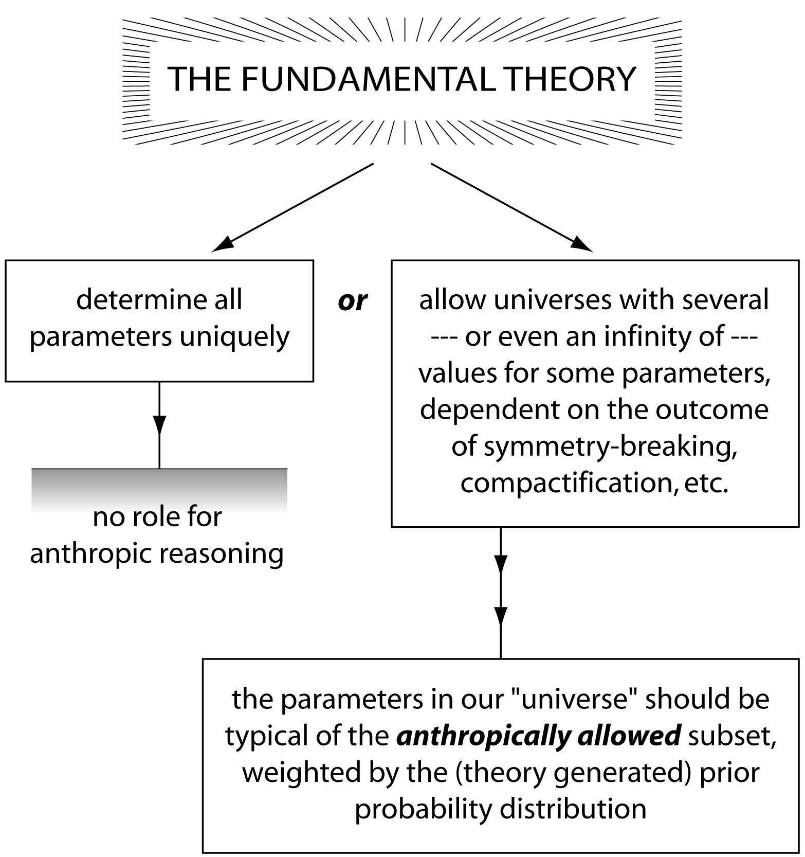
Notes:
Here’s another version of decision tree
Are we on the left (when what I’ve discussed is just ‘counterfactual’)
Or are we on the right
-- in which case I’ve suggested that tuning needed for emergent complexity isn’t as fine as sometimes claimed
We don’t know – maybe we’ll never know, but it’s a scientific question, Reality is larger than what’s observable.
At a conference at Stanford…
Alll dead – but 4th Cpernican evolution.
It’s fascianting and may be true.

Slide 37
