Slide 1
Primordial Nucleosynthesis
Alain Coc
(Centre de Spectrométrie Nucléaire et de Spectrométrie de Masse, Orsay)
Standard Big-Bang Nucleosynthesis of ⁴He, D, ³He, ⁷Li compared with observations
The SBBN “lithium problems”: nuclear aspects
(⁶Li, ⁹Be , ^{10,11}B) and CNO in extended SBBN network
Neutron injection and the lithium problem

Slide 2
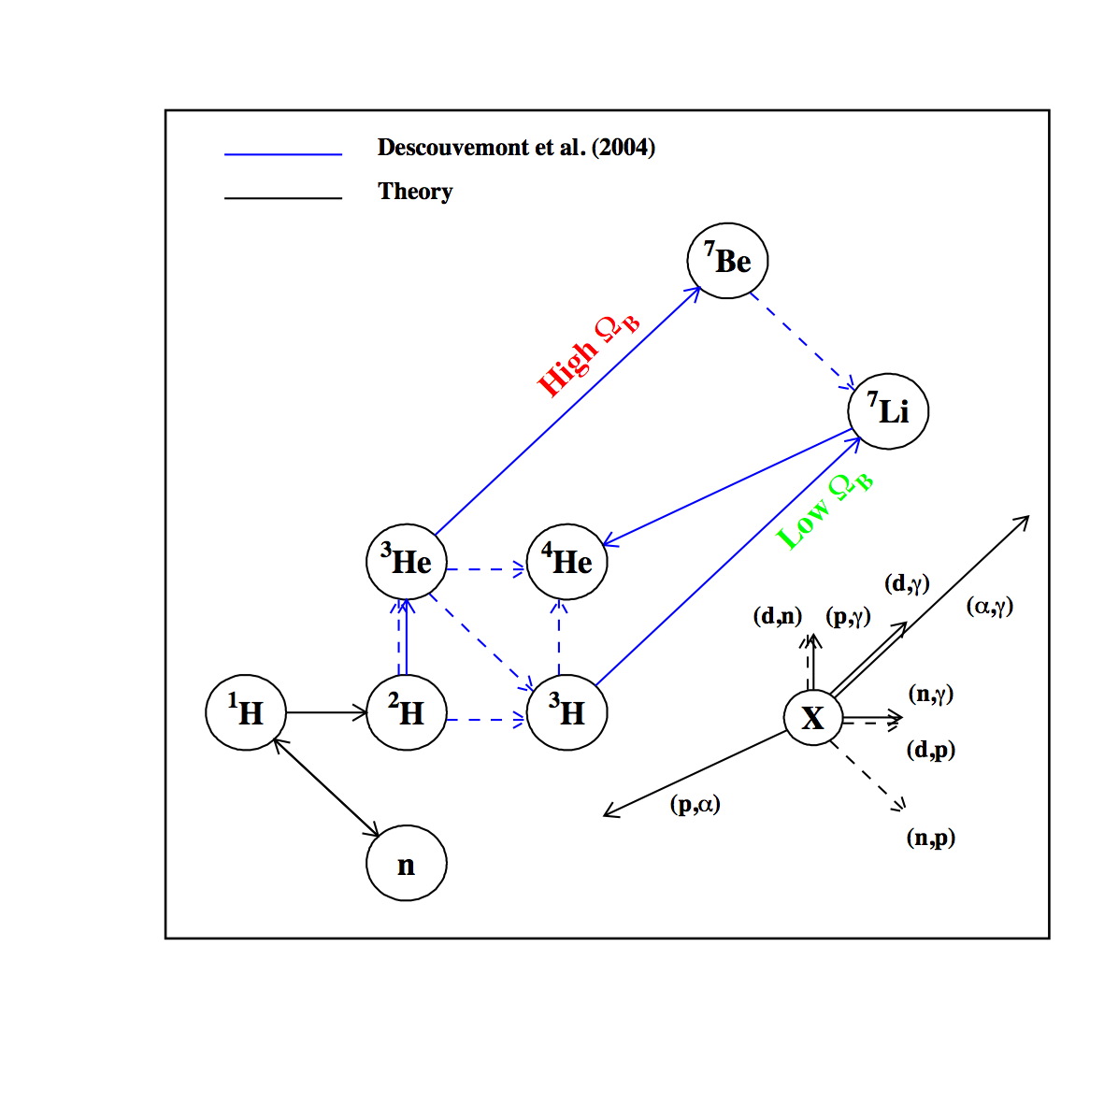
The 12 reactions of standard BBN
10 thermonuclear reaction rates deduced from experimental data
First 2 from theory: weak n↔p rate and p(n,γ)d
Standard BBN
No convection
No diffusion
No mixing
Known physics
<12 reactions
Simple nucleosynthesis (?)
T<1GK
⇒
T>10GK
Additional 400 reactions up to CNO
Notes:
Bbnetw_new.kumac

Slide 3
n↔p weak reaction rates
λ_{n↔p}∝ τ_{n}⁻¹ ×
∫ (phase space)×(e distribution)×(ν_{e} distribution) dE
+ small corrections
The neutron lifetime is still a matter of debate (but not essential to BBN)
τ_{n} = 885.7±0.8 s [PDG 2008] or τ_{n}=878.5±0.7 ±0.3 s [Serebrov et al. 2005] 881.5 ± 1.5 s [PDG 2011] ; 880–884 s [Wietfeldt & Greene 2011]
Weak rate change mostly affects n/p ratio at freeze out and hence ⁴He abundance
Change in expansion rate gives similar effect (n/p freezeout when weak rate ≈ expansion rate)
Notes:
Verifie 31/05/2011

Slide 4
Sensitivity to thermonuclear reaction rates
At WMAP baryonic density
¹⁰ [Coc & Vangioni 2010]
 | ∂ ln(Y) /∂ ln(N_{A}<σv>) |  |  |  | E₀(ΔE₀/2) (MeV @ 1GK)
Reaction | ⁴He | D | ³He | ⁷Li
τ_{n} (n↔p) | 0.73 | 0.42 | 0.15 | 0.40
¹H(n,γ)²H | 0 | -0.20 | 0.08 | 1.33 | 0.025
²H(p,γ)³He | 0 | -0.32 | 0.37 | 0.57 | 0.11(0.11)
²H(d,n)³He | 0 | -0.54 | 0.21 | 0.69 | 0.12(0.12)
²H(d,p)³H | 0 | -0.46 | -0.26 | 0.05 | 0.12(0.12)
³H(d,n)⁴He | 0 | 0 | -0.01 | -0.02 | 0.13(0.12)
³H(α,γ)⁷Li | 0 | 0 | 0 | 0.03 | 0.23(0.17)
³He(n,p)³H | 0 | 0.02 | -0.17 | -0.27
³He(d,p)⁴He | 0 | 0.01 | -0.75 | -0.75 | 0.21(0.15)
³He(α,γ)⁷Be | 0 | 0 | 0 | 0.97 | 0.37(0.21)
⁷Li(p,α)⁴He | 0 | 0 | 0 | -0.05 | 0.24(0.17)
⁷Be(n,p)⁷Li | 0 | 0 | 0 | -0.71

Slide 5
10 rates deduced from experimental data
Compilations and evaluations for/including BBN thermonuclear rates
Smith, Kawano & Malaney 1999 (with uncertainties)
NACRE, Angulo et al. 1999 (7/10, tabulated rates and uncertainties)
Nollett & Burles 2000 (no rates provided)
Cyburt, Fields & Olive 2003 (revaluation of NACRE)
Serpico et al. 2004 (rates and uncertainties provided)
Descouvemont, Adahchour, Angulo, Coc & Vangioni-Flam 2004 [DAACV]
« R-Matrix » formalism: S-factors fits of data constrained by theory
Provide also reaction rate uncertainties
Cyburt 2004 (rates provided, uncertainties calculated but not provided)
Update with post 2004 experimental data yet to be done…
Notes:
Gamow hag at 1GK: 163-574 keV

Slide 6
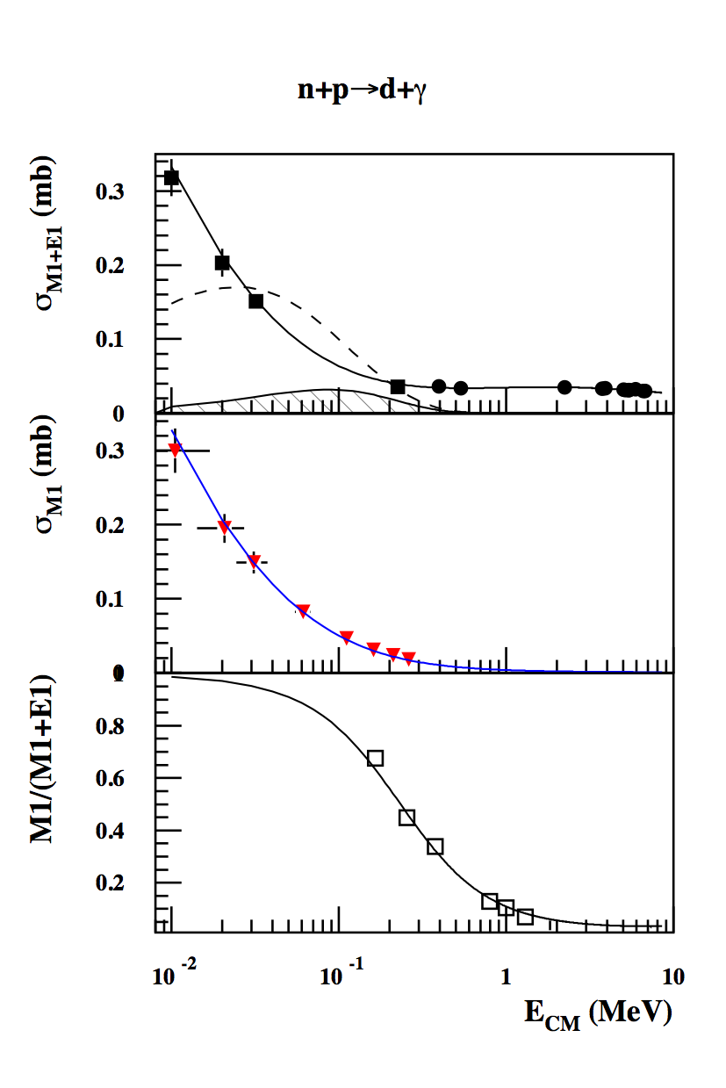
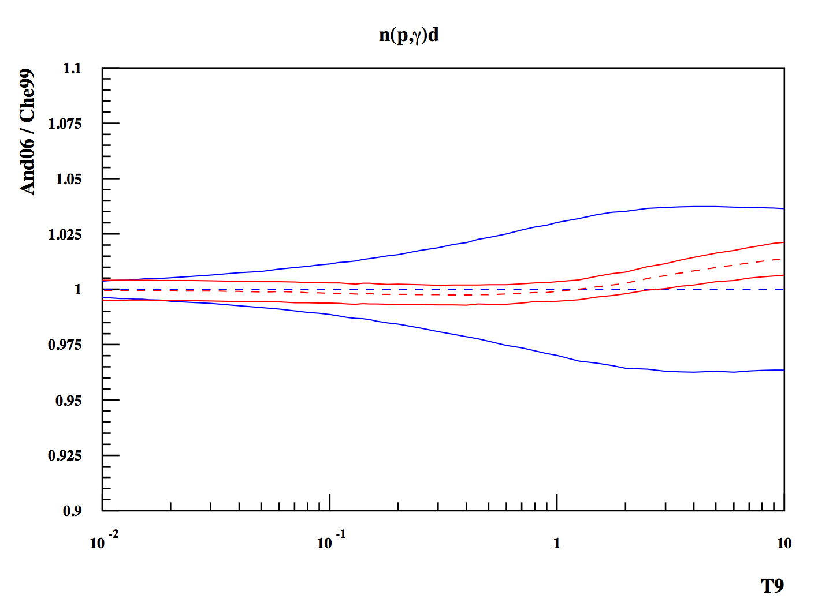
The ¹H(n,γ)²H reaction
Sensitivity = 1.33
E ~ 25 keV
New measurement of the M1 contribution [Ryezaveva et al. 2006] by inelastic electron scattering off D
New precise n(p,γ)d EFT cross section and rate calculation [Ando et al. 2006]
Variation of constants (K. Olive talk)
Notes:
* From Ryezayeva et al. PRL 100, 172501 (2008)
Npgexp_new in paw/BBN/nucl/npdg

Slide 7
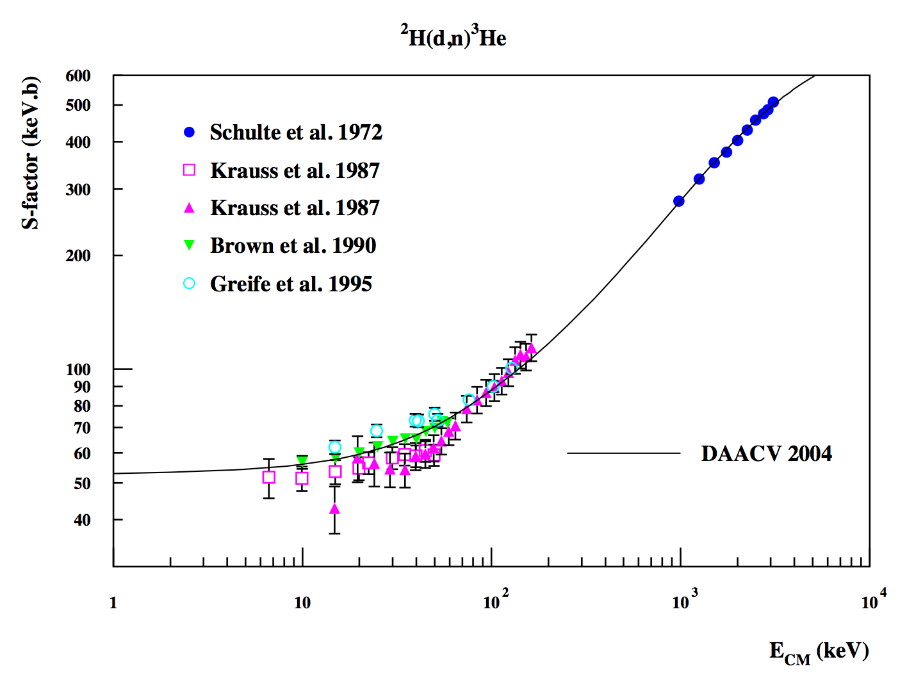
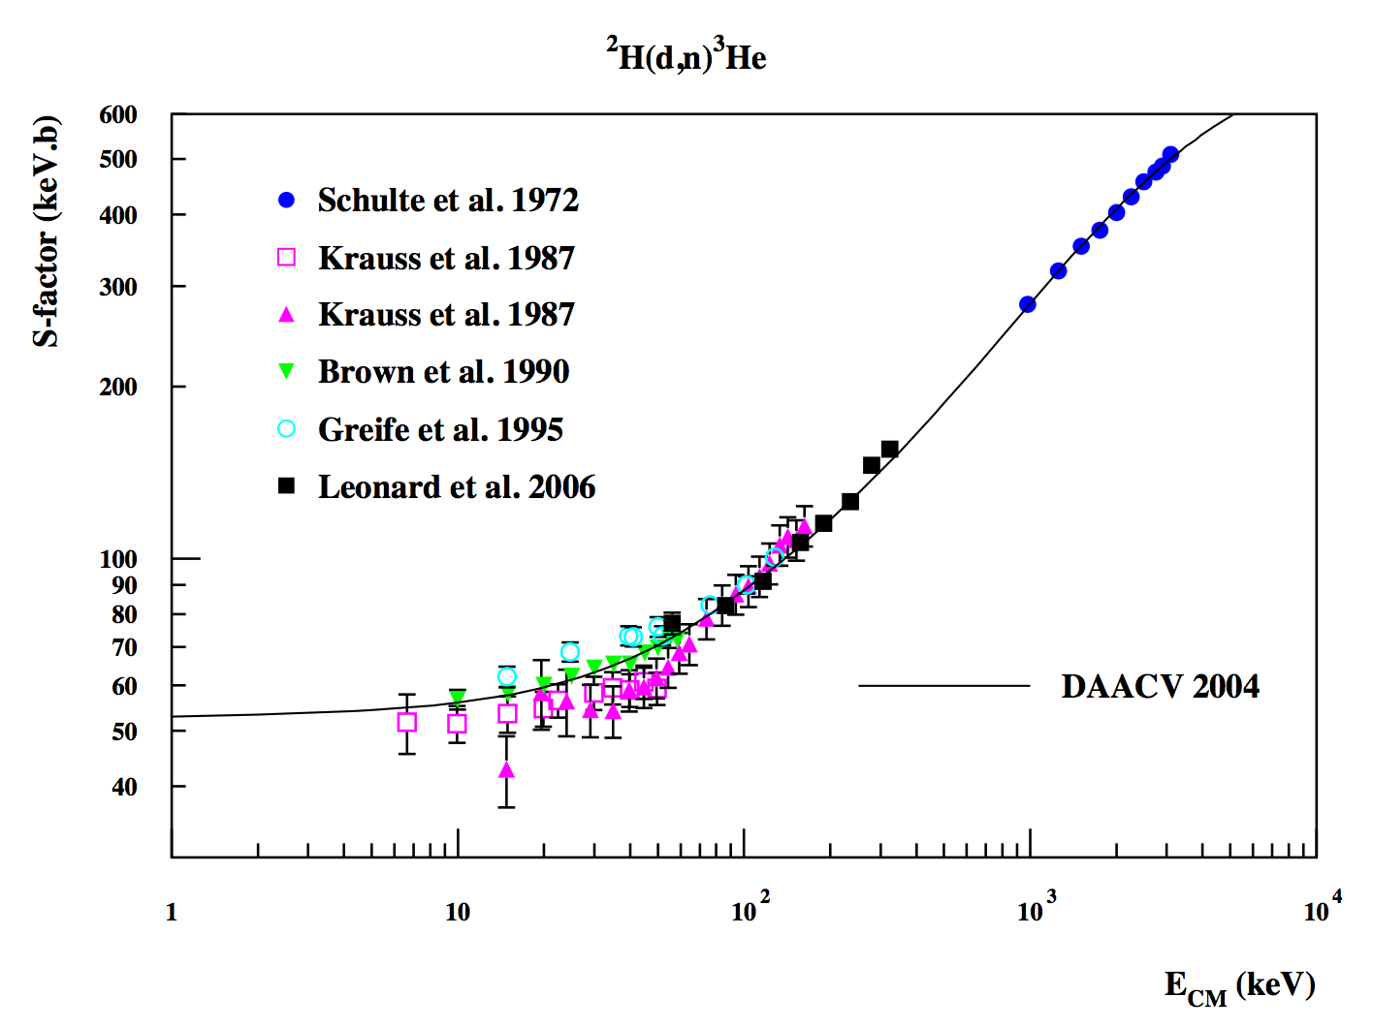
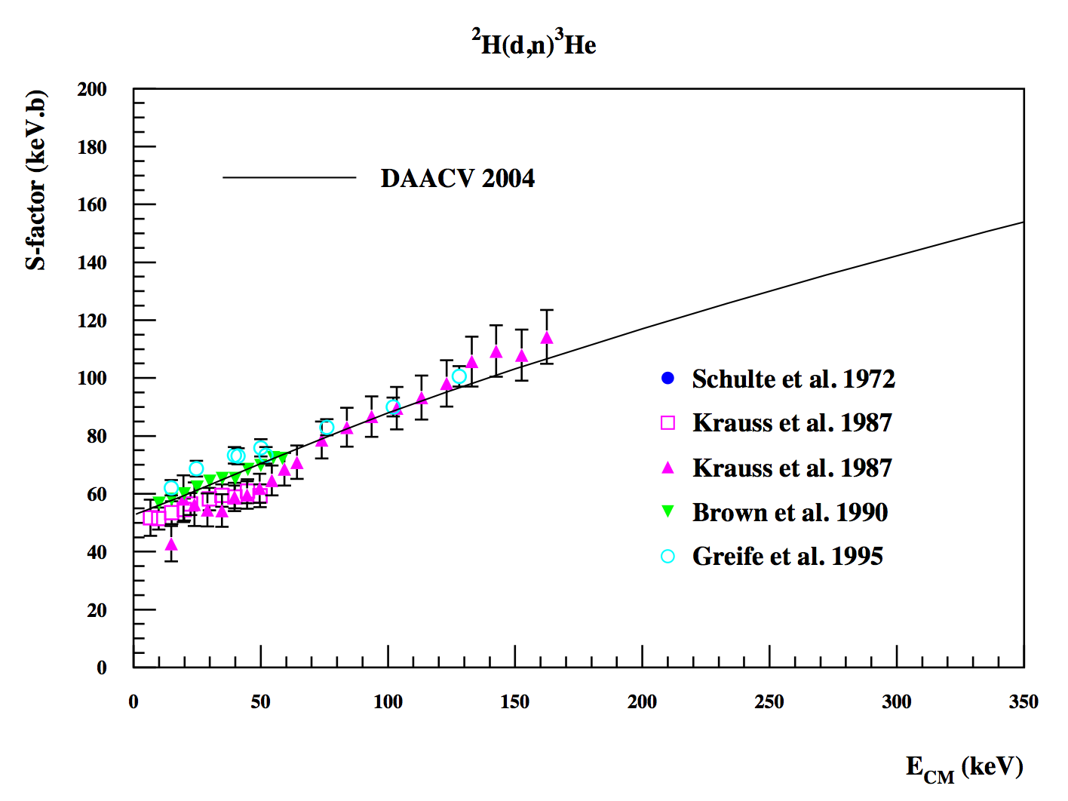
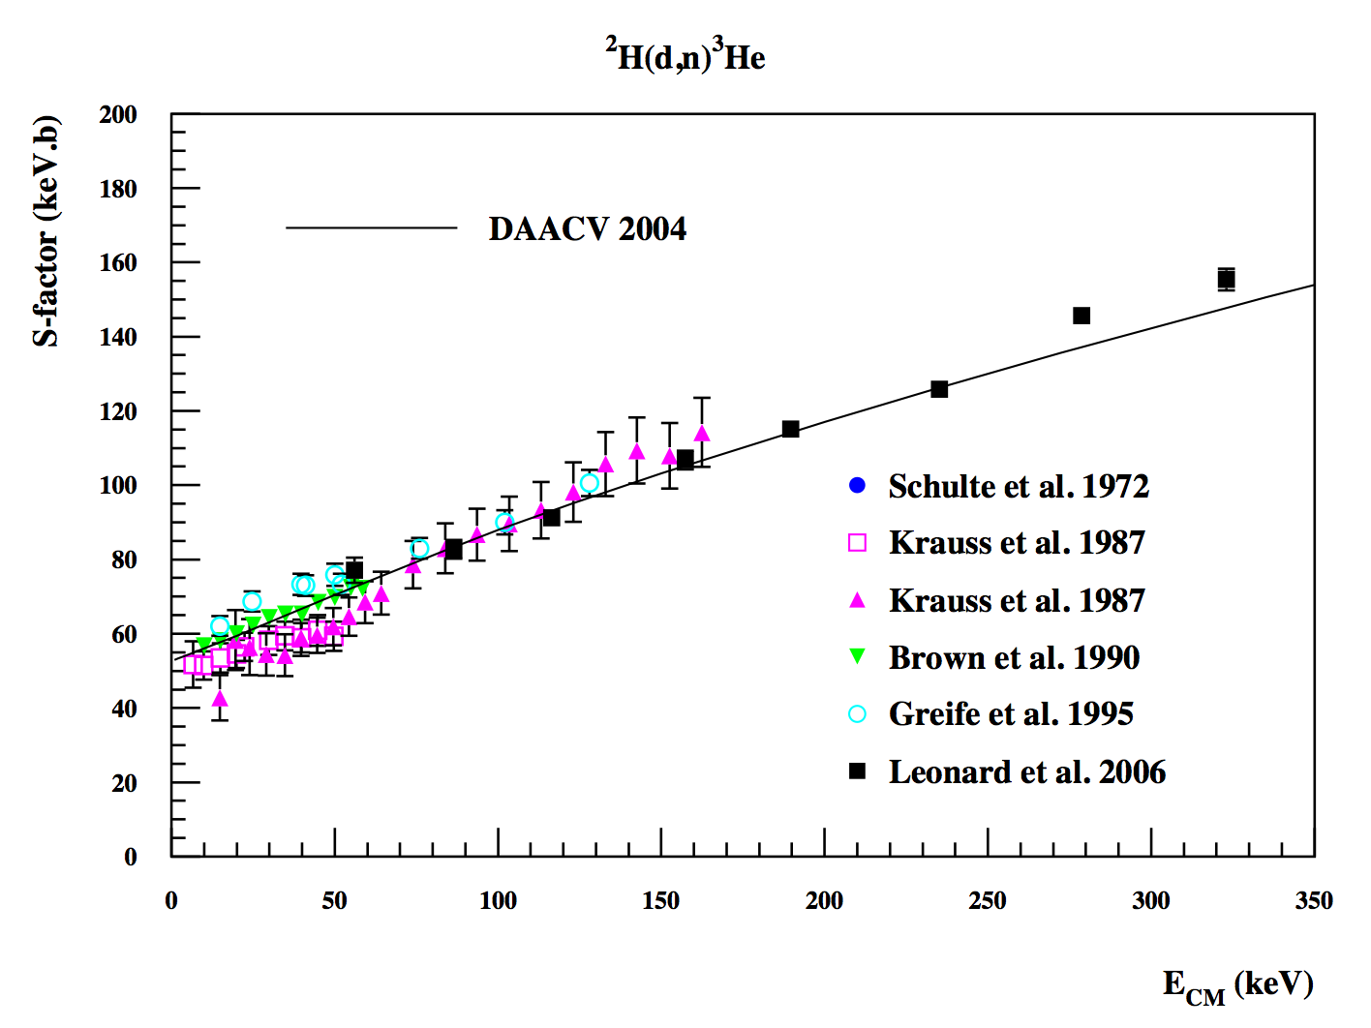
The ²H(d,n)³He reaction
Sensitivity = 0.61
E₀(ΔE₀/2) = 0.12(0.12) MeV
New precise measurements of ²H(d,n)³He (and ²H(d,p)³H) reaction at TUNL [Leonard et al. 2006]
Excellent agreement with DAACV 2004 fit within Gamow window
No change in central Li/H value
Reduced uncertainty
R-matrix fit reliability
Notes:
Ddn_sfac

Slide 8
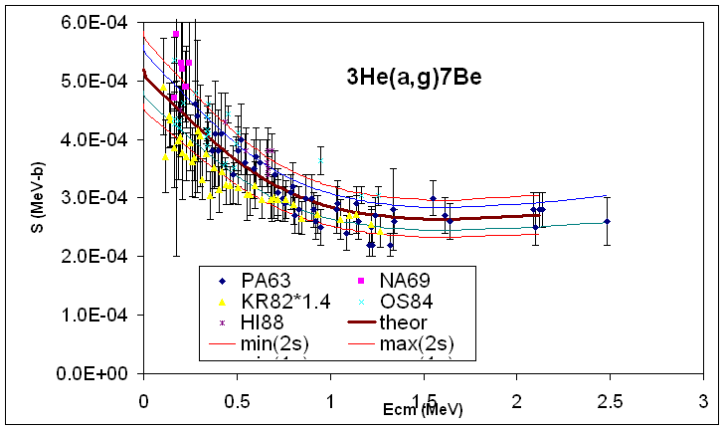
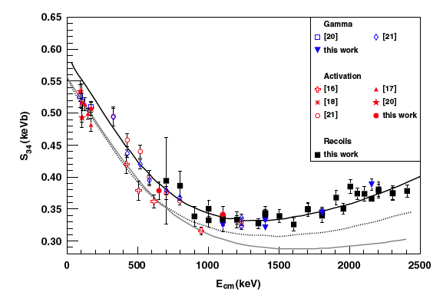
The ³He(α,γ)⁷Be reaction
Sensitivity = 0.97
E₀(ΔE₀/2) = 0.37(0.21) MeV
[DAACV]
Systematic uncertainties : prompt versus activation measurements
New precise measurements :
Prompt [Brown et al. 2007, Confortola et al. 2007, Costantini et al. 2008]
Activation [Nara Singh et al. 2005, Brown et al. 2007, Confortola et al. 2007, Gyürky et al. 2007]
Recoil [Di Leva et al. 2009]
Reanalysis of ³He(α,γ)⁷Be rate [Cyburt & Davids 2008]: S(0) = 0.580±0.043 keV.b (13% higher than in DAACV04) S(0) = 0.56±0.02±0.02 keV.b [Adelberger et al. 2010]

Slide 9
Determination of primordial abundances
Primordial abundances :
Observe a set of primitive objects born when the Universe was young
Extrapolate to zero metallicity : Fe/H, O/H, Si/H,…. → 0
⁷Li at the surface of low metallicity stars in the halo of our Galaxy: Li/H = (1.58±0.35)×10⁻¹⁰ [Sbordone et al. 2010]
⁴He in H II (ionized H) regions of blue compact galaxies: 0.245 < Y_{p} < 0.267 [Aver, Olive & Skillman 2010] (0.245 < Y_{p} < 0.262 [Skillman, this workshop])
D in remote cosmological clouds (i.e. at high redshift) on the line of sight of quasars: (2.84±0.26)× 10⁻⁵ (1-σ) [Fields & Sarkar 2008]
³He in H II regions of our Galaxy: ³He/H ≤ (1.1±0.2)×10⁻⁵ [Bania et al. 2002]

Slide 10
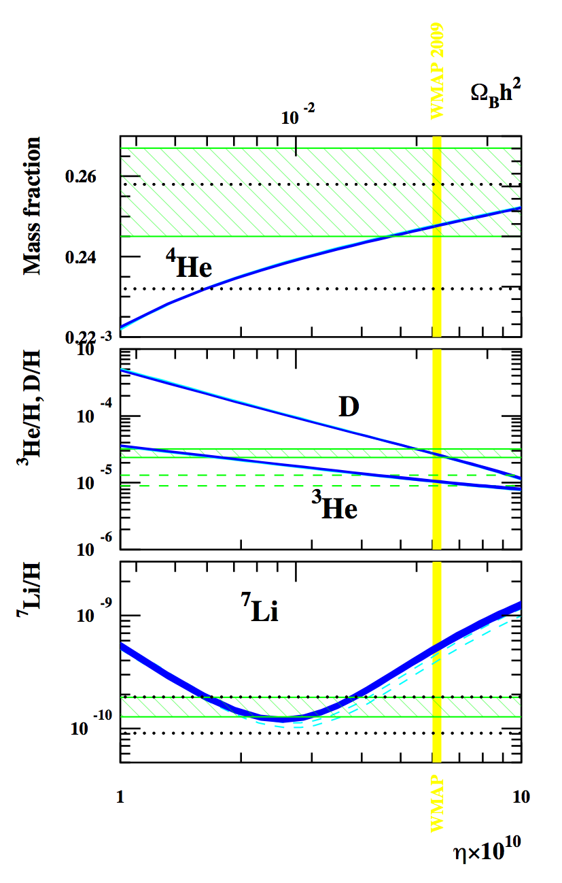
The Li problem update
New nuclear data
New abundance determinations
Agreement for ⁴He, D and ³He
⁷Li difference of a factor of > 3 !
 | BBN calculations
 | Cyburt et al. 2008 | Coc & Vangioni 2010
⁴He | 0.2486±0.0002 | 0.2476±0.0004
D/H | 2.49±0.17 | 2.68±0.15
³He/H | 1.00±0.07 | 1.05±0.04
⁷Li/H | 5.24^{+0.71}_{-0.62} | 5.14±0.50

Slide 11
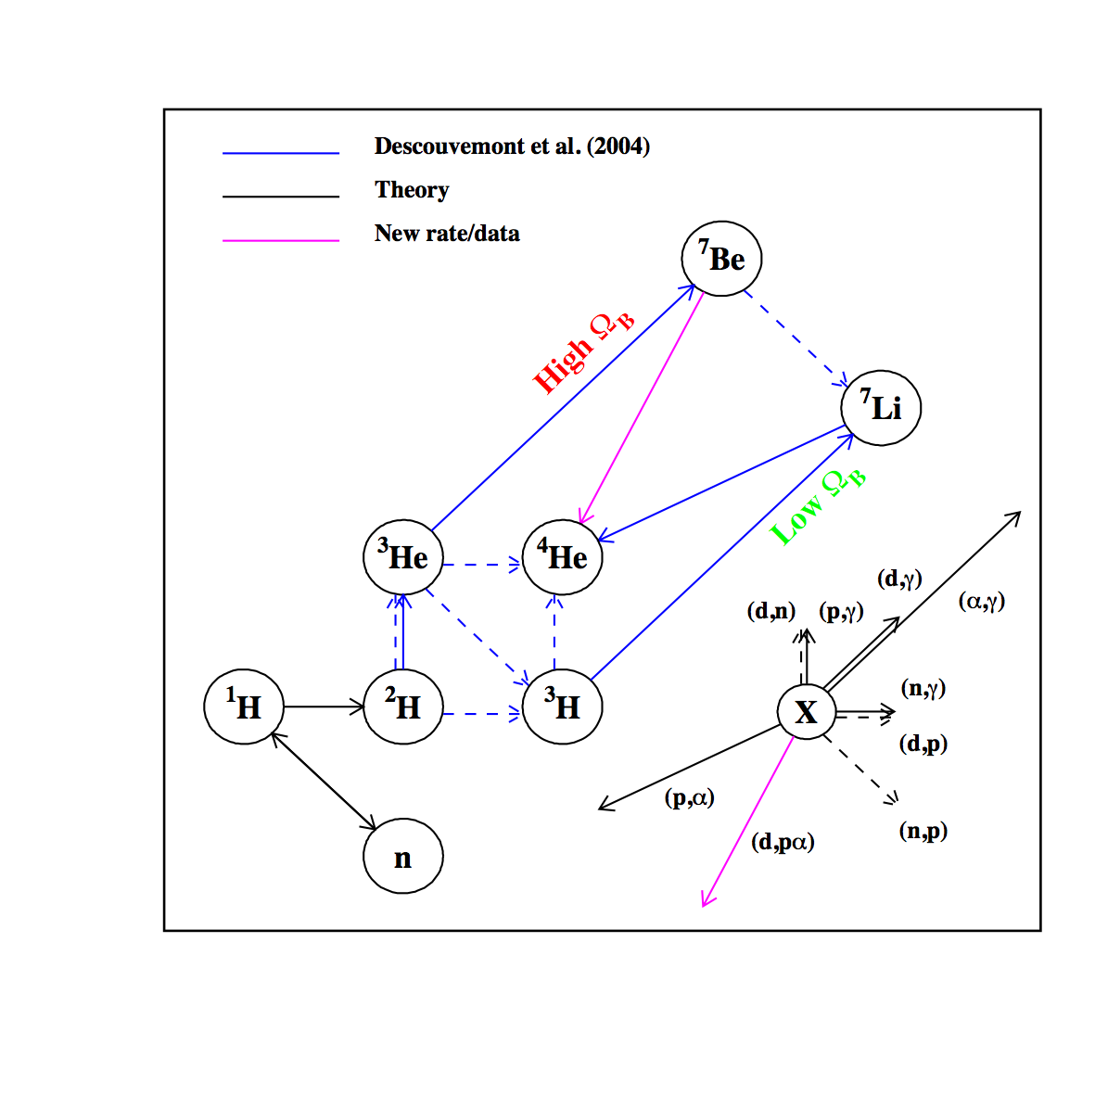
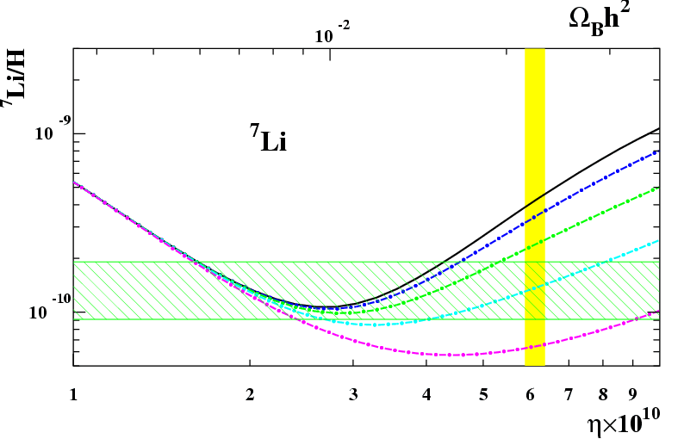
New ⁷Be (i.e. ⁷Li) destruction channels
←×30
←×100
←×300
←×1000
The ⁷Be(d,p)⁸Be*→2α reaction [Coc et al. 2004]
Experiment at Louvain LN [Angulo et al. 2005] : no (integrated) cross-section enhancement
Hypothetical resonance at E_{R} = 200±100 keV with Γ≤40 keV [Cyburt & Pospelov 2009]; corresponding to ≈16.7 MeV ⁹B level ?
No resonance observed at Oak Ridge in D(⁷Be,d)⁷Be scattering [O’Malley et al. 2011]
Measured E_{x}=16.8 MeV and Γ=81 keV [Scholl et al. 2011] ⇒primordial effect on ⁷Li < 4% [Kirsebom & Davids 2011]

Slide 12
Other resonances ?
[Chakraborty, Fields & Olive (2011)]
Unknown Resonances in ⁷Be + n, p, d, t, ³He and α ?
⁸Be, ^{9,10,11}B, ^{10,11}C compound nuclei
Unknown level properties in ^{9,11}B and unknown levels in ¹⁰C
16.50 (2+)
15.04 (2⁻, 1⁻) ?
15.00
⁷Be+³He
14.99 (2⁻, 1⁻) ?
10.00
⁷Be+³He→¹⁰C→2p+2α
¹⁰C level structure investigated trough other reactions e.g.
⁹Be+³He→¹⁰C+d
9.000
Γ_{p}?
6.580 (2⁺)
5.220
5.10
3.353 2⁺
⁶Be+α
⁹B+p
¹⁰C
Notes:
Physical Review D, vol. 83 (2011) 063006

Slide 13
Ongoing
Proposed Tandem Experiment
Indirect study of ¹⁰C, ⁹B & ¹⁰B states via (³He,t), (³He,d) reactions
on ¹⁰B and ⁹Be targets
ORSAY SPLIT-POLE spectrometer
. Bρ(pos)
. ΔE particle
. E identification
t or d
Position
gas chamber
DSSDs
ΔE proportional
counter
³He @
35MeV
¹⁰B,⁹Be targets 100 μg/cm²
Plastic scintillator (E)
© F. Hammache

Slide 14
First results from Tandem experiment
New ¹⁰C level:
E_{x}=
Γ_{Tot} =
Spin-parity ?
Partial widths ?
Experiment in progress
Provisional !
[F. Hammache, priv. comm.]
But unlikely to contribute (Coulomb barrier) [Broggini et al. ArXiv:1202.5232 and Poster 5]

Slide 15
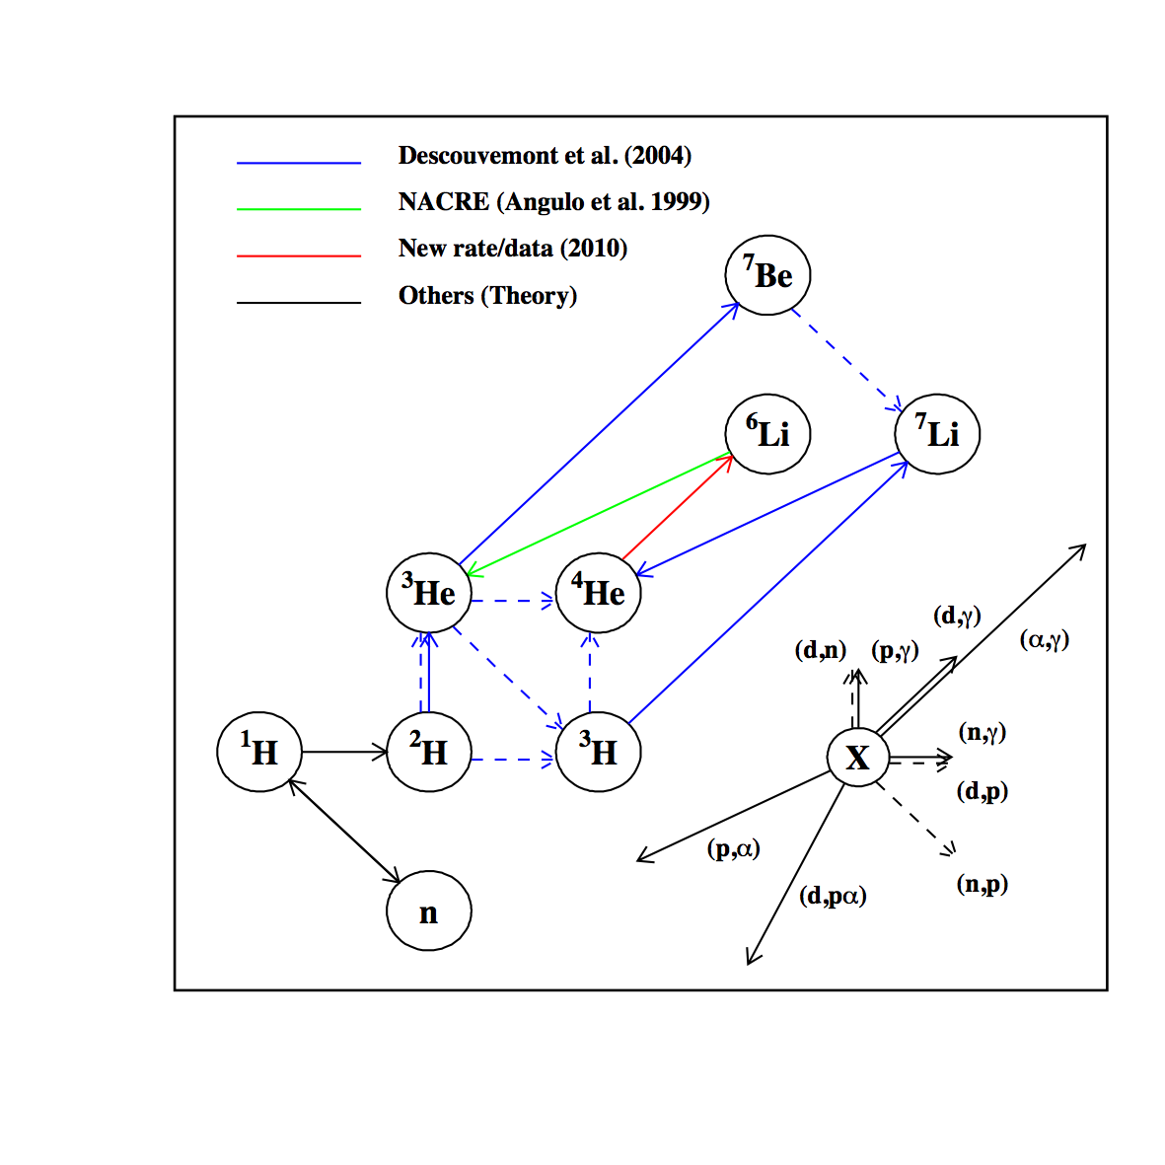
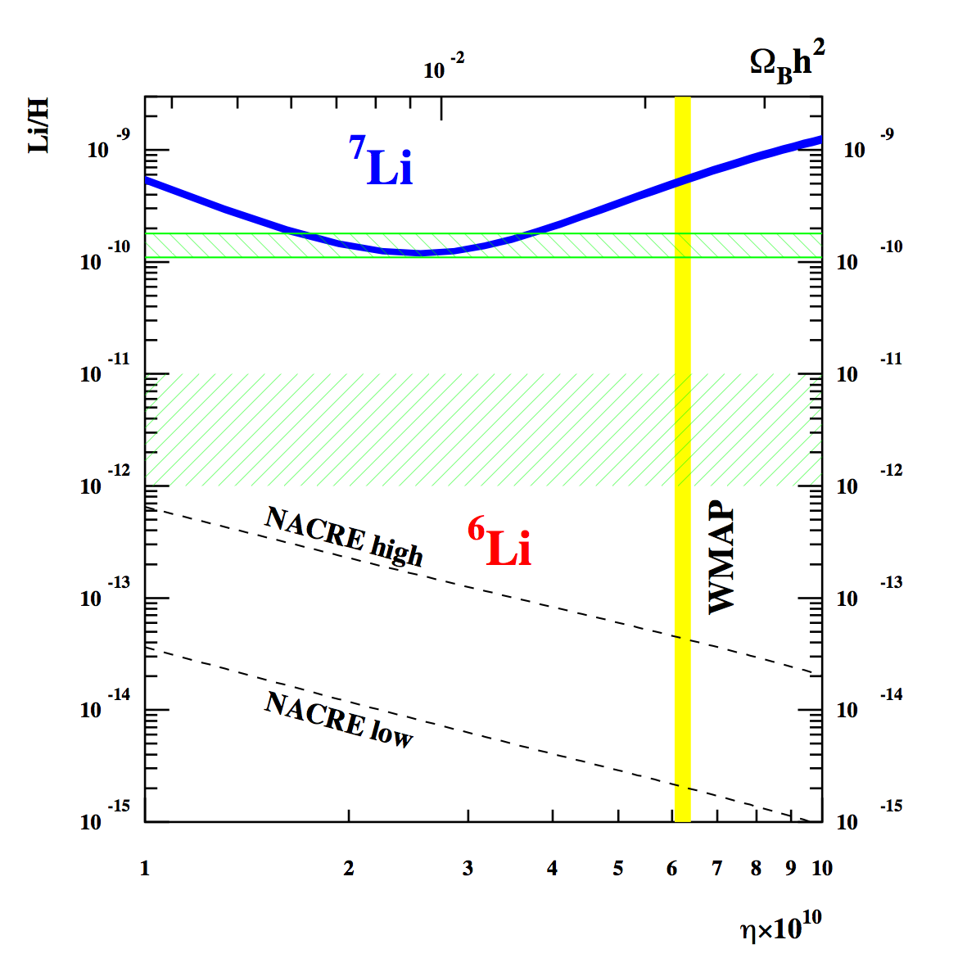
⁶Li nucleosynthesis
⁴He(t,n)⁶Li, ⁷Li(p,d)⁶Li : Q ≈ -5MeV
³He(t,γ)⁶Li : too slow [Fukugita & Kajino,1990]
Conservative range of ⁶Li/H observations [Nissen et al. 1999; Cayrel, et al. 1999; Aoki et al. 2004; Asplund et al. 2006]
Uncertainty from ²H(α,γ)⁶Li [NACRE 1999]
Notes:
Bbnetw_new
xtime06

Slide 16
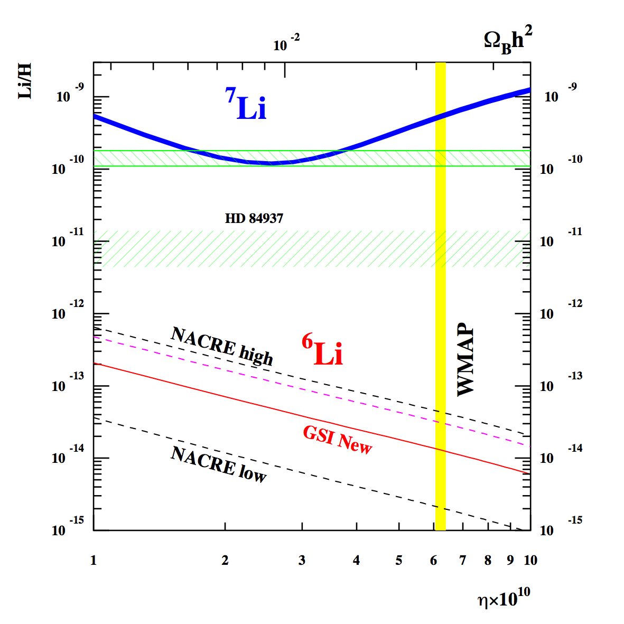
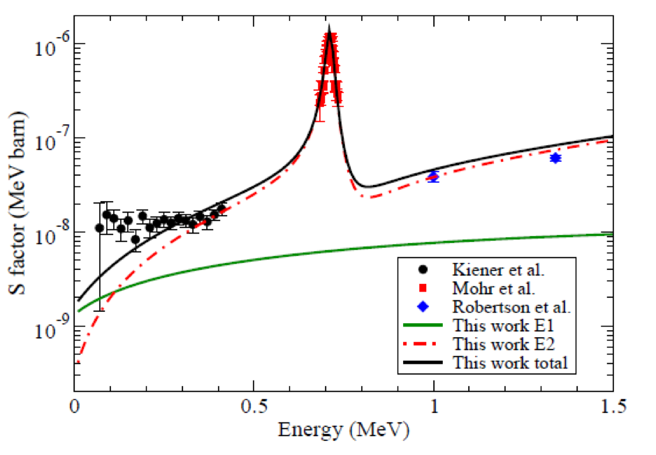
⁶Li nucleosynthesis after GSI experiment
Coulomb dissociation of ⁶Li at GSI
[Hammache et al. 2011] ⁶Li + γ* → ⁴He + D
The nuclear dissociation contribution is important and was dominant in previous experiment!
[See also Poster 9]
γ* : virtual photon in the vicinity of high Z nucleus
HD 84937 : Cayrel, et al. 2008; Steffen et al. 2010
BBN
⁶Li BBN production ⁶Li/H ≈ 1.3×10⁻¹⁴ [Hammache et al. 2011]

Slide 17
CNO nucleosynthesis with an extended BBN network
Extended to CNO network predictions : CNO/H ≈ 10⁻¹⁵ [Iocco et al. 2007]
Motivation for extended network:
Potential neutron sources for ⁷Be destruction by ⁷Be(n,p)⁷Li(p,α)⁴He in BBN; unexpected effect (e.g. ⁷Li sensitivity to n(p,γ)d)
CNO seeds for first (Population III) stars : CNO/H > 10⁻¹¹ [Cassisi & Castellani 1993]; CNO/H > 10⁻¹³ [Ekström et al. 2008]
Standard CNO primordial abundances versus exotic production (e.g. “variation of fundamental constants”)
Future observations CNO ?

Slide 18
CNO nucleosynthesis updated network
Involves many (>400), ^{A}Z + n, p, d, t, ³He and α, reactions
Mostly unknown rates hence possibly high yield uncertainty
Origin of rates in previous works: unclear!
59 isotopes
33 decay rates [Audi et al. 2003]
391 reaction rates
Experimental rates [CF88, NACRE I, Descouvemont et al. 2004, NACRE II, Iliadis et al. 2010, ….]
Theoretical rates for Z≥3 Talys (271 rates) within 3 orders of magnitude, at T=1 GK, compared with experiments!
Z | A
n | 1
H | 1-3
He | 3,4,6
Li | 6-9
Be | 7,9-12
B | 8,10-15
C | 9-16
N | 12-17
O | 13-20
F | 17-20
Ne | 18-23
Na | 20-23

Slide 19
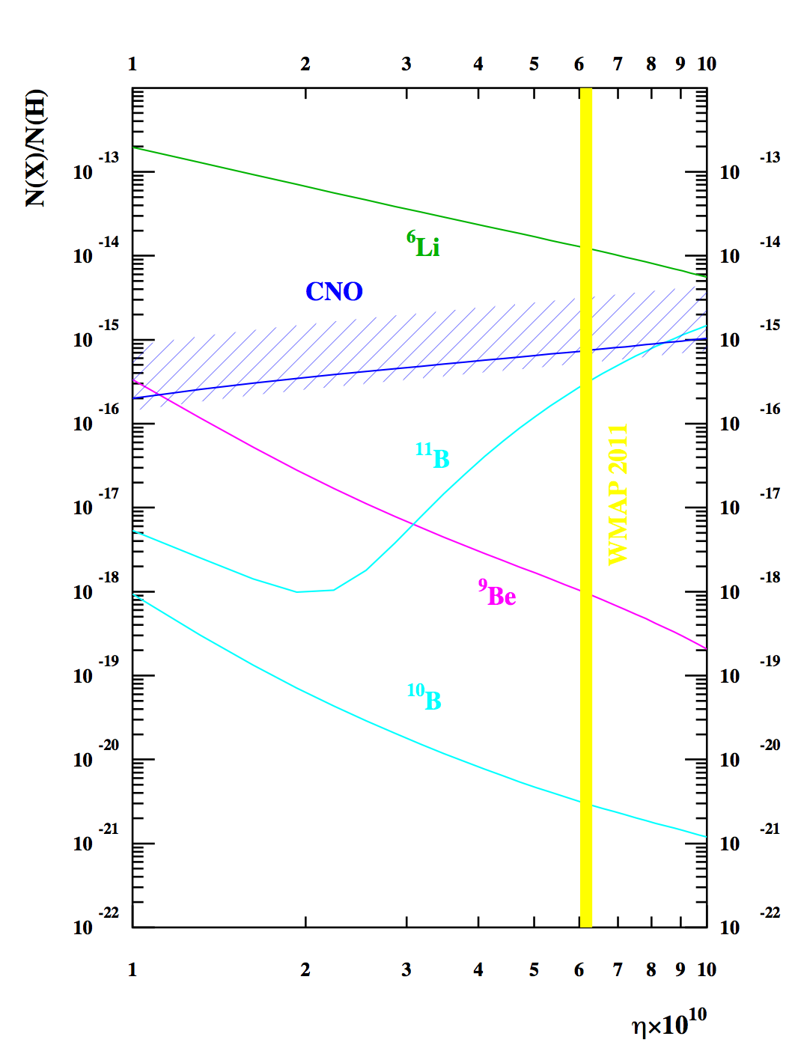
CNO nucleosynthesis
Systematic test of yield sensitivities to up to 10⁻³-10³ rate variations
Identification of important reactions for A>7 yields
Analysis of available experimental and theoretical data → new rates and limits
[Coc, Goriely, Xu, Saimpert & Vangioni 2012]

Slide 20
Monte-Carlo BBN versus observations
Number of atoms | 13 reactions Monte-Carlo † [CV 2010] | 424 reactions Network †† [Coc et al. 2012]
⁴He (Y_{p}) | 0.2476±0.0004 | 0.2476
D/H(×10⁻⁵) | 2.68±0.15 | 2.59
³He/H(×10⁻⁵) | 1.05±0.04 | 1.04
⁷Li/H(×10⁻¹⁰) | 5.14±0.50 | 5.24
⁶Li/H(×10⁻¹⁴) | 1.3* | 1.2
*Hammache et al. 2010, Ω_{b}from Spergel et al. 2007† or Komatsu et al. 2011††
Number of atoms | [Iocco et al. 2007] | [Coc et al. 2012]
(¹²C+¹³C)/H (×10⁻¹⁶) | 5.5 | 6.75
(¹⁴C+¹⁴N)/H (×10⁻¹⁷) | 5.0 | 6.76
¹⁶O/H (×10⁻²⁰) | 2.7 | 9.13
CNO/H (×10⁻¹⁶) | 6.0 | 7.43

Slide 21
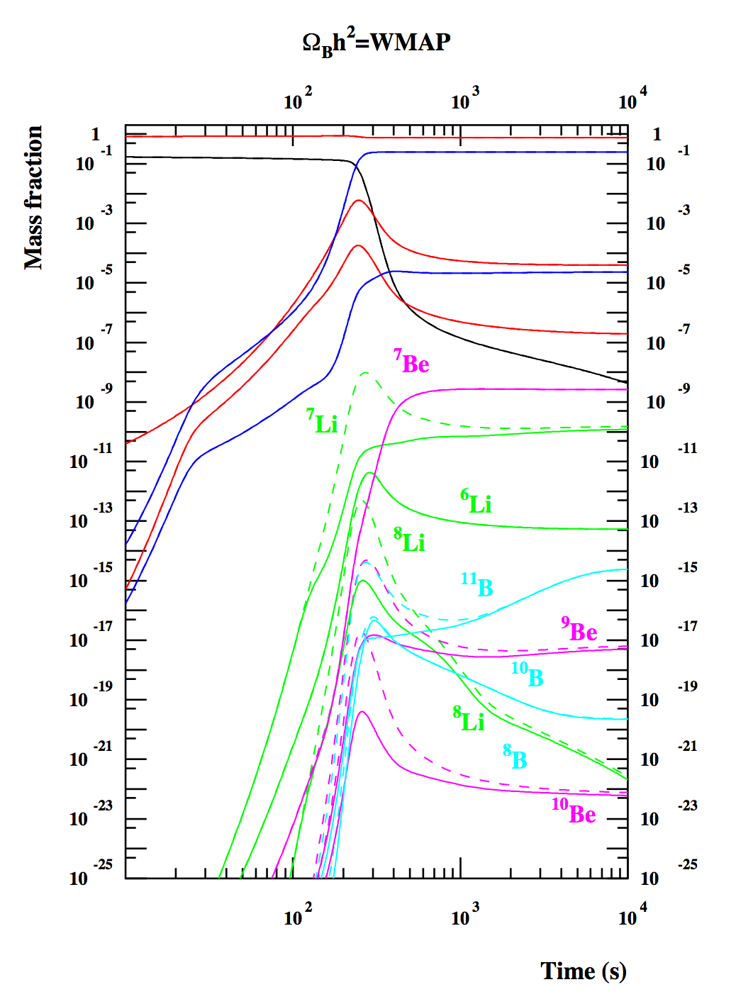
Counter intuitive effects in BBN
The ¹H(n,γ)D reaction affects mostly ⁷Li : neutron abundance
The ⁷Li(d,n)2⁴He reaction affects strongly the CNO but leaves ⁷Li (and other isotopes) unchanged!
Systematic sensitivity studies are important

Slide 22
Dark matter neutron injection
Small increase in neutron abundance reduces ⁷Be (⁷Li) production without affecting much ⁴He, D and ³He
Extra source of neutrons from Dark Matter ?
Dark Matter decay: χ → n + ….
λ_{→n}∝λ₀exp(-t/τ_{χ})
Dark Matter annihilation: χ+χ → n + ….
λ_{→n}∝λ₀a(t)⁻³ (dilution ∝(T/T_{C})³)
[Albornoz Vásquez, Belikov, Coc, Silk & Vangioni, submitted]

Slide 23
Dark matter injection of thermal neutrons
Thermalization of neutrons on shorter time-scale than
Expansion rate
Neutron lifetime
Energy loss
From multiple scattering rather than single collision
Negligible spallation
No ⁶Li overproduction by spallation reactions:
n + ⁴He → ³He + 2n
⁴He + ³He → ⁶Li + p
Achievable for Mχ in the 1 to 30 GeV range

Slide 24
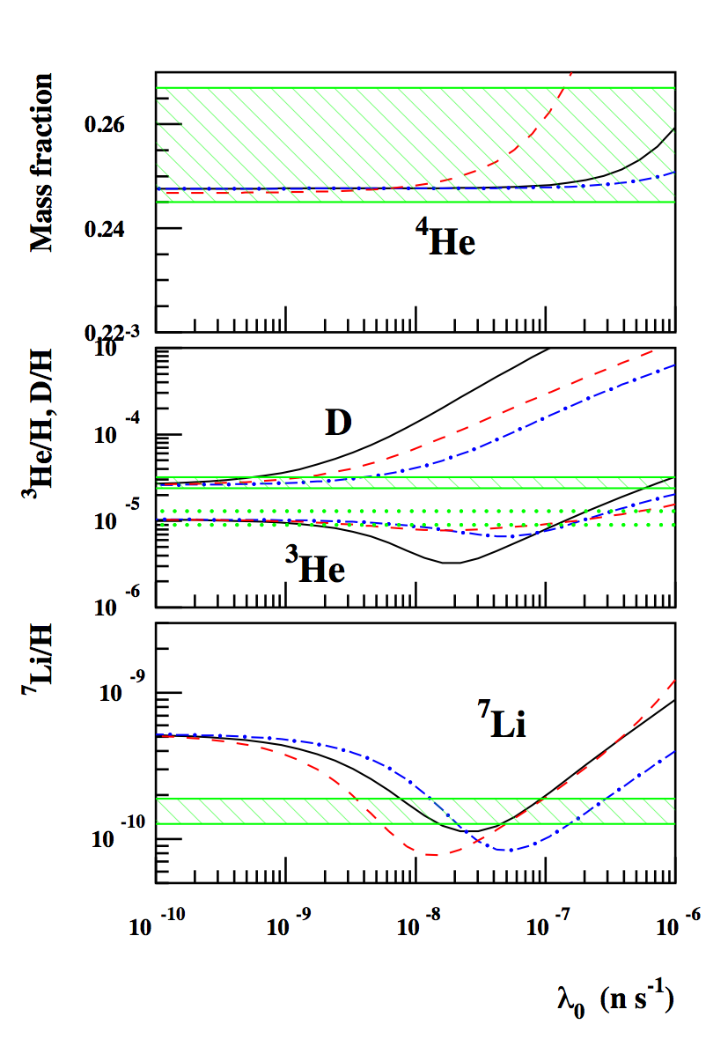
Representative results
[Albornoz Vásquez, Belikov, Coc, Silk & Vangioni, submitted]
③
①
Neutron injection at constant rate
②
Neutron injection from decay with τ_{χ} = 40 mn
Neutron injection from annihilation with T_{C} = 0.3 GK
Alleviates the ⁷Li problem at the expense of D

Slide 25
Conclusions
SBBN calculations confirm good agreement between CMB and SBBN (D and ⁴He).
However disagreement between Li observations, SBBN and CMB :
Nuclear (⁷Li) : Very highly unlikely (extra neutron source? additional resonances e.g. in ⁷Be+α [Broggini et al. ArXiv:1202.5232 and Poster 5]) but important to quantify the amount of needed depletion.
Nuclear (⁶Li) : No, ²H(α,γ)⁶Li rate now experimentally well constrained ( ⁶Li/H ≈ 1.3×10⁻¹⁴); direct measurement at LUNA [Poster 9]
Stellar depletion ?
Particle physics/Cosmology (e.g. DM neutron source, variation of constants)
CNO/H in the range (0.2-3.) ×10⁻¹⁵ will not affect Pop. III stars
SBBN is now a parameter free model !
Probe of the physics of the early Universe (K. Olive and T. Kajino talks)

