Slide 1


Dark matter distributions around
massive black holes:
A general relativistic analysis
Clifford Will
University of Florida & IAP
GreCo Seminar, 28 October 2013

Slide 2
Motivation:
A massive black hole (Sgr A*) resides at the
center of the galaxy
Dark matter dominates the overall mass of the
galaxy
Does the black hole induce a spike of DM density
at the center?
Implications for indirect detection via decays or
self-annihilations
Added mass could affect orbits of stars near
the black hole (tests of the no-hair theorems)

Slide 3
Testing the no-hair theorem at the galactic center:
no-hair theorems:
J = Ma; Q = -Ma²
precession of orbit planes
@ 10 μas/yr
e ~ 0.9, a ~ 0.2 mpc (500 R_{s})
future IR adaptive optics
telescopes (GRAVITY, Keck)
disturbing effects of other
stars & dark matter
CMW, Astrophys. J. Lett 674, L25 (2008)

Slide 4
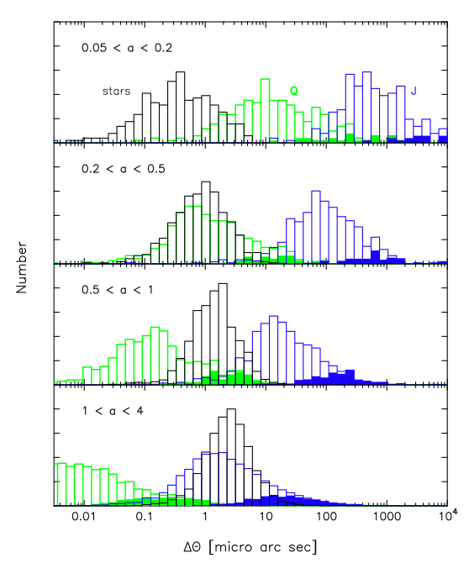
Effect of other stars/BH in the central mpc
10 stars (1M_{o}) & 11 BH (10M_{o})
within 4 mpc
100 realizations
isotropic, mass segregated
J/M² = 1
Numerical N-body simulations:
D. Merritt, T. Alexander, S. Mikkola,
& CMW, PRD 81, 062002 (2010)
Analytic orbit perturbation theory:
L. Sadeghian & CMW, CQG 28,
225029 (2011)

Slide 5
Dark matter around black holes:
The Gondolo-Silk paper
initial DM distribution
let black hole grow adiabatically
f(E, L) unchanged
E = E(E’, L’), L = L(E’, L’) holding
adiabatic invariants fixed
Newtonian analysis, but with
L cutoff at 4M_{BH}
ρ ~ ∫f(E’,L’)dE’ L’ dL’
Gondolo & Silk, PRL 83, 1719 (1999)

Slide 6
Dark matter around black holes:
A fully relativistic analysis
Kerr geometry:
Sadeghian, Ferrer & CMW (PRD 88, 063522, 2013)

Slide 7
Dark matter around black holes:
A fully relativistic analysis
Schwarzschild limit:

Slide 8
Example: the Hernquist profile
Approximates features of more realistic
models such as NFW close to the center
f(E) is an analytic function
M = 2πρ₀a³ = 10¹² M_{SUN} , a = 20 kpc

Slide 9
Example: the Hernquist profile
Mass inside 4 mpc ≈ 10³ M_{SUN} (1 M_{SUN)}
no-hair
target
star
S2

Slide 10
Dark matter distributions around
massive black holes:
A general relativistic analysis
Future work:
Incorporate more realistic profiles (NFW), self-gravity
Implement Kerr geometry
  Phase space volume more complex
  Capture criterion more complex
  (approximate analytic formula for E =1 (CMW, CQG 29, 217001 (2012)
  Will be circulation & non-sphericity even for f(E,L)

Slide 11
The Schwarzschild metric:
It’s the coordinates, stupid!*
The textbook method
Schwarzschild’s method
The “Relaxed Einstein Equation” method
*During Bill Clinton’s first campaign for the US Presidency, his top advisor James Carville tried to keep him focused on talking about the first Bush administration’s economic failures by repeatedly telling him: “It’s the economy, stupid!”

Slide 12
Finding the Schwarzschild metric:
The textbook way
Calculate the Christoffel symbols, Riemann, Ricci and Einstein tensors
Vacuum Einstein eq’ns
Voilà!

Slide 13
Finding the Schwarzschild metric:
Schwarzschild’s way
Calculate the Christoffel symbols, Riemann, and Ricci tensors
Standard Schwarzschild
metric
English translation: arXiv:9905030

Slide 14
Finding the Schwarzschild metric:
The “relaxed” Einstein Equations*
Lorenz gauge
Harmonic coordinates
Einstein’s equations:
*Exercise 8.9 of Poisson-Will, Gravitation: Newtonian, post-Newtonian, Relativistic (Cambridge U Press 2014)

Slide 15
Finding the Schwarzschild metric:
The “relaxed” Einstein Equations
Static, spherical symmetry:
Lorenz gauge

Slide 16
Pieces of the field equations
Left-hand side
Right-hand side

Slide 17
3 differential equations
Define:
3 equations:

Slide 18
Solutions
Equation (1)+(2):
implies
Case 1: c=0
Subst X=0 in Eq. (2):
Newtonian limit:

Slide 19
The metric in harmonic coordinates
Obtain from Schwarzschild coordinates by substituting

Slide 20
The other solution?
Equation (1)+(2):
implies
Case 2: c ≠0
Attempts to find a solution failed (Pierre Fromholz, Ecole Normale, Paris)
change variables
Abel’s resolution
inversion

Slide 21
What does the other solution mean?
Legendre’s equation (L=1), with solution:
Fromholz, Poisson & CMW, arXiv:1308.0394

