Slide 1


Stochastic inflation and the probability of large density perturbations
GReCO seminar, Institut d’Astrophysique, Paris
15th June 2020
David Wands
Institute of Cosmology and Gravitation, University of Portsmouth
+ Chris Pattison, Hooshyar Assadullahi (ICG) and Vincent Vennin (Paris)
Hassan Firouzjahi and Mahdiyar Noorbala (IPM, Tehran)
Emmanuel Frion and Tays Miranda (UFES, Brazil)

Slide 2
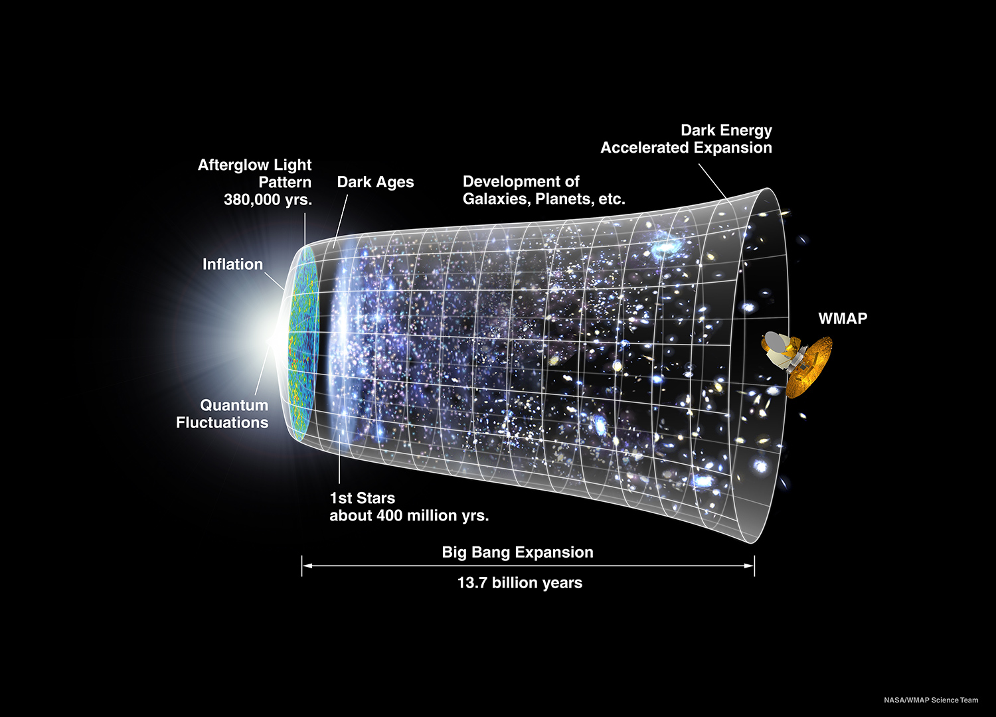
a 21st century history of our Universe

Slide 3
a 21st century history of our Universe
vacuum energy, V + clock, φ
10¹⁵ GeV < ρ^{1/4} < 1 TeV
inflation
vacuum energy
ρ^{1/4} ~ 1 meV

Slide 4
outline
classical + quantum inflation
  classical GR + homogeneous (FLRW) spacetime
  quantum vacuum fluctuations
perturbative δN approach to calculate typical perturbations
    works well for primordial power spectrum, bispectrum, etc
stochastic δN approach to calculate large fluctuations
  Langevin equations for stochastic field evolution
  give full probability distribution for primordial density
examples and open questions
summary

Slide 5
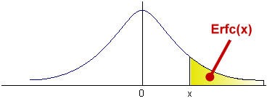
Correlation functions in stochastic inflation
Vennin & Starobinsky, arXiv:1506.04732
non-perturbative stochastic approach to calculate large excursions in the primordial density field
  e.g., primordial black holes form in radiation era from dimensionless density perturbation, ζ, that exceeds critical value, ζ > ζ_{crit} ~ 1
  standard abundance calculations assume Gaussian pdf, P(ζ), possibly with some non-Gaussian modification, but not well-suited to describe the tail of the distribution

Slide 6
Correlation functions in stochastic inflation
Vennin & Starobinsky, arXiv:1506.04732
non-perturbative stochastic approach to calculate large excursions in the primordial density field

Slide 7
Classical inflation:
GR+ homogeneous (flat FLRW) spacetime
V(φ)
φ
homogeneous scalar field
  slow roll (“vacuum”) Hubble expansion rate approx constant
    first slow-roll parameter
  logarithmic expansion (“e-folds”) determined by field

Slide 8
Slow-roll inflation:
V(φ)
φ
two coupled non-linear equations:

Slide 9
Slow-roll inflation:
V(φ)
φ
two coupled non-linear equations:
  standard ``slow roll approximation” makes two assumptions
    quasi-de Sitter (H slowly varying, ε << 1)
    quasi-equilibrium (damping = - gradient)
  stable attractor whenever it exists
✘
✘

Slide 10
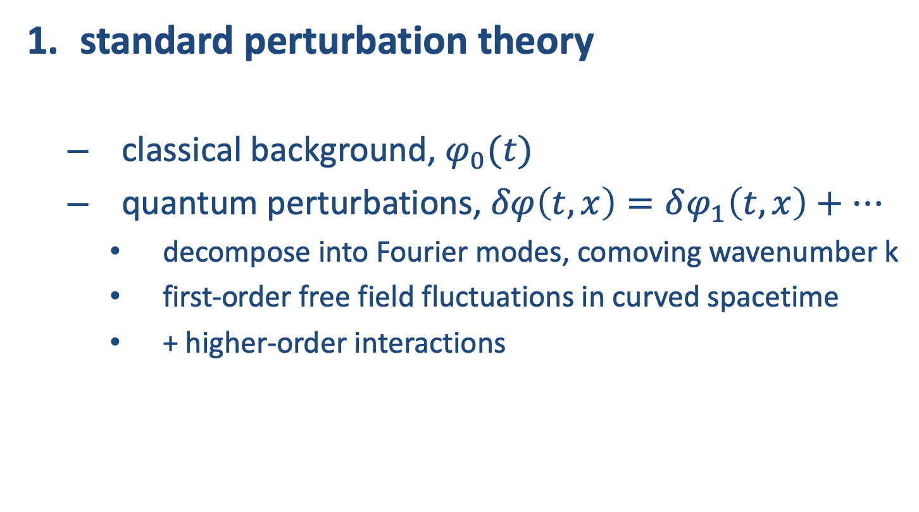
two semi-classical approaches to studying classical background + quantum fluctuations
standard perturbation theory
  classical background, $φ_{0}(t)$
  quantum perturbations, $δφ\left(t,x\right)=δφ_{1}\left(t,x\right)+…$
    decompose into Fourier modes, comoving wavenumber k
    first-order free field fluctuations in curved spacetime
    + higher-order interactions

Slide 11
quantum fluctuations
Hawking ’82, Starobinsky ’82, Guth & Pi ‘82
V(φ)
φ
  small-scale/underdamped vacuum oscillations:
  give large-scale/overdamped perturbations in squeezed state:

Slide 12
Wave equation for massless field in FLRW cosmology:
Characteristic timescales for waves, comoving wavemode k: oscillation vs damping
small-scales , k/a > H, under-damped oscillator
large-scales , k/a < H, over-damped “frozen-in”
Inflation -> almost constant Hubble length
Hubble length, H⁻¹, grows with time during radiation or matter eras
initial quantum vacuum state for under-damped oscillator on sub-Hubble scales
N = ln(a)

Slide 13
δN for primordial density fluctuations
Starobinsky ‘85; Sasaki & Stewart ‘96; Lyth & Rodriguez ‘05
after inflation: curvature perturbation ζ on uniform-density hypersurface
t
x
during inflation: field perturbations φ(x,t_{i}) on initial spatially-flat hypersurface

Slide 14
δN order by order at Hubble exit
e.g., <ζ³>
N’
N’
N’
N’’
N’
N’
sub-Hubble field interactions
super-Hubble “local” evolution
Byrnes, Koyama, Sasaki & DW (arXiv:0705.4096)

Slide 15
Classical vs quantum inflation
Classical slow-roll inflates universe
Quantum field fluctuations about fixed FLRW background lead to primordial metric perturbations (at first order)
N

Slide 16
Classical vs quantum inflation
Classical slow-roll inflates universe
Quantum field fluctuations about fixed FLRW background lead to primordial metric perturbations
N

Slide 17
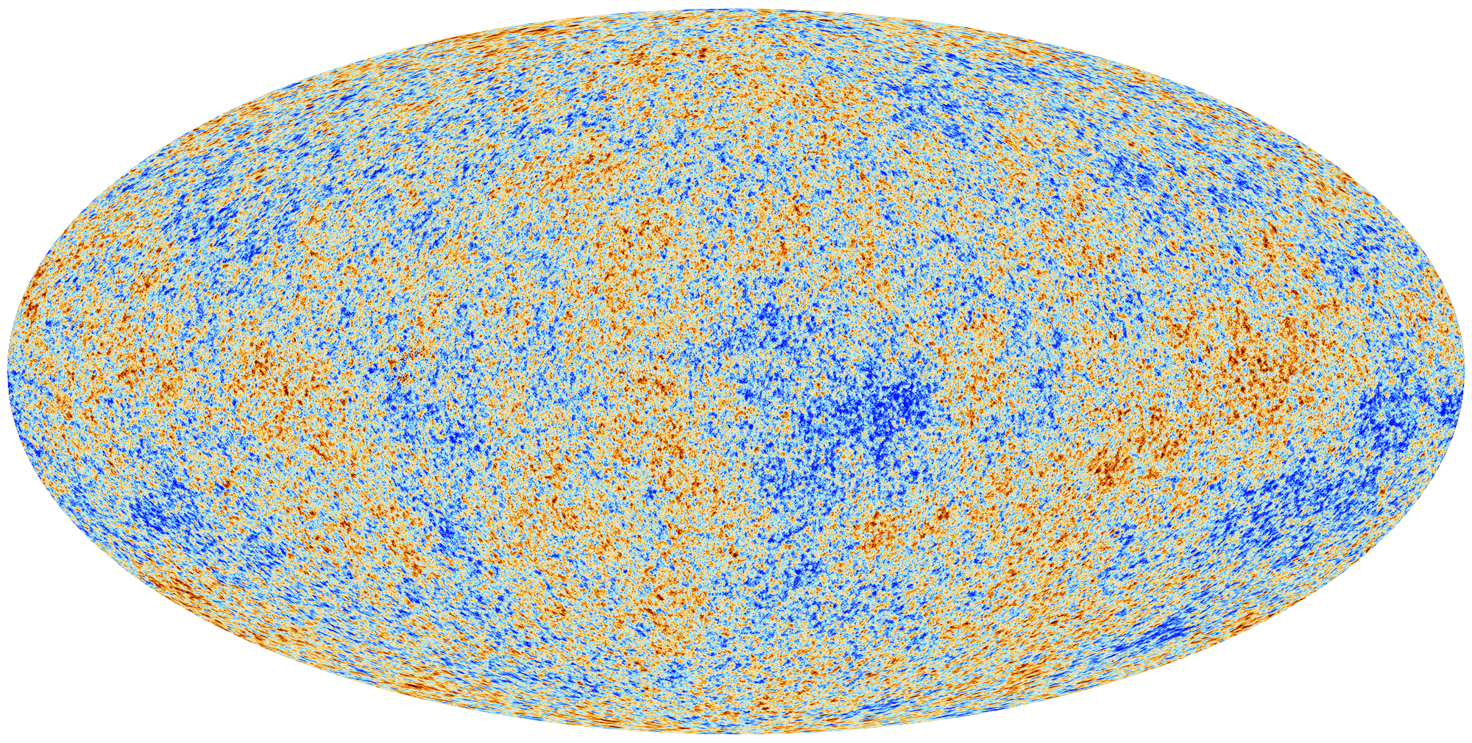
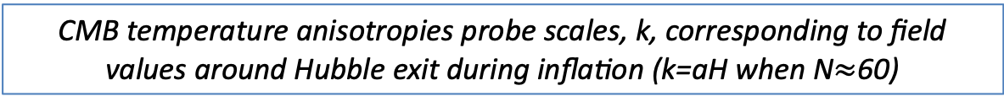
Seeing quantum fluctuations
CMB temperature anisotropies probe scales, k, corresponding to field values around Hubble exit during inflation (k=aH when N$≈$60)
© ESA

Slide 18
Classical vs quantum inflation
Classical slow-roll inflates universe
Quantum field fluctuations about fixed FLRW background lead to primordial metric perturbations
PBHs form, ζ ~ 1, when δφ_{quantum} ~ δφ_{classical},
i.e., when quantum fluctuations not small
N

Slide 19
two semi-classical approaches to studying classical background + quantum fluctuations
standard perturbation theory
stochastic approach
  introduce a coarse-graining scale, k_{cg} ≈ aH
  quantise small-scale (sub-Hubble) vacuum fluctuations
  large-scale squeezed state, effectively classical
  absorb into local stochastic FLRW background
Starobinsky (1986); Goncharov, Linde & Mukhanov (1987)…

Slide 20
Wave equation for massless field in FLRW cosmology:
Characteristic timescales for waves, comoving wavemode k
small-scales , k/a > H, under-damped oscillator
large-scales , k/a < H, over-damped
coarse-grained field
during inflation on super-Hubble scales
φ_{long}
φ_{short}
Hubble length, H⁻¹, grows with time during radiation or matter eras
initial quantum vacuum state for under-damped oscillator on sub-Hubble scales
N = ln(a)

Slide 21
Stochastic inflation:
V(φ)
φ
classical evolution of long-wavelength field + momentum, (φ,π), with respect to e-folds, N:

Slide 22
Stochastic inflation:
V(φ)
φ
Langevin evolution of long-wavelength field + momentum, (φ,π), with respect to e-folds, N,
stochastic kicks from small scale quantum fluctuations:
Grain & Vennin (2017)

Slide 23
Stochastic inflation:
V(φ)
φ
Langevin evolution of long-wavelength field + momentum, (φ,π), with respect to e-folds, N:
slow roll, massless field in super-Hubble limit (k_{cg}<<aH):
✘
✘
✘

Slide 24
Stochastic inflation:
V(φ)
φ
Langevin equation describes stochastic evolution of long-wavelength field, φ, with respect to e-folds, N:
can be cast as Fokker-Planck equation for probability distribution for field values, φ, at given time, N :
classical drift (slow-roll)
quantum diffusion, <ξ(N)ξ(N’)> = δ(N-N’)
quantum diffusion
classical drift (slow-roll)

Slide 25

Stochastic δN:
Enqvist, Nurmi, Podolsky & Rigopoulos (2008)
Fujita, Kawasaki, Tada & Takesako (2013, 2014)
Vennin & Starobinsky (2015)
Number of e-folds, N, from a given field value, φ, to the end of inflation becomes a stochastic variable:
  first-passage time formalism (Louis Bachelier 1900)
  invert Fokker-Planck equation to find probability distribution for number of e-folds, N, from given field values, φ:
N
$$φ_{\text{end}}$$

Slide 26
Stochastic δN:
Vennin & Starobinsky (2015)
integration domain covers the entire field space
infinite inflation, <N> → infinity, possible for plateau potential or multiple fields
  require UV cut-off at V(φ₊) ~ M_{Pl}⁴ Vennin et al (2016)
figure from Vincent Vennin

Slide 27
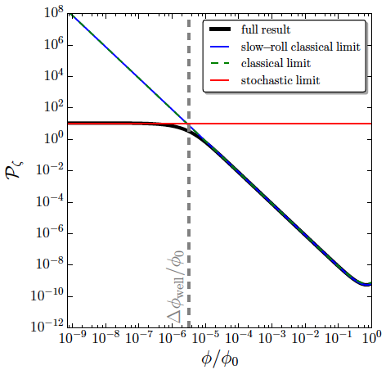




Pattison, Vennin, Assadullahi & Wands (2017)
Power spectrum:
large deviations from perturbative δN when quantum diffusion dominates over classical drift approaching end of inflation
quantum diffusion regularises classical divergence as φ → 0
stochastic
$$φ_{\text{end}}$$
$$φ_{\text{end}}+Δφ_{\text{well}}$$
classical

Slide 28
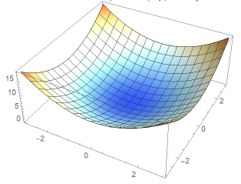
UV dependence for multiple (D) fields
Vennin, Assadullahi, Firouzjahi, Noorbala & Wands (2016)
e.g., quadratic potential with D>2 fields requires UV regularisation (boundary) at V₊ ~ M_{Pl}⁴
D=3
D=2
primordial power, P_{ζ} (k*)
D=1
UV boundary, v₊ = V(φ₊) / M_{Pl}⁴

Slide 29
Higher-order moments of stochastic δN
moments obey an iterative relation (Vennin & Starobinsky 2015)
  where L_{FP}† is adjoint Fokker-Planck operator

Slide 30
Full PDF for δN Pattison et al (2017)
moments obey an iterative relation (Vennin & Starobinsky 2015)
define characteristic function (includes all the moments)
obeys differential equation
inverse Fourier transform gives full probability distribution

Slide 31
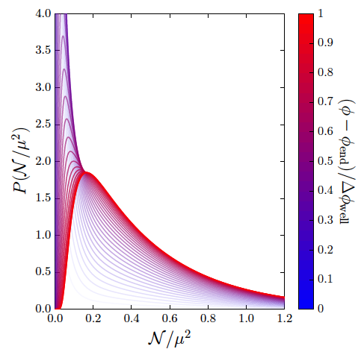


Pattison, Vennin, Assadullahi & Wands (2017)
Probability distribution function, P(N)
large deviations from classical δN when quantum diffusion dominates over classical drift -> non-Gaussian probability distribution, P(N)
exponential
tail
exp(-ΛN)
$$φ_{\text{end}}$$
$$φ_{\text{end}}+Δφ_{\text{well}}$$

Slide 32
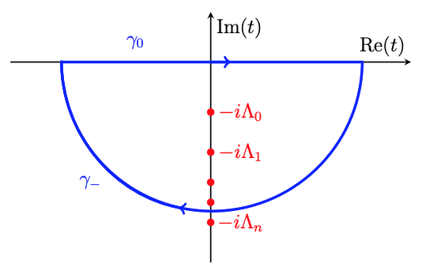
exponential tail of inflationary fluctuations
Ezquiaga, Garcia-Bellido & Vennin (2019)
general form of characteristic function for slow-roll potentials
  integrate in complex plane to invert Fourier transform, recover, P(N)
  probability distribution has exponential tail
    highly non-Gaussian
poles on imaginary axis
regular function

Slide 33
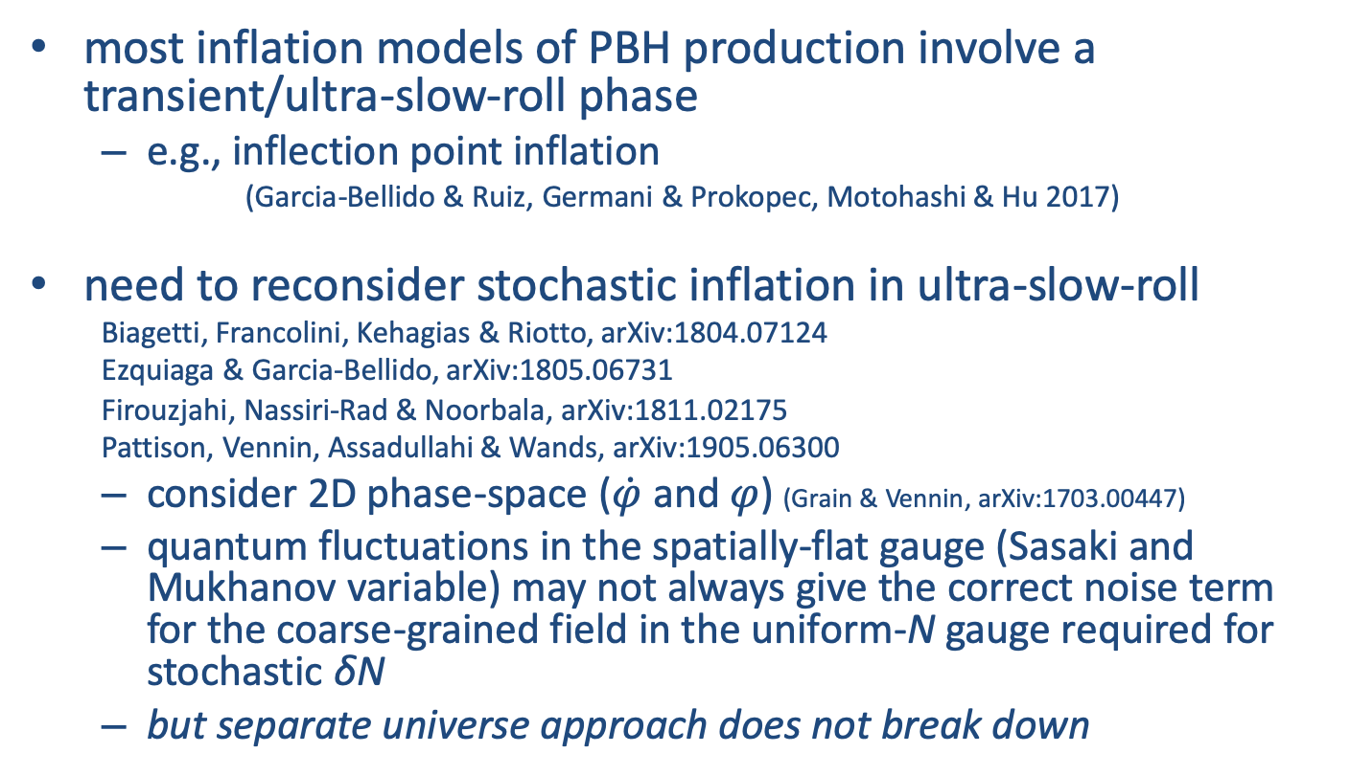
beyond slow-roll
most inflation models of PBH production involve a transient/ultra-slow-roll phase
  e.g., inflection point inflation
  (Garcia-Bellido & Ruiz, Germani & Prokopec, Motohashi & Hu 2017)
need to reconsider stochastic inflation in ultra-slow-roll
Biagetti, Francolini, Kehagias & Riotto, arXiv:1804.07124
Ezquiaga & Garcia-Bellido, arXiv:1805.06731
Firouzjahi, Nassiri-Rad & Noorbala, arXiv:1811.02175
Pattison, Vennin, Assadullahi & Wands, arXiv:1905.06300
  consider 2D phase-space ($\dot{φ}$ and $φ$) (Grain & Vennin, arXiv:1703.00447)
  quantum fluctuations in the spatially-flat gauge (Sasaki and Mukhanov variable) may not always give the correct noise term for the coarse-grained field in the uniform-N gauge required for stochastic δN
  but separate universe approach does not break down

Slide 34
Ultra-slow-roll inflation:
Inoue & Yokoyama, hep-ph/0104083; Kinney gr-qc/0503017
V(φ)
φ
two coupled non-linear equations:
  ``ultra-slow roll” makes two assumptions
    quasi-de Sitter (H slowly varying , ε << 1)
    faster than slow-roll (damping >> gradient)
      important when potential suddenly becomes very flat
  usually transient, but can be a local attractor (Pattison et al, 2018)
    e.g., field rolling down a convex potential M_{P} V’’ > |V’|
✘
✘

Slide 35
Stochastic inflation:
V(φ)
φ
Langevin evolution of long-wavelength field + momentum, (φ,π), with respect to e-folds, N:
validity of stochastic Langevin equations requires
  quantum-classical transition
    squeezed quantum state on super-Hubble scales
  separate universe approach
    spatial gradients and anisotropy neglected on super-horizon scales
  uniform-N gauge
    describe distribution of field values at given “time”, N

Slide 36
Stochastic inflation:
V(φ)
φ
Langevin evolution of long-wavelength field + momentum, (φ,π), with respect to e-folds, N:
validity of stochastic Langevin equations requires
  quantum-classical transition ✓slow roll ✓ultra-slow roll
    squeezed quantum state on super-Hubble scales
  separate universe approach ✓slow roll ✓ultra-slow roll
    spatial gradients and anisotropy neglected on super-horizon scales
  uniform-N gauge ✓slow roll ✓ultra-slow roll
    describe distribution of field values at given “time”, N
    Stochastic inflation beyond slow-roll, Pattison, Vennin, Assadullahi & Wands (2019)

Slide 37
Stochastic USR inflation:
V(φ)
φ
Langevin evolution of long-wavelength field + momentum, (φ,π), with respect to e-folds, N: (Firouzjahi, Nassiri-Rad & Noorbala (2018))
ultra-slow roll, massless field in super-Hubble limit (k_{cg}<<aH):
✘
✘
✘

Slide 38
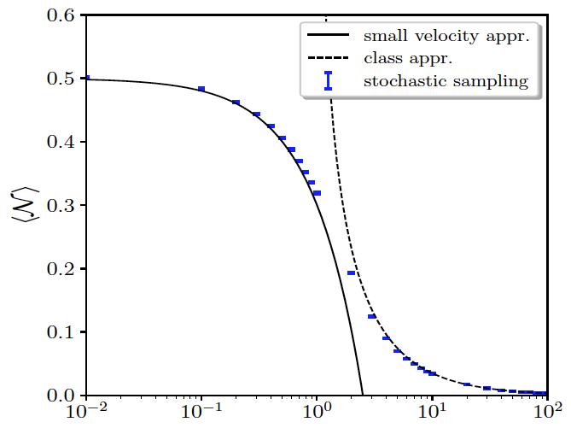
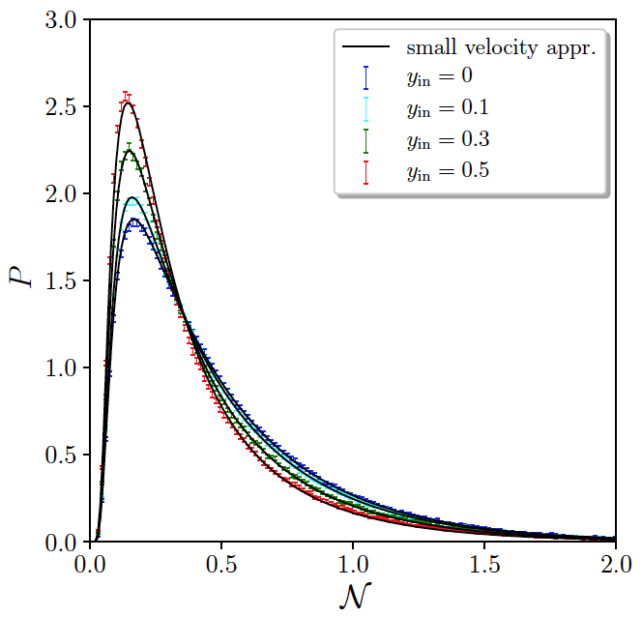
Stochastic USR inflation:
V(φ)
φ
two ultra-slow roll limits
  (Pattison, Assadullahi, Vennin, DW, to appear soon!)
  large velocity corresponds to classical N(φ) (Firouzjahi, Nassiri-Rad & Noorbala (2018))
  small velocity expansion about previous slow-roll limit as π->0
    recover same exponential tail of the pdf as Pattison et al (2017) and Ezquiaga et al (2019)
π_{initial} [dimensionless units]

Slide 39
open questions
primordial black hole abundance beyond slow-roll
  specific (tuned) PBH production models with slow-roll violation
  multiple fields (e.g., phase transitions) and non-canonical scalars (geometrical destabilistion)
stochastic δN in collapse models (see Frion, Miranda + DW (2019))
  evolution away from power-law (w=constant) collapse
  may lead to anisotropic stochastic collapse
consequences of the exponential tail in the probability
  when are deviations from non-Gaussianity important?
  ultra-compact mini-halos? massive clusters at high redshift? reionisation?
  rogue waves? pandemic outbreaks…?

Slide 40
summary
Stochastic δN allows us to calculate non-linear primordial density perturbations beyond usual perturbative approach
  stochastic evolution probes whole potential (sensitive to UV cut-off)
full probability distribution function for density field
  solve for characteristic function, then Fourier transform (Pattison et al 2017)
  highly non-Gaussian exponential tail of the distribution (Ezquiaga et al 2019)
stochastic δN beyond slow roll
  separate universe (local-FLRW) approach does not require slow roll (Pattison et al 2019)
  growing+decaying modes require 2D phase-space (Grain & Vennin 2017)
  can also study stochastic collapse models (Frion, Miranda & Wands 2019)

Slide 41
thank you

Slide 42
bonus slides

Slide 43
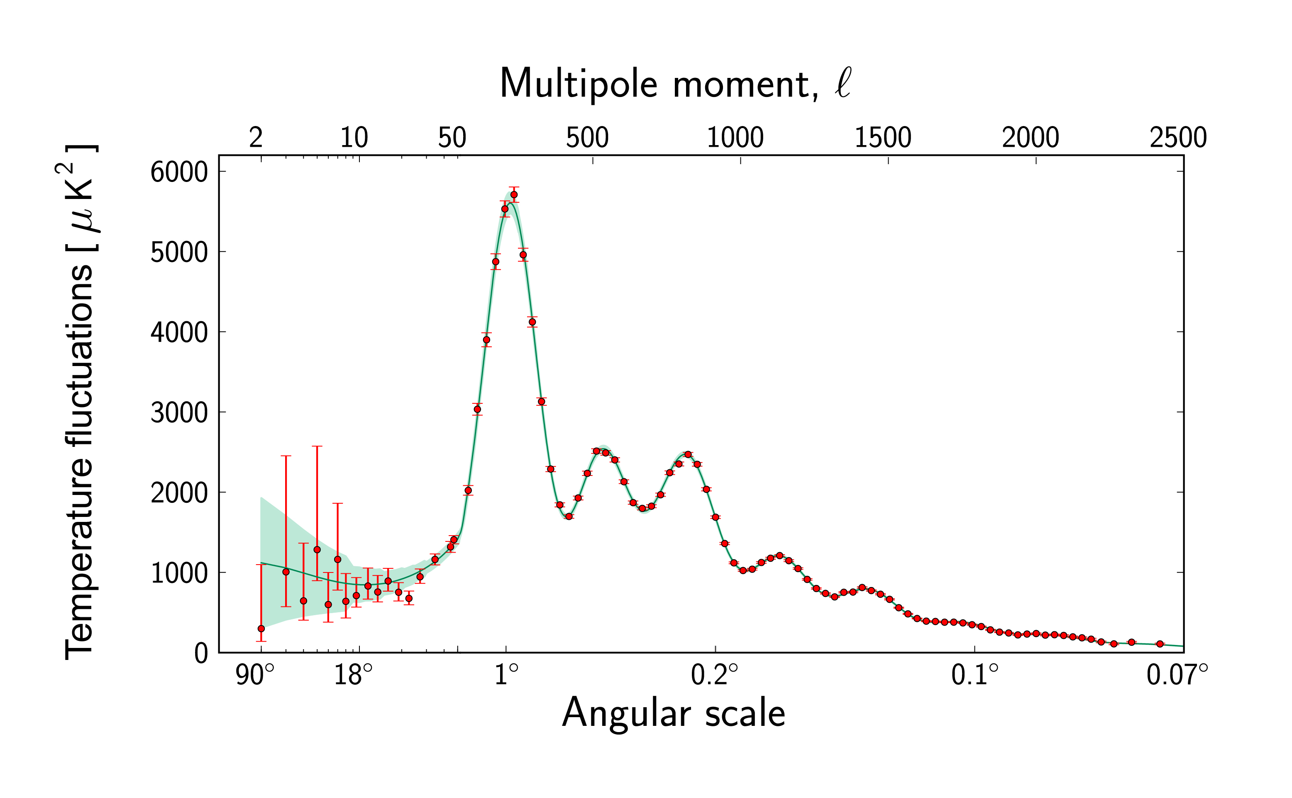
Precision cosmology Ade et al 2015
Angular power spectrum:
6-parameter model:
4-parameter cosmology:
H₀ = 67.8 ± 0.9
Ω_{matter} = 0.308 ± 0.012
Ω_{Λ}= 0.692 ± 0.012
Reionisation z = 8.8 ± 1.7
2-parameter primordial fluct’ns:
Amplitude ΔT/T = 0.000047
Tilt = -0.032 ± 0.006
© ESA

Slide 44
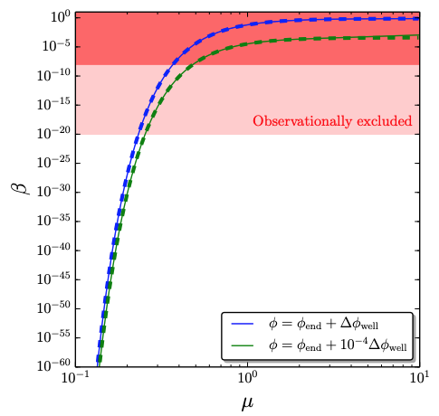
Pattison, Vennin, Assadullahi & Wands (2017)
Primordial black hole mass fraction, β(μ)
large deviations from classical δN when quantum diffusion dominates over classical drift -> non-Gaussian probability distribution, P(N)
$$φ_{\text{end}}$$
$$φ_{\text{end}}+Δφ_{\text{well}}$$
μ = Δφ_{well} / H

Slide 45



separate universe approach
Starobinsky (1985); Salopek & Bond (1990); Wands, Malik, Lyth, Liddle (2001)
key assumption in stochastic approach:
the coarse-grained field on large scales (neglecting spatial gradients) even in an inhomogeneous universe follows the same equations of motion as an unperturbed background universe locally
background equations of motion

Slide 46
Stochastic inflation:
V(φ)
φ
Langevin evolution of long-wavelength field + momentum, (φ,π), with respect to e-folds, N:
good agreement with QFT calculations where comparisons possible
    Starobinsky & Yokoyama (1994); Tsamis & Woodard (2005); Finelli et al (2009); Garbrecht, Rigopoulos & Zhu (2014)

Slide 47
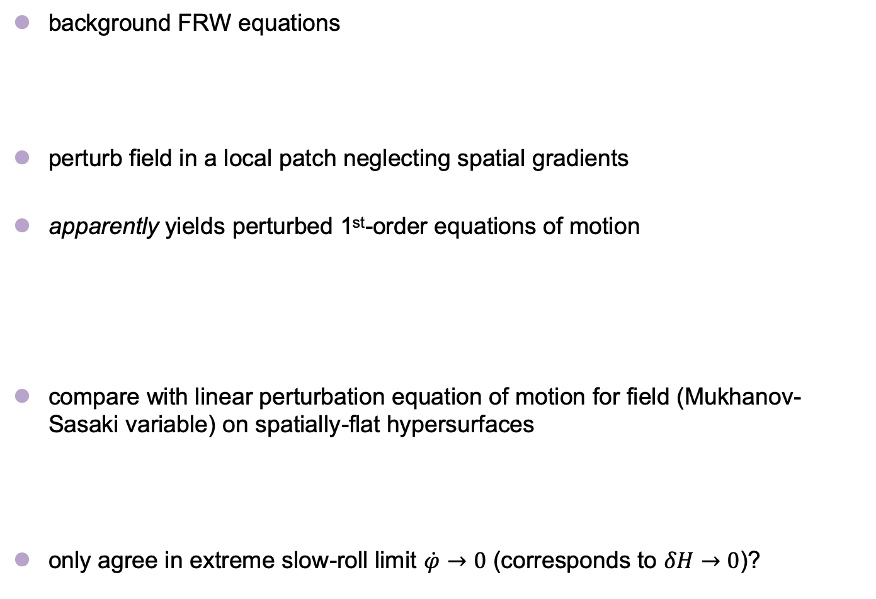
  failure of the separate universe approach beyond slow-roll?
  Cruces, Germani & Prokopec arXiv:1807.09057
background FRW equations
perturb field in a local patch neglecting spatial gradients
apparently yields perturbed 1st-order equations of motion
compare with linear perturbation equation of motion for field (Mukhanov-Sasaki variable) on spatially-flat hypersurfaces
only agree in extreme slow-roll limit $\dot{φ}→0$ (corresponds to $δH→0$)?

Slide 48
consistency of separate universe approach
also need to perturb local time coordinate
perturbed equation of motion for field on large-scales
subject to momentum constraint equation
  spatially-flat gauge is only synchronous (A=0) at zeroth-order in slow-roll
agrees on large-scales with linear perturbation equation for field perturbation (Mukhanov-Sasaki variable) on spatially-flat slices

Slide 49
spatially-flat (Sasaki-Mukhanov) gauge vs uniform-N
Langevin equations for 2D phase-space use global time-coordinate, N
integrated expansion
so uniform-N requires
spatially flat and uniform-N coincide whenever non-adiabatic pressure perturbation vanishes:
  in slow-roll in large-scale limit,
  vanishes even quicker in ultra-slow roll

Slide 50
further work:
stochastic δN in alternative PBH models
  transient non-slow-roll backgrounds, e.g., inflection point inflation (e.g., Garcia-Bellido & Ruiz, Germani & Prokopec, Motohashi & Hu 2017)
explore nature of non-Gaussianity beyond leading order (classical) δN
  corrections to tail of distribution even close to classical limit?
  understand consistency of non-Gaussian pdf with absence of correlation between large and small physical scales in single-clock inflation (e.g., Pajer, Schmidt & Zaldarriaga 2013)

Slide 51
stochastic collapse
Frion, Miranda & Wands (2019)
Grain & Vennin (2020)
quantum fluctuations in a collapsing FRW cosmology behave like inflationary perturbations
  e.g., scale-invariant spectra from pressure-less collapse
  (Starobinsky 1979 and Wands 1999)
non-stiff collapse (w<1) classically unstable
  classical lifetime depends on initial conditions
quantum fluctuations gives a finite lifetime for w=0
  Frion, Miranda and Wands, 2019
quantum shear backreaction from massless test field for w<-1/9
  Grain & Vennin (2020)

Slide 52
Infinite inflation and number of fields (D)
Vennin, Assadullahi, Firouzjahi, Noorbala & Wands (2016)
slide from Vincent Vennin
15/20

Slide 53
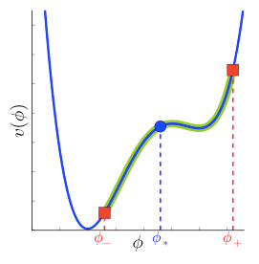
Stochastic N Vennin & Starobinsky (2015)
Langevin equation
Fokker-Planck equation
First Passage Time: Louis Bachelier, 1900
where
September 2016

Slide 54
Saddle Point Approximation
Classical result
First order correction
slide from Vincent Vennin
Vennin & Starobinsky (2016)

Slide 55
Higher-order moments of stochastic δN
moments obey an iterative relation (Vennin & Starobinsky 2015)
for example, power spectrum
Saddle Point Approximation
Linear perturbation theory
leading order correction

