Slide 1




Collisionless shocks formation,
spontaneous electromagnetic fluctuations
and streaming instabilities
Antoine Bret, Erica Perez Alvaro
Anne Stockem, Federico Fiuza, Luis Silva
Charles Ruyer, Laurent Gremillet
Ramesh Narayan
UCLM, Spain
IST, GoLP, Portugal
CEA, France,
Harvard CfA, USA
ATELIER PNHE – Paris, 3-5 octobre 2012

Slide 2
Understanding shock formation
How exactly do you form a shock?
Does it always form?
Are they really “Weibel mediated”?
How much time does it take?
…?
Work in progress

Slide 3
Shock Formation: PIC’s (OSIRIS)
Simplest possible: cold, symmetric, e⁻e⁺ shells, no B₀
Simulation
Window
Chocks

Slide 4
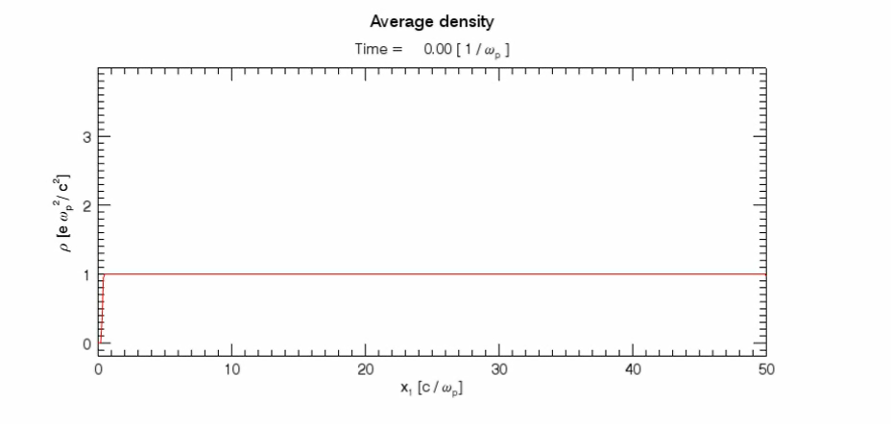
Shock Formation: PIC’s (Osiris)
Simplest possible PIC’s: cold, symmetric, e⁻e⁺ shells,
γ = 1.05

Slide 5
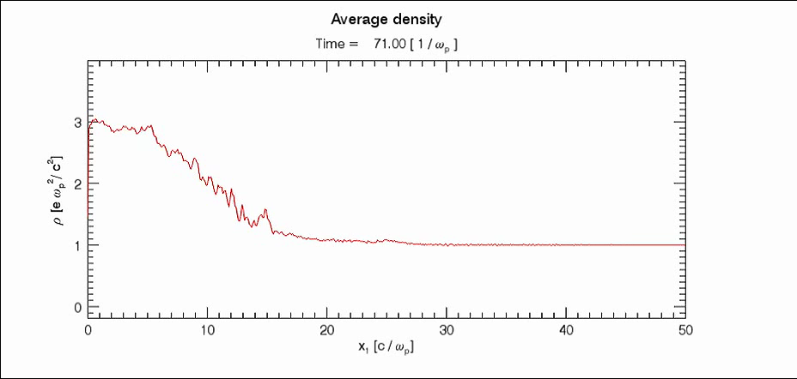
Shock Formation: PIC’s (Osiris)
Simplest possible PIC’s: cold, symmetric, e⁻e⁺ shells,
γ = 1.05

Slide 6
Shock Formation: Two Phases
Shells overlap: instability grows & saturates
Shock Forms
Unstable
Density

Slide 7
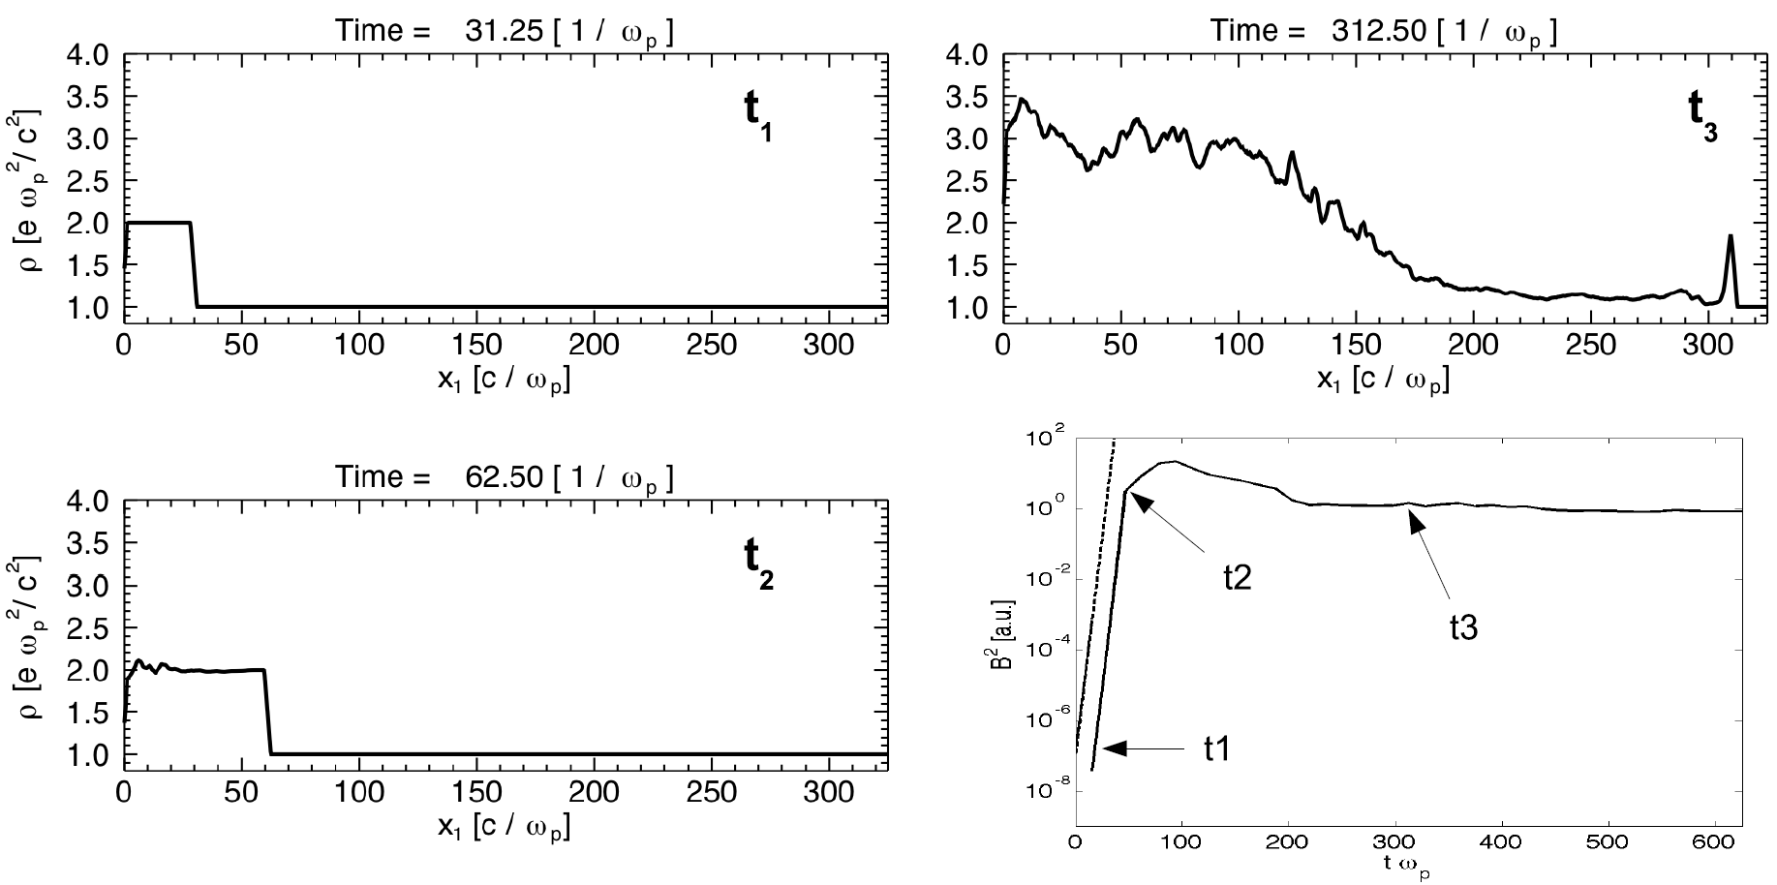
Shock Formation: Two Phases
Shock
forms
Insta. triggered
Phase 2
Phase 1
Insta. saturates
B² in central region
γ = 25

Slide 8
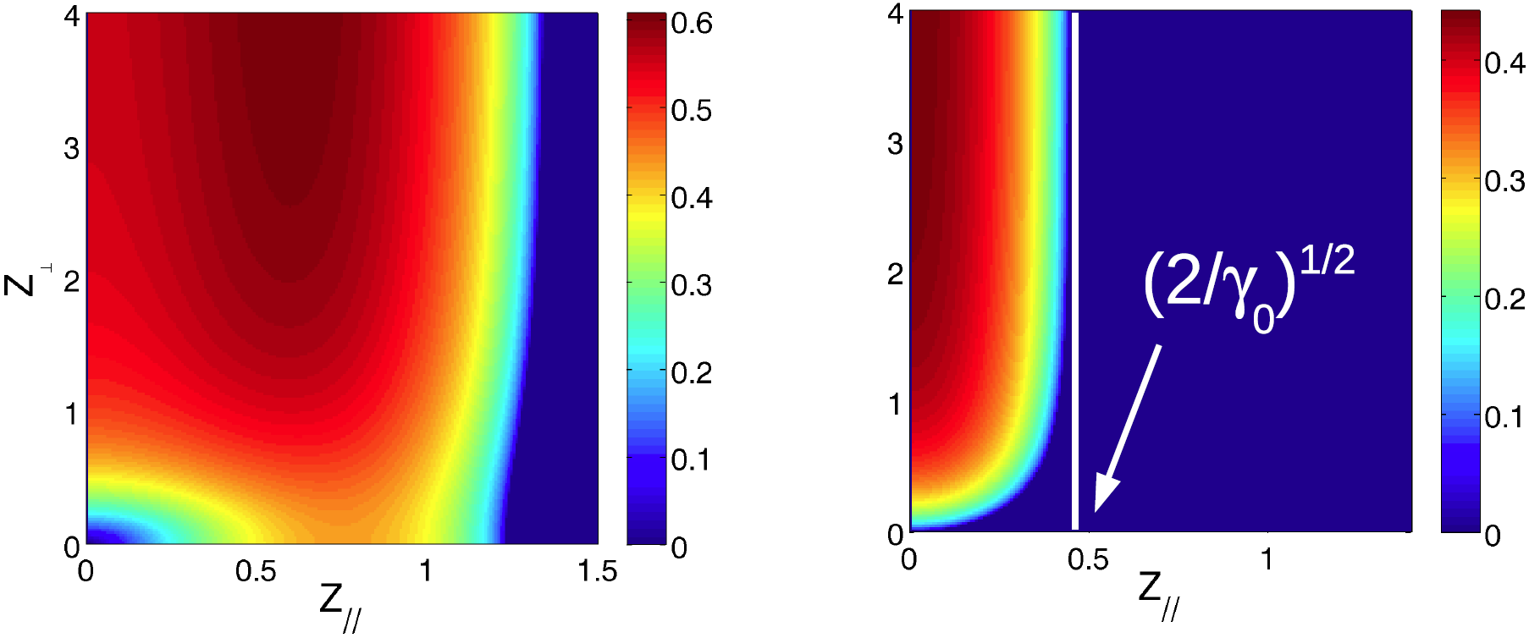


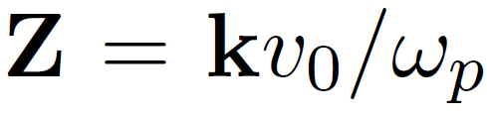
First Phase: Instabilities
Which instability grows? All… but some do it faster
Growth rate δ(k)
For γ > (3/2)^{1/2}, “Weibel” wins

Slide 9
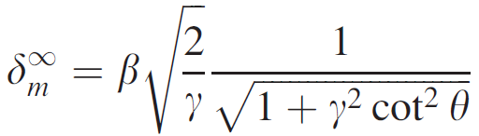
First Phase: Instabilities
Instability is bad news in Fast Ignition for ICF
Here, it is good news
A flow aligned B₀ can cancel Weibel (Godfrey ‘75)
What if not aligned (+ sym, cold flow)?
B₀
GR for B₀ → ∞
FLOW
θ
Bret & Perez-Alvaro, Phys. Plasmas, 18, 080706 (2011)

Slide 10
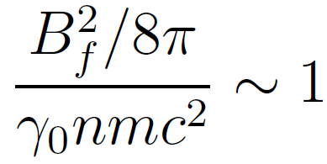
First Phase: Saturation Field
Weibel grows at δ, from B_{i} to B_{f}.
What about B_{f}? Cyclotron freq. = δ gives
Good agreement with PIC’s

Slide 11
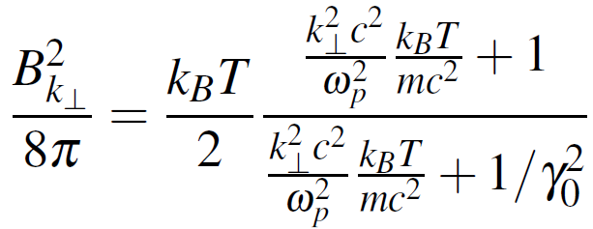
First Phase: Seed Field
What about B_{i}?
Instability amplifies spontaneous fluctuations
Focus on modes with k// = 0 (ω integrated)
Their d³k density reads (Ruyet & Gremillet)
Not trivial

Slide 12

First Phase: Seed Field
Need to integrate seed density on d³k
k-integration domain?
Numerically
determined (?)

Slide 13
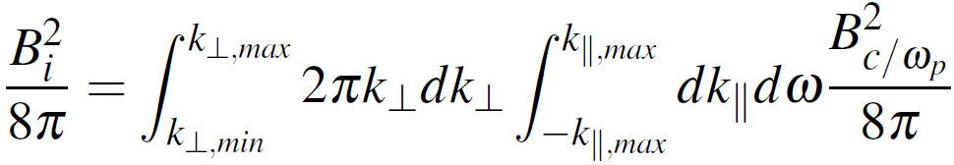
First Phase: Seed Field
Need to integrate seed density on d³k
We thus compute

Slide 14
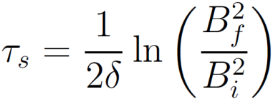
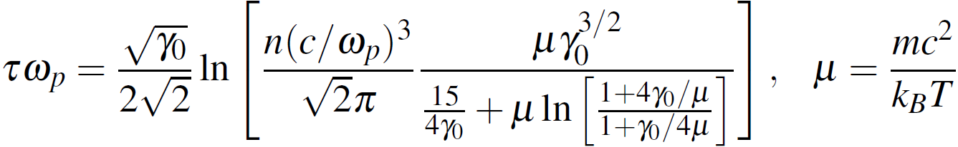
First Phase: Saturation Time
Saturation time τ_{s} simply reads
“Final” result (so far)

Slide 15
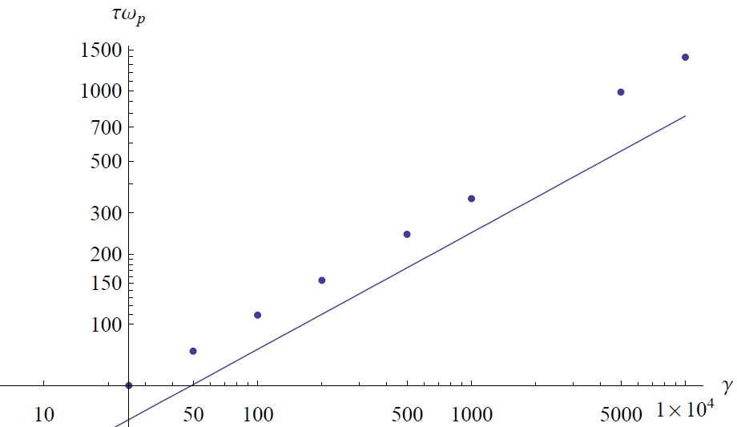
First Phase: Saturation Time
Saturation time τ_{s} simply reads
PIC

Slide 16
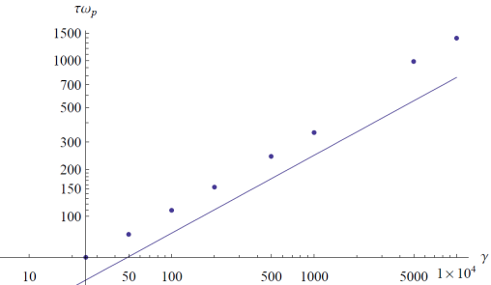
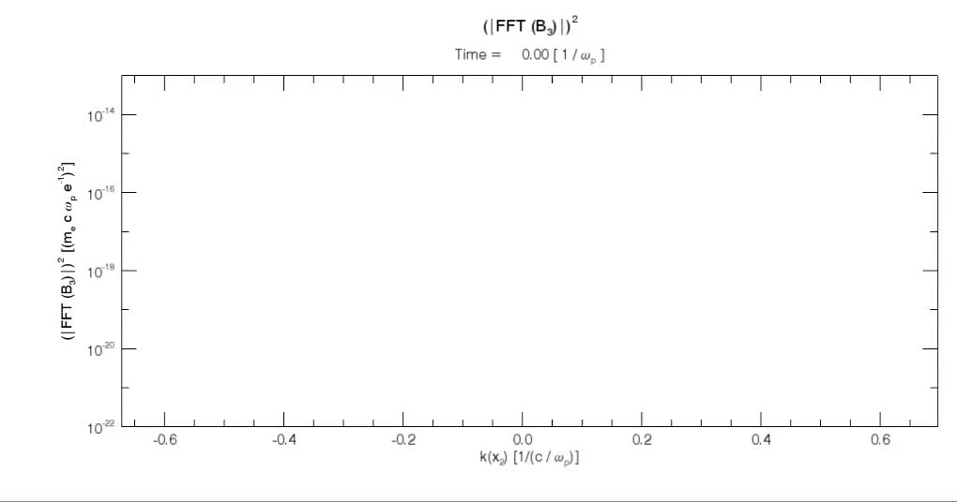
First Phase: Saturation Time
Not bad… but not good either
Possible issue 1:
  Delay before interaction
Evolution of the PIC noise from the beginning of the simulation
Wait before shells collide to avoid numerically low noise, ie, large τ_{s}.

Slide 17
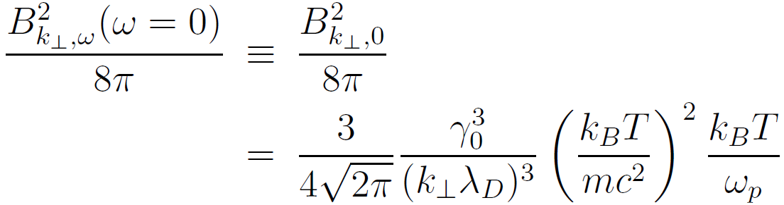
First Phase: Saturation Time
Not bad… but not good either
Possible issue 2:
  Start from noise at ω = 0 instead of integrating ?
  Can the instability select the amplified frequency?
  Yes, with an accuracy ω = 0 ± δ
  Laurent & Charles,
Delicate…

Slide 18
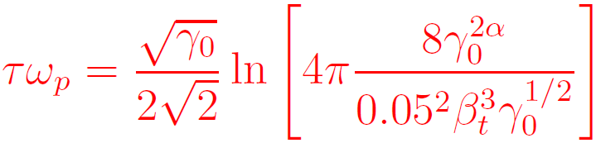
First Phase: Saturation Time
Not bad… but not good either
Possible issue 3:
  3D Theory, but 2D simulations
  Laurent & Charles, with noise at ω = 0 ± δ :
  Agreement slightly better. Still, weird at γ → ∞
3/2

Slide 19
Conclusion
Shock formation mechanism. How, When…
Two phases:
  Shells overlap and turn unstable. Instability saturates.
  Material piles up, + ?? = Shock.
Theory for first phase. On track.
Can we expect perfect agreement (Luis Silva)?
Stay tuned…
Thank you for your attention

Slide 20
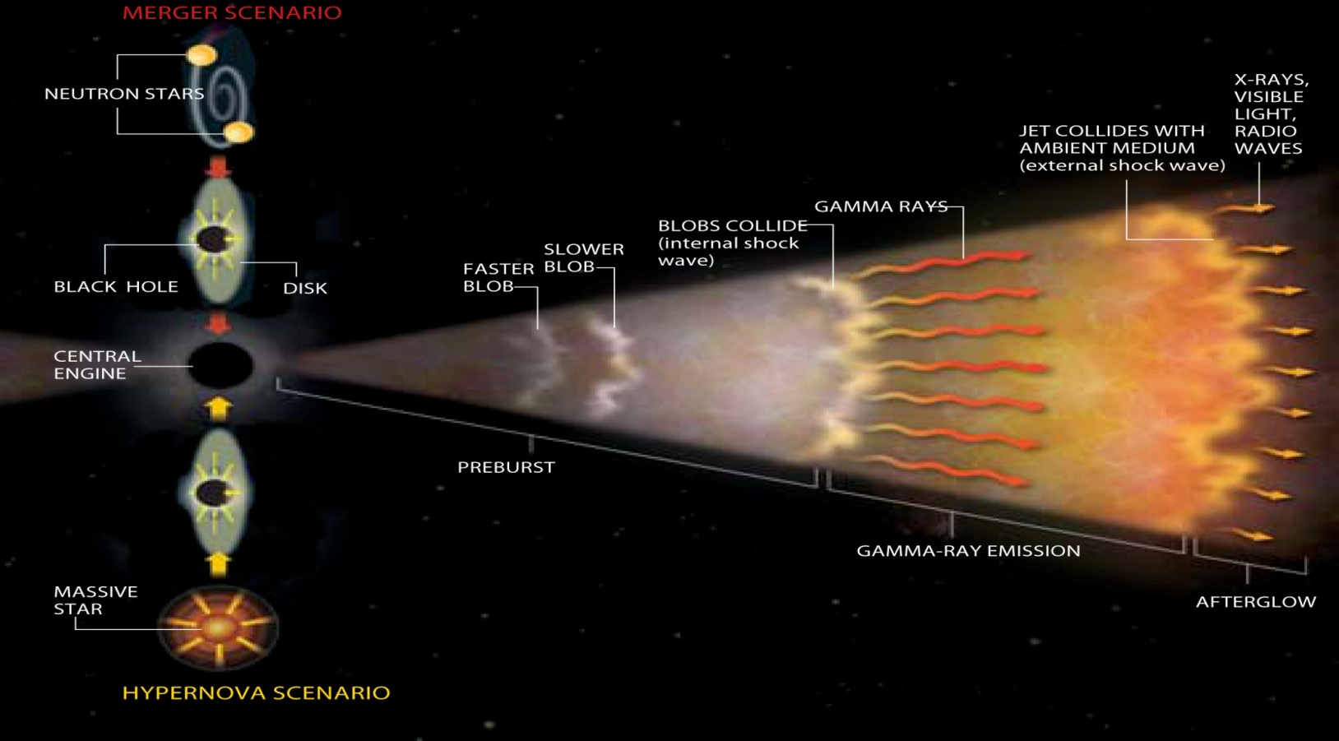
Motivation
Collisionless shocks are key fundamental processes
Role in Fireball Scenario for GRB’s and HECR’s
1
2
3
Plasma shells “collision”
Shock Formation - Collisionless
Particle acceleration: GRB

