Slide 1
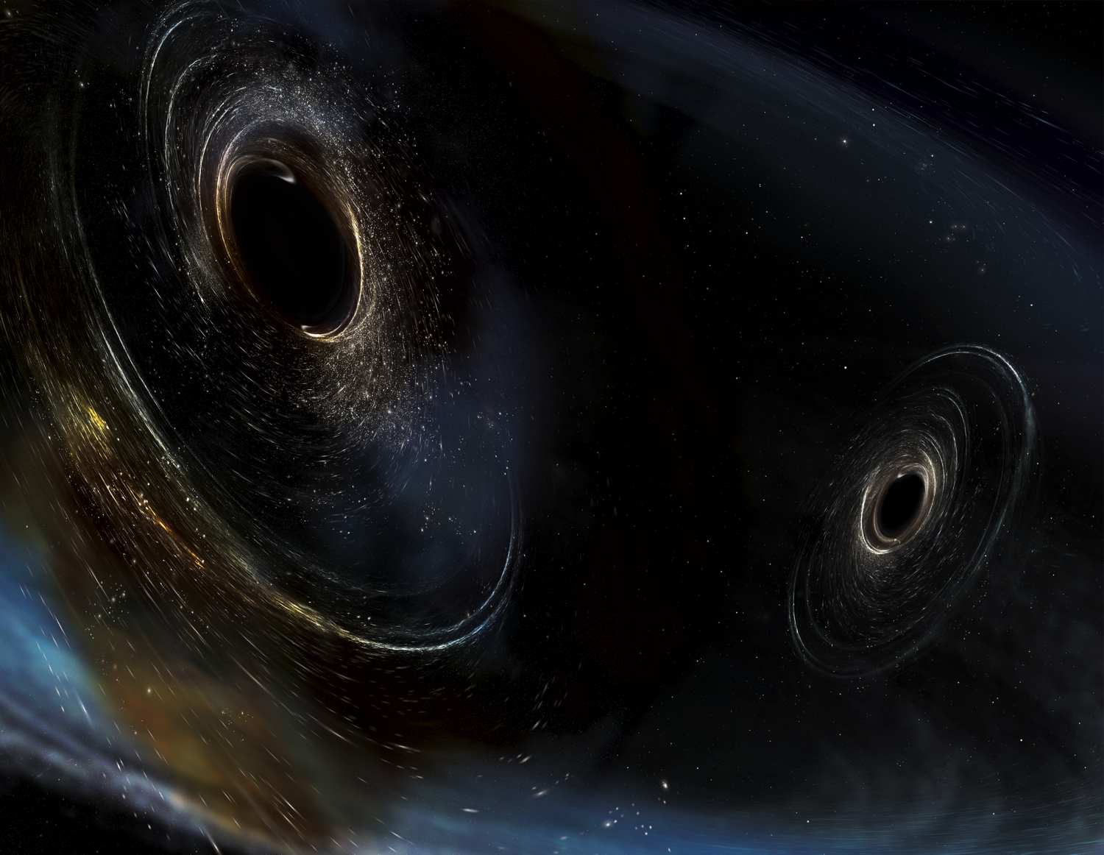


The Era of Gravitational-wave Astronomy, IAP, Paris, June 26, 2017
Ground-based Gravitational-wave Detectors: Prospects for the Future
David Reitze
Executive Director
LIGO Laboratory
For the LIGO Scientific Collaboration and Virgo Collaboration
LIGO-G1701183
Image Credit: Aurore Simmonet, Sonoma State

Slide 2
The Next Hour
Primer on Gravitational-wave Detectors
Advanced LIGO: Current Status
Advanced LIGO: Near Term Prospects
Beyond Advanced LIGO: The ‘A+’ Upgrade
Probing the Horizons of the Gravitational-wave Universe: Voyager & Cosmic Explorer

Slide 3
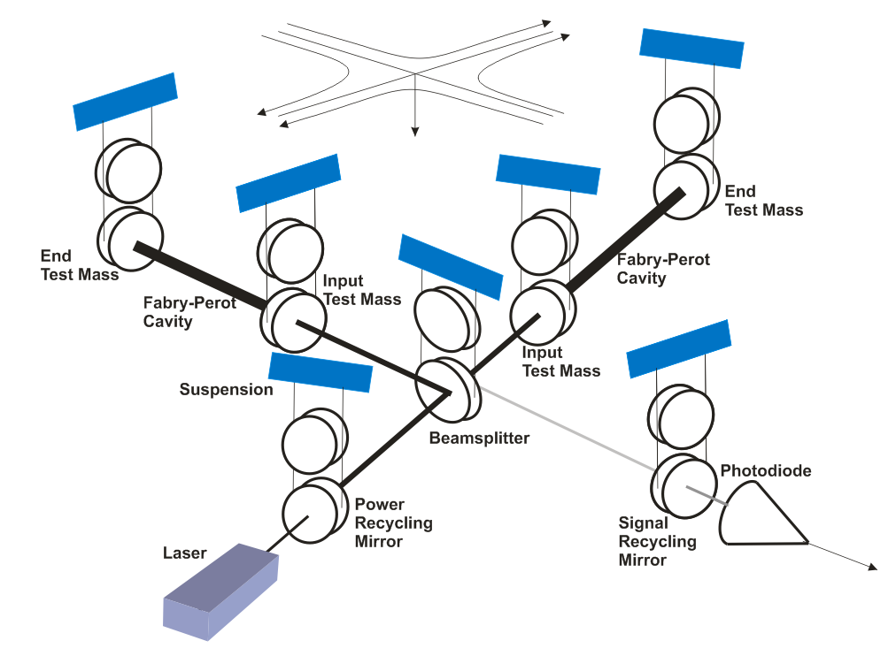
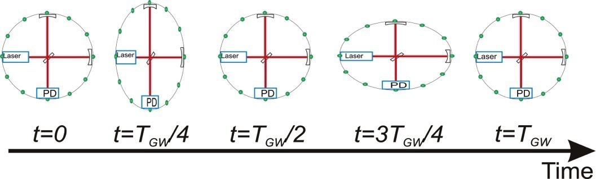
The Advanced LIGO Interferometer
Advanced LIGO uses enhanced Michelson interferometry
  suspended (‘freely falling’) mirrors
Passing GWs stretch and compress the distance between the end test mass and the beamsplitter
The interferometer acts as a transducer, turning GWs into photocurrent
  A coherent detector
Advanced LIGO
4 km
J. Aasi et al., (LIGO Scientific Collaboration and Virgo Collaboration), “Advanced LIGO” Classical Quantum Gravity 32, 074001 (2015).

Slide 4
The Advanced LIGO Interferometers
In air
In vacuum

Slide 5
The Advanced LIGO Interferometers
In air
In vacuum

Slide 6
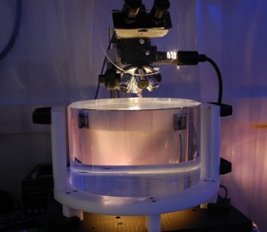
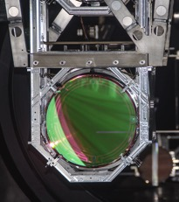
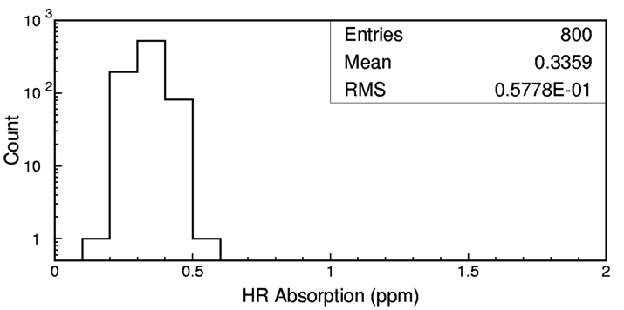
Advanced LIGO ‘Test Mass’ Mirrors
Truly the ‘crown jewels’ of the detector
Physical specifications:
  Ultra-pure, ultra-homogeneous fused silica
  340 mm diameter, 200 mm thick, 40 kg mass
Surface figure: super-polish followed by ion beam ‘spot’ polish
  < 0.15 nm RMS deviation from sphere
Coatings: TiO₂-doped Ta₂O₅/SiO₂
  Reflectivity depends upon type of mirror
  Ultralow absorption (< 0.5 ppm)
Notes:
Mention CSIRO

Slide 7
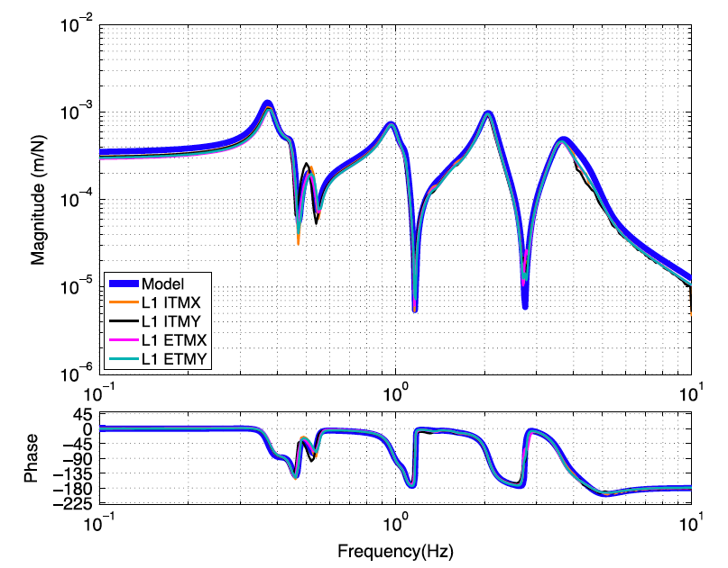
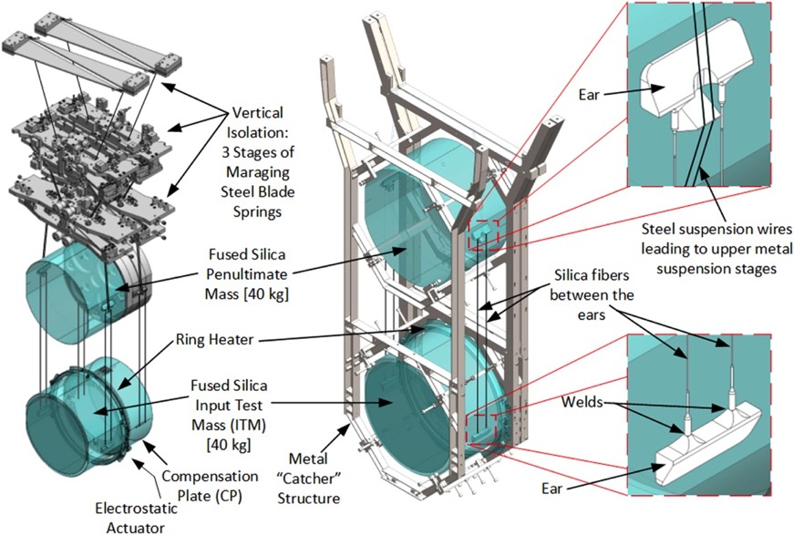
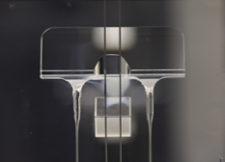
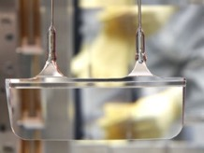
Advanced LIGO Suspensions:
A Tour-de-Force in Engineering
Force → Displacement
Transfer Function
Model vs. Measured
Concept:
Implementation:
Upper ‘ear’
Lower ‘ear’

Slide 8
Advanced LIGO:
Current Status

Slide 9
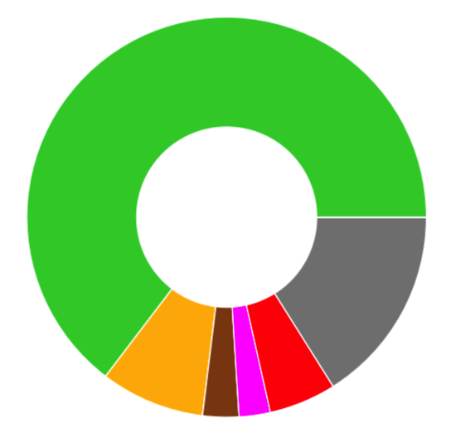
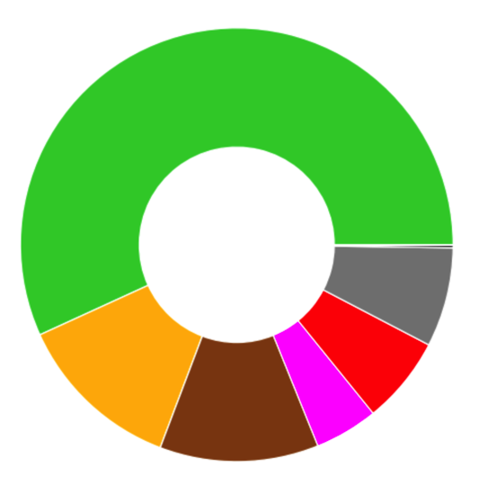
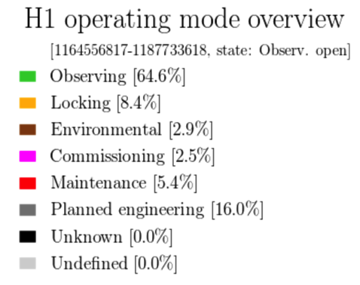
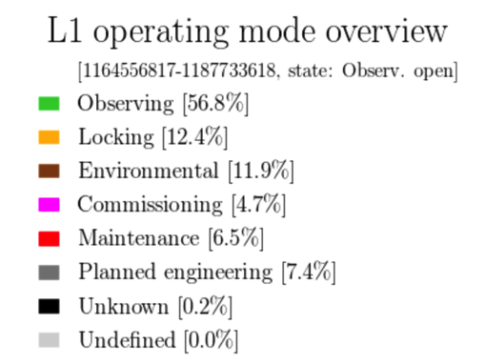
H1, L1 Uptime Dashboard
Hanford H1
Livingston L1

Slide 10
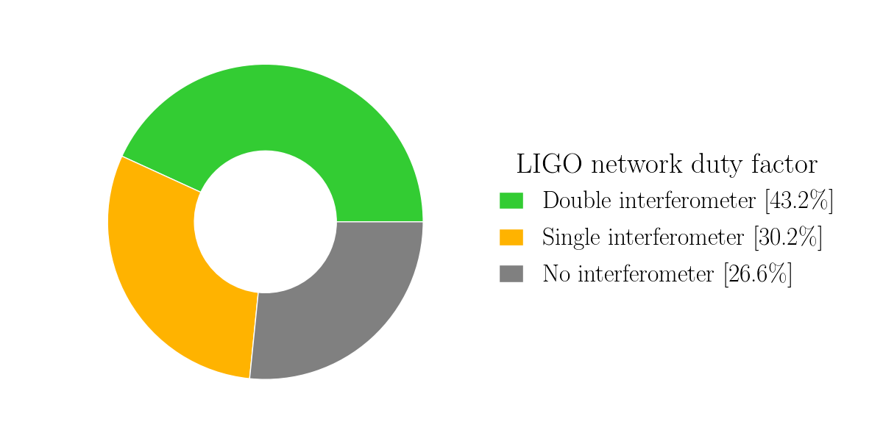
LIGO Network Duty Factor

Slide 11
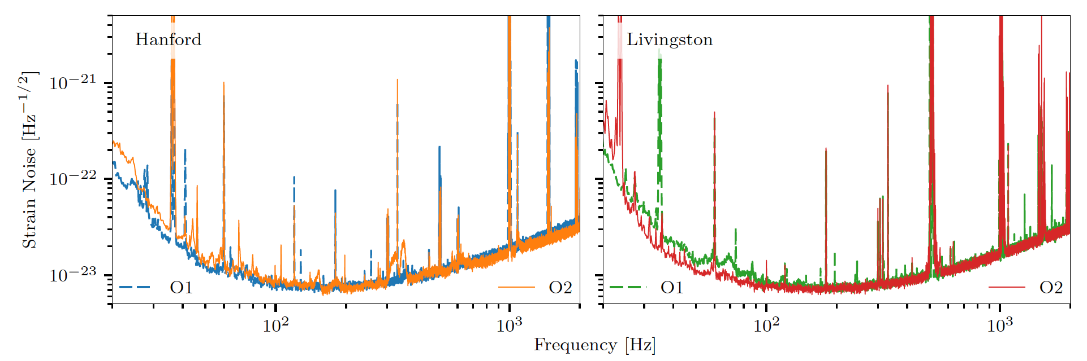
Comparison of Strain
Sensitivity: O1 vs. O2
  L1 detector is 30 – 40% more sensitive than in O1
    25 W laser power into the interferometer
      Limited by high power amplifier stage failure at LLO prior to O1
  H1 is slightly ~ 5 – 10% less sensitive
    30 W laser power; noise penalty at higher power related to input beam jitter
Hanford H1 Strain Sensitivity
Livingston L1 Strain Sensitivity

Slide 12
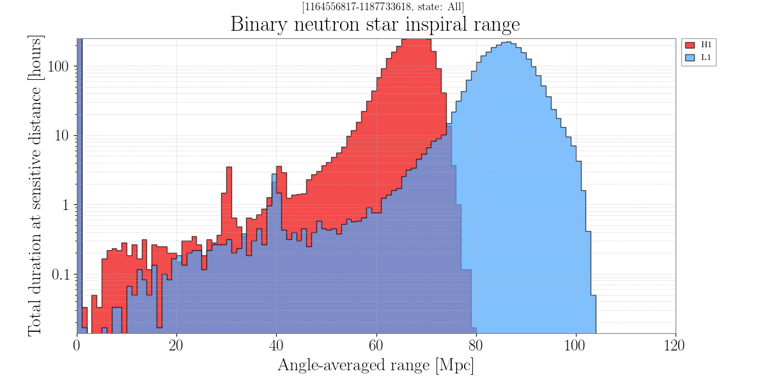
Binary Neutron Star Inspiral Range
Goal for O2: > 80 MPc BNS range for H1 and L1

Slide 13
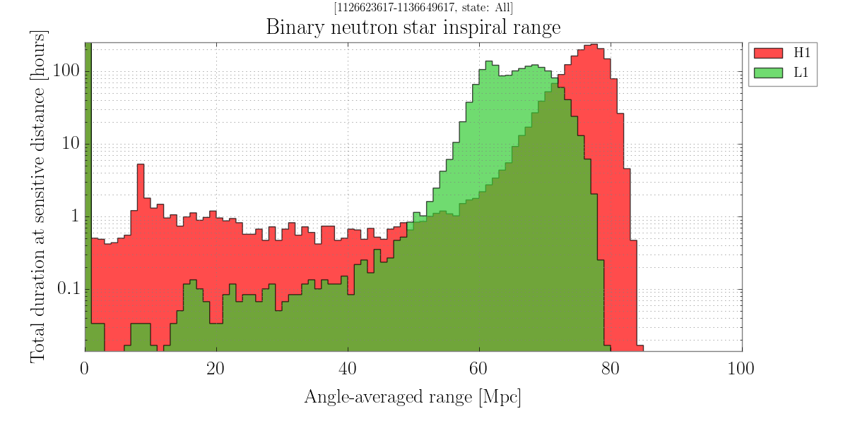
Binary Neutron Star Inspiral Range
Goal for O2: > 80 MPc BNS range for H1 and L1

Slide 14
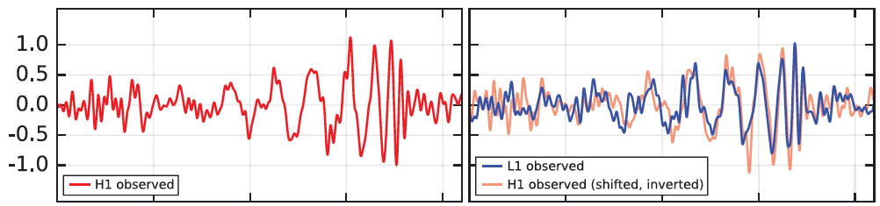

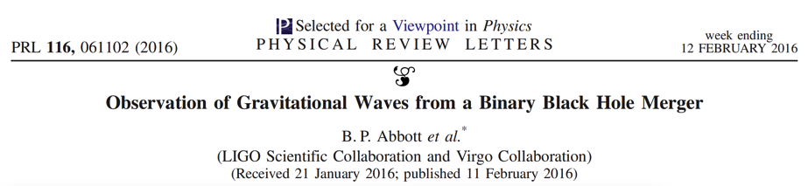
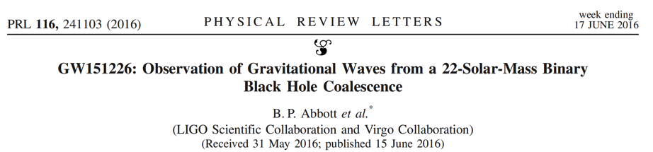
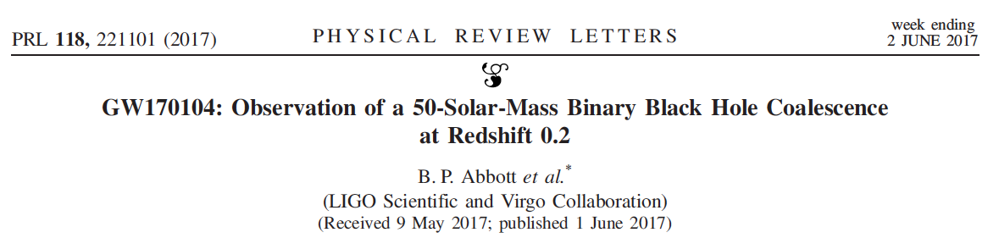
Nonetheless, LIGO is an Observatory!
GW150914
NEW RESULT!

Slide 15
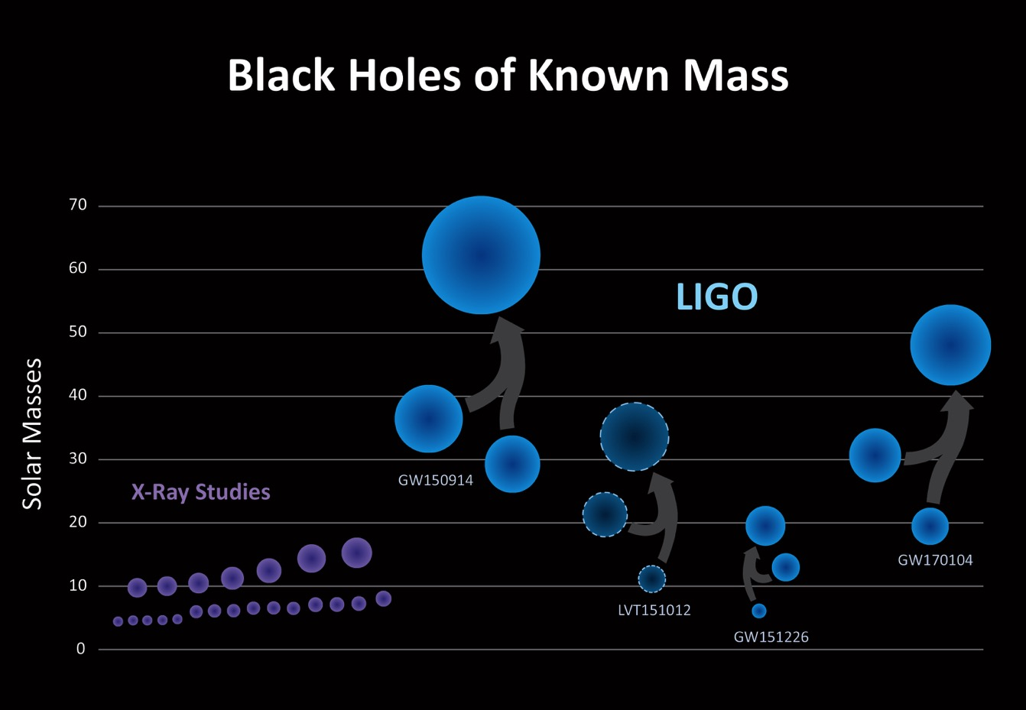
The Newest Black Hole Merger
asd
Reported June 1, 2017
Credit: Robert Hurt/Caltech, Aurore Simmonet, SSU

Slide 16
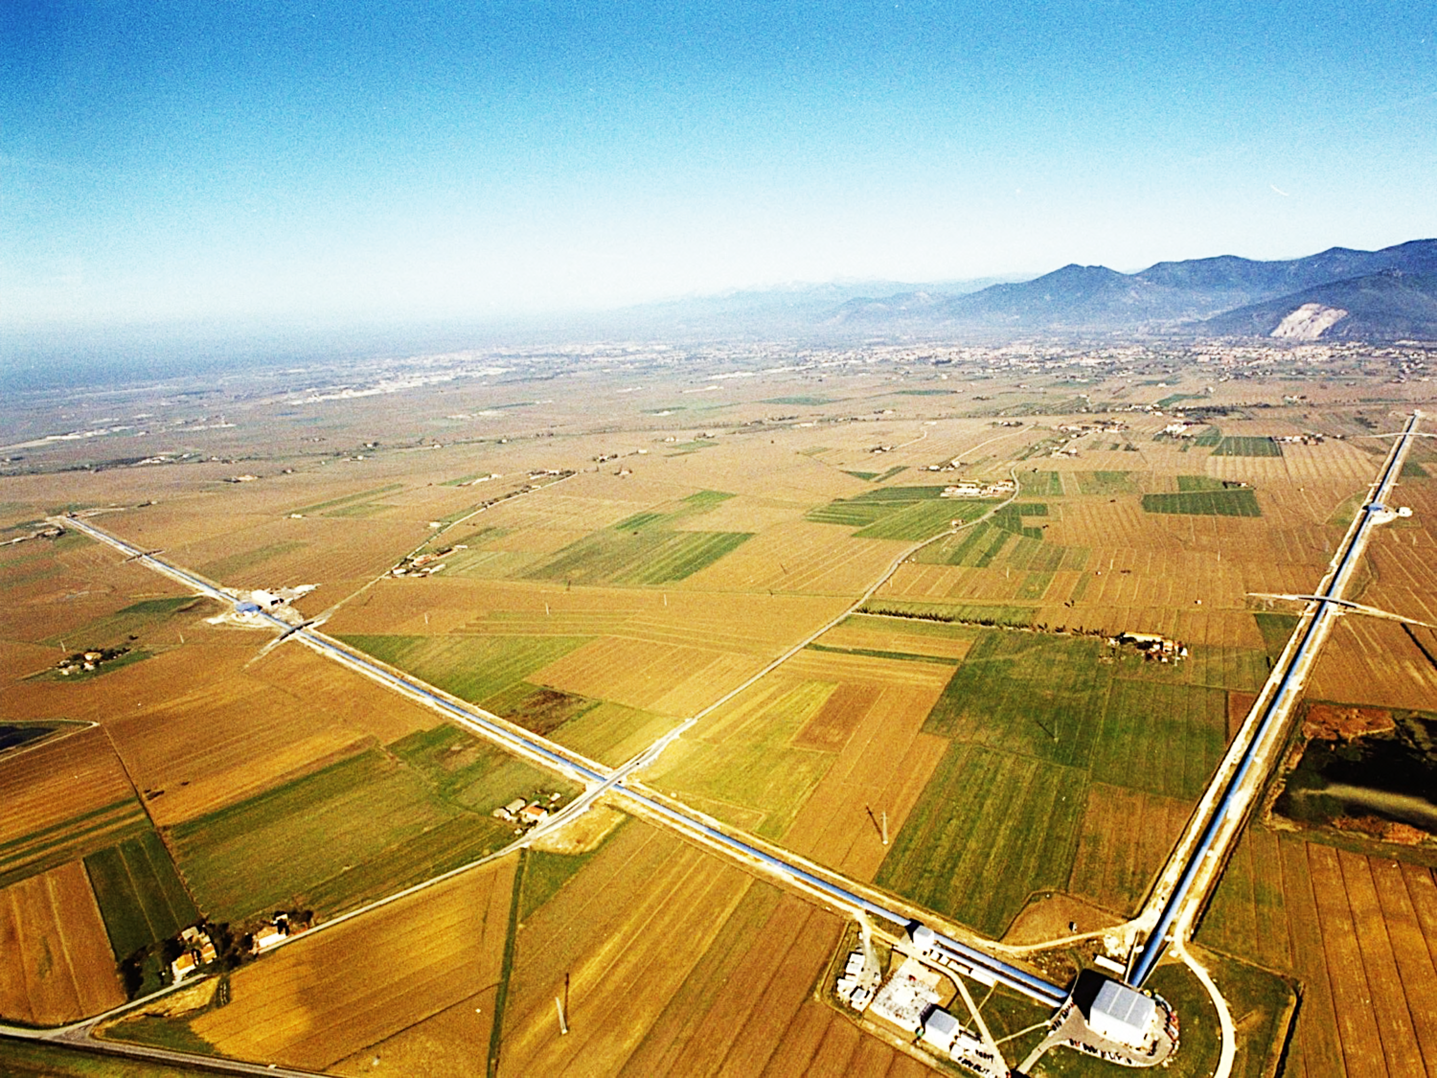







ADVANCED VIRGO
6 EU countries
20 labs, ~250 authors
APC Paris
ARTEMIS Nice
EGO Cascina
INFN Firenze-Urbino
INFN Genova
INFN Napoli
INFN Perugia
INFN Pisa
INFN Roma La Sapienza
INFN Roma Tor Vergata
INFN Trento-Padova
LAL Orsay – ESPCI Paris
LAPP Annecy
LKB Paris
LMA Lyon
NIKHEF Amsterdam
POLGRAW(Poland)
RADBOUD Uni. Nijmegen
RMKI Budapest
University of Valencia

Slide 17
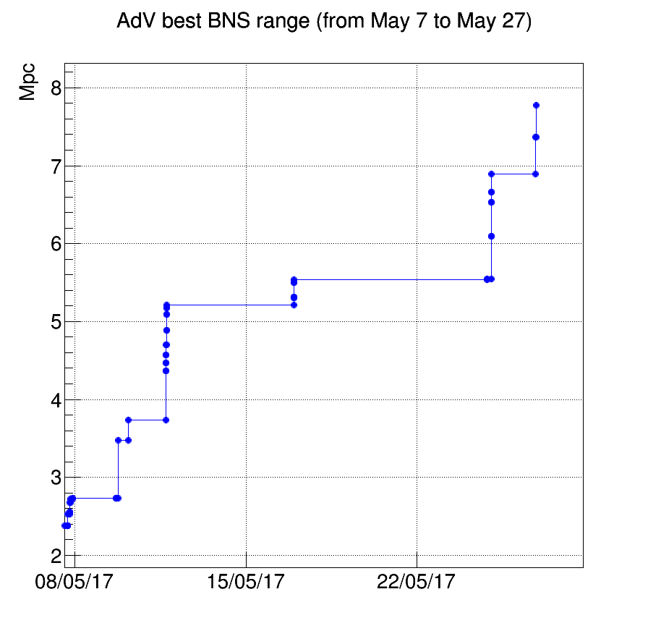
Virgo pathway to O2
Path to join O2 includes:
  Improve power recycling cavity (PRC) stability with thermal compensation (TCS)
  Suspend the detection bench (includes output photodiodes)
  Employ low noise actuation
  Make use of noise subtraction techniques
  Initiate weekend engineering/science runs
  Increase interferometer input power from 13W to 25W
  Noise hunting!

Slide 18
Advanced LIGO:
Near Term Prospects

Slide 19
Roadmap to
Design Sensitivity for Advanced LIGO
Roadmap developed in 2013 by the LIGO Scientific Collaboration
  Based on collective knowledge of LIGO’s Detector Science and Engineering Team at that time
B. E. Abbott, et al., “Prospects for Observing and Localizing Gravitational-Wave Transients with Advanced LIGO and Advanced Virgo”, Living Reviews in Relativity, https://link.springer.com/article/10.1007/lrr-2016-1

Slide 20
Slide Credit: Valera Frolov

Slide 21
?
Slide Credit: Valera Frolov

Slide 22
?
Coating Thermal Noise
Slide Credit: Valera Frolov

Slide 23
‘Rogues Gallery’ of Possible Noises
Bi-Linear coupling of length control system auxiliary loops to DARM
Bi-Linear coupling of angular sensing and control system noise (> 10 Hz)
Radiation pressure anomaly?
Laser frequency noise (~bilinear)
Laser amplitude noise (~bilinear)
Audio RAM from electro-optic modulators
Gas damping (between ERM and ETM)
Penultimate mass coil driver electronics
Correlated noise in output mode cleaner photodiodes
Magnetic fields (~RF and baseband)
Electric fields in main vacuum chambers
Audio band vacuum chamber motion
Downconversion of f > 100 kHz laser noise
‘Crackling’ mechanical noise in the blades of the test mass suspensions
Excess thermal noise in the suspension monolithic stage (ears/ fibers)
Auxiliary optics coating noise
Scattering from auxiliary vacuum chambers
Backscatter from the arm beamtubes
PUM coil driver electronics
Backscatter from the end stations
Upconversion of low frequency seismic motion
Pointing/Intensity noise of TCS lasers

Slide 24
‘Rogues Gallery’ of Possible Noises
Bi-Linear coupling of length control system auxiliary loops to DARM
Bi-Linear coupling of angular sensing and control system noise (> 10 Hz)
Radiation pressure anomaly?
Laser frequency noise (~bilinear)
Laser amplitude noise (~bilinear)
Audio RAM from electro-optic modulators
Gas damping (between ERM and ETM)
Penultimate mass coil driver electronics
Correlated noise in output mode cleaner photodiodes
Magnetic fields (~RF and baseband)
Electric fields in main vacuum chambers
Audio band vacuum chamber motion
Downconversion of f > 100 kHz laser noise
‘Crackling’ mechanical noise in the blades of the test mass suspensions
Excess thermal noise in the suspension monolithic stage (ears/ fibers)
Auxiliary optics coating noise
Scattering from auxiliary vacuum chambers
Backscatter from the arm beamtubes
PUM coil driver electronics
Backscatter from the end stations
Upconversion of low frequency seismic motion
Pointing/Intensity noise of TCS lasers

Slide 25
Major H1, L1
Work Planned for post-O2
Replace H1’s ITMX (excess absorption)
Squeezed Light injection at LLO
  Target is 3 dB of effective squeezing: equivalent to doubling the laser power
  LHO will get the hardware as well; install & commissioning TBD
Scattered Light Control improvements & additions
70 W laser amplifier stage
  LLO: allows doubling of O2 laser power
  LHO: plan to move from the HPO to a 70 W amplifier as well
Replace End Reaction Masses w/ Annular versions
  Squeezed film damping; possibly electro-static charge
  May also replace End Test Masses
Monolithic Signal Recycling Mirrors
  Remove several kHz peak in DARM; lower frequency impact?

Slide 26
The Road to O3 ‘Late aLIGO’
4 – 7 months
70 W amp
LLO
Corner volume: scattered light baffles, new SRM, etc
Commissioning with higher power & squeezed light
Gate valve repair
Commissioning
to O3
O2 end
Squeezed light upgrade
ERM & ETM replacement
months
September 2017
0
1
2
3
4
5
6
7
Corner volume: new ITM, scattered light baffles, new SRM,
HAM5 SQZ, etc
ERM & ETM replacement
Commissioning
to start of O3
LHO
Squeezed light upgrade: in-air table; electronics; vacuum OPO
70 W amp
5 – 8
months
Cryo-pump decommissioning

Slide 27
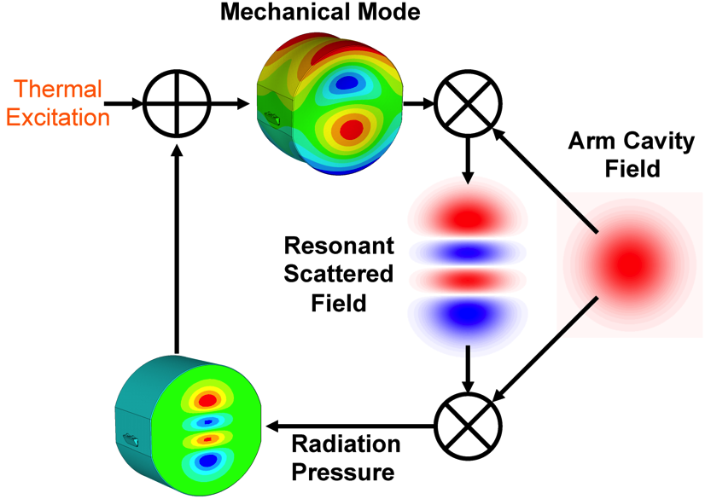
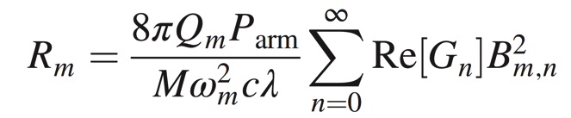
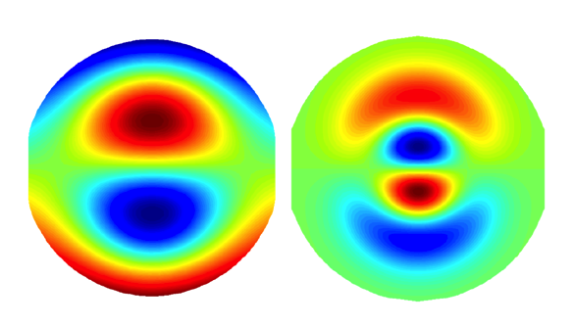
Problems with High Laser Power:
Parametric Instability
mechanical mode
Q-factor
power in the
arm cavity
Parametric Gain:
spatial overlap
Optical-mechanical mode
Mirror
mass
Acoustic mode
frequency
optical mode
gain
Acoustic mode Optical mode
f_{m} = 15,539 Hz
Theory: V. B. Braginsky, S. E. Strigin, and S. P. Vyatchanin, Phys. Lett. A 305, 111 (2002)
Experiment: C. Zhao, L. Ju, J. Degallaix, S. Gras, and D. G. Blair,
Phys. Rev. Lett. 94, 121102 (2005); M. Evans, et al., “Observation of Parametric Instability in Advanced LIGO”, Phys. Rev. Lett. 114, 161102 (2015).

Slide 28
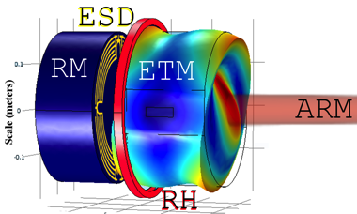
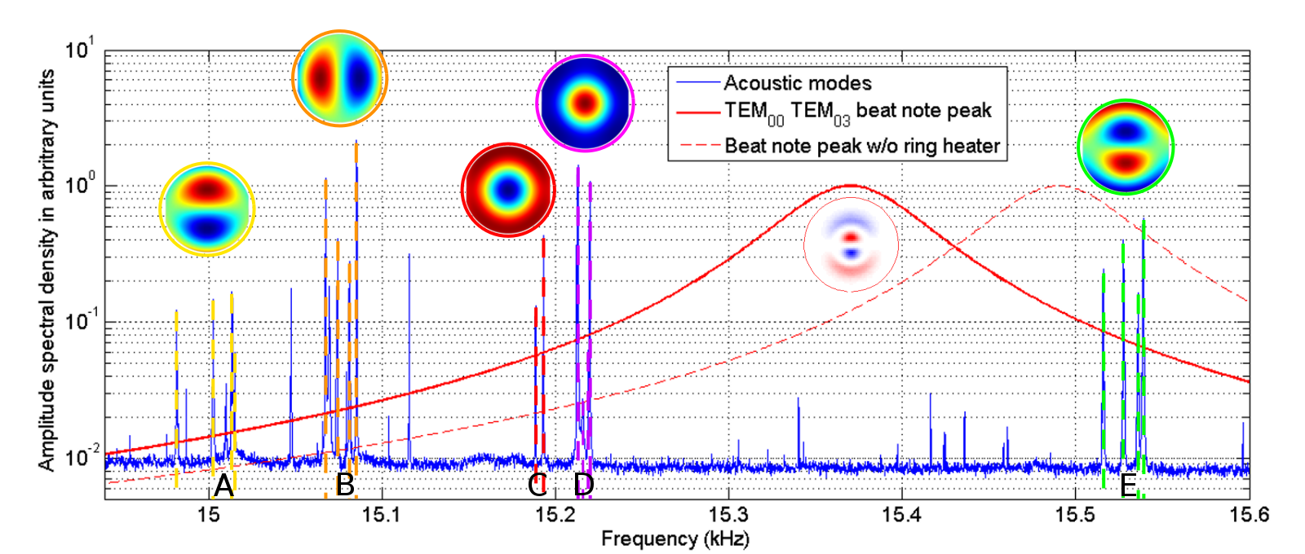
Passive Damping of
Parametric Instabilities
Thermal tuning of the Test Mass Radii of Curvature
LLO: ring heaters tuned to ‘sweet spot’ (low PI mode density)
Slide Credit: Terra Hardwick

Slide 29
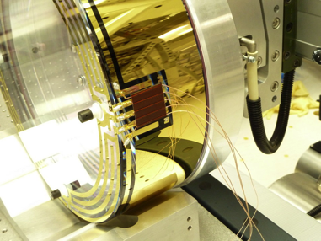
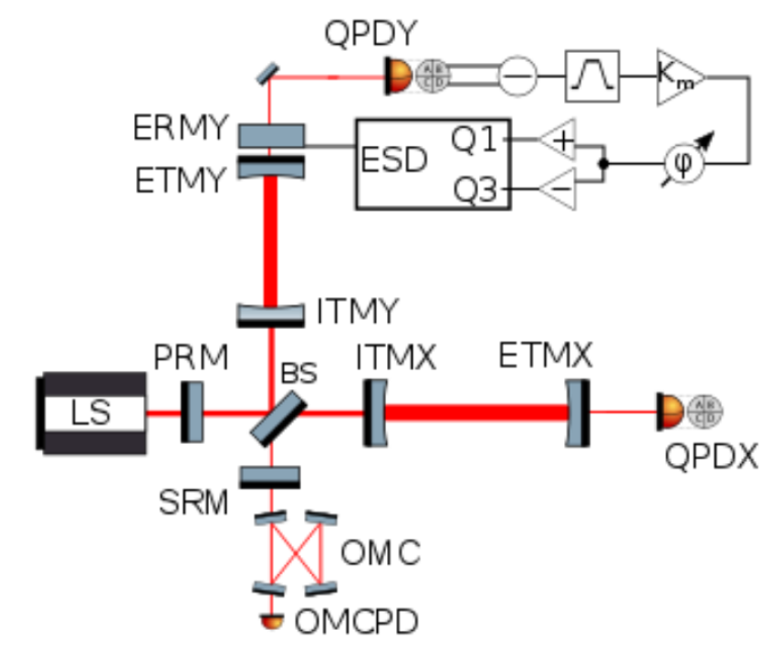
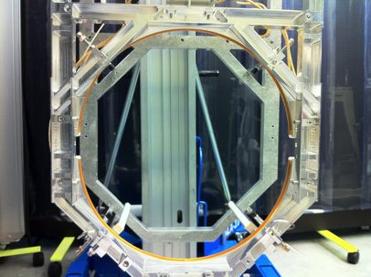
Active Damping of Parametric Instabilities
End Reaction Mass (X, Y arms)
Active Electrostatic Damping of PI modes
Passive Thermal Tuning of the Mirror
Radii of curvature via Ring Heater
In O2, 4 modes are actively damped (130 kW in the arm cavities)
At 50 W, 10 modes are actively damped (200 kW in the arm cavities)
Challenge: Going beyond 200 kW will require new methods (passive acoustic mass dampers)

Slide 30
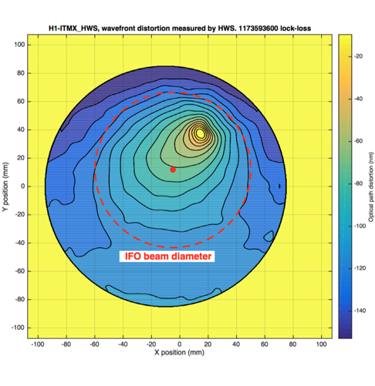
H1’s ITM-X: Excess Absorption
March 2017: discovered small absorber on H1’s ITM-X high reflecting surface
60 nm distortion over 20 mm
Hartman wavefront sensor image
Small absorber, ~ 15 mW absorbed (out of 130 kW arm power)
Results in phase front distortion negatively impacting:
RF sideband build-up
Alignment sensing
Noise couplings
Higher-order mode jitter
Vented in May 2017 to inspect and clean
Absorber remained, so ITMX replacement is being planned for post-O2
Slide Credit:
Peter Fritschel

Slide 31


Quantum Engineering
‘Squeezed’ Light for O3
Electromagnetic fields are quantized:
Quantum fluctuations exist in the vacuum state:
H. P. Yuen, Phys. Rev. A13, 2226 (1976)
C. M. Caves, Phys. Rev. D26, 1817 (1982)
Wu, Kimble, Hall, Wu, PRL (1986)
Main Laser
Coherent State
PLL
Amplitude squeezing
Faraday
Isolator
Squeezed Vacuum
Source
Squeezed Vacuum
State
│E │
x₂
Phase
squeezing
Photodiode
ϕ
x₁
Notes:
Two demonstrations of squeezing!

Slide 32
Quantum Engineering
‘Squeezed’ Light for O3
Electromagnetic fields are quantized:
Quantum fluctuations exist in the vacuum state:
H. P. Yuen, Phys. Rev. A13, 2226 (1976)
C. M. Caves, Phys. Rev. D26, 1817 (1982)
Wu, Kimble, Hall, Wu, PRL (1986)
Main Laser
Coherent State
PLL
Amplitude squeezing
Faraday
Isolator
Squeezed Vacuum
Source
Squeezed Vacuum
State
│E │
x₂
Phase
squeezing
Photodiode
ϕ
x₁
Notes:
Two demonstrations of squeezing!

Slide 33
Quantum Engineering
‘Squeezed’ Light for O3
Electromagnetic fields are quantized:
Quantum fluctuations exist in the vacuum state:
H. P. Yuen, Phys. Rev. A13, 2226 (1976)
C. M. Caves, Phys. Rev. D26, 1817 (1982)
Wu, Kimble, Hall, Wu, PRL (1986)
3.5 dB squeezing
(1.5X reduced noise)
Typical noise without squeezing
Squeezing-enhanced sensitivity
Coherent State
Amplitude squeezing
│E │
2.1 dB squeezing
(1.27X reduced noise)
Phase
squeezing
ϕ
Aasi, et al., (LIGO Scientific Collaboration), Nature Physics, 7, 962 (2011); Nature Photonics 7 613 (2013).
Notes:
Two demonstrations of squeezing!

Slide 34
Squeezed Light Sensitivity Improvement
PRELIMINARY
x2 Higher power
or
3 dB squeezing
x2 Higher power + squeezing
No further reduction of low frequency noise assumed in this plot
Slide Credit:
Peter Fritschel

Slide 35
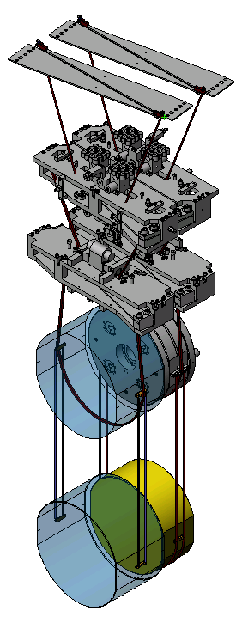
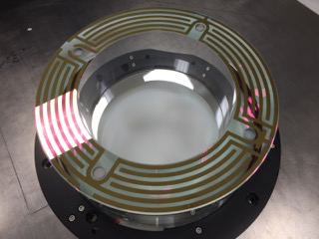
Annular End Reaction Masses
The current end reaction masses are solid cylinders
  Gap spaced 5 mm from the end test mass
‘Squeezed film’ gas damping is non-negligible
  Will be a limit assuming existing tank pressure; but could be a limiting noise source now
Annular ERM
Same electro-static force as current ERM
Slide Credit:
Peter Fritschel

Slide 36
Beyond Advanced LIGO:
The A+ Upgrade
2020-2025

Slide 37
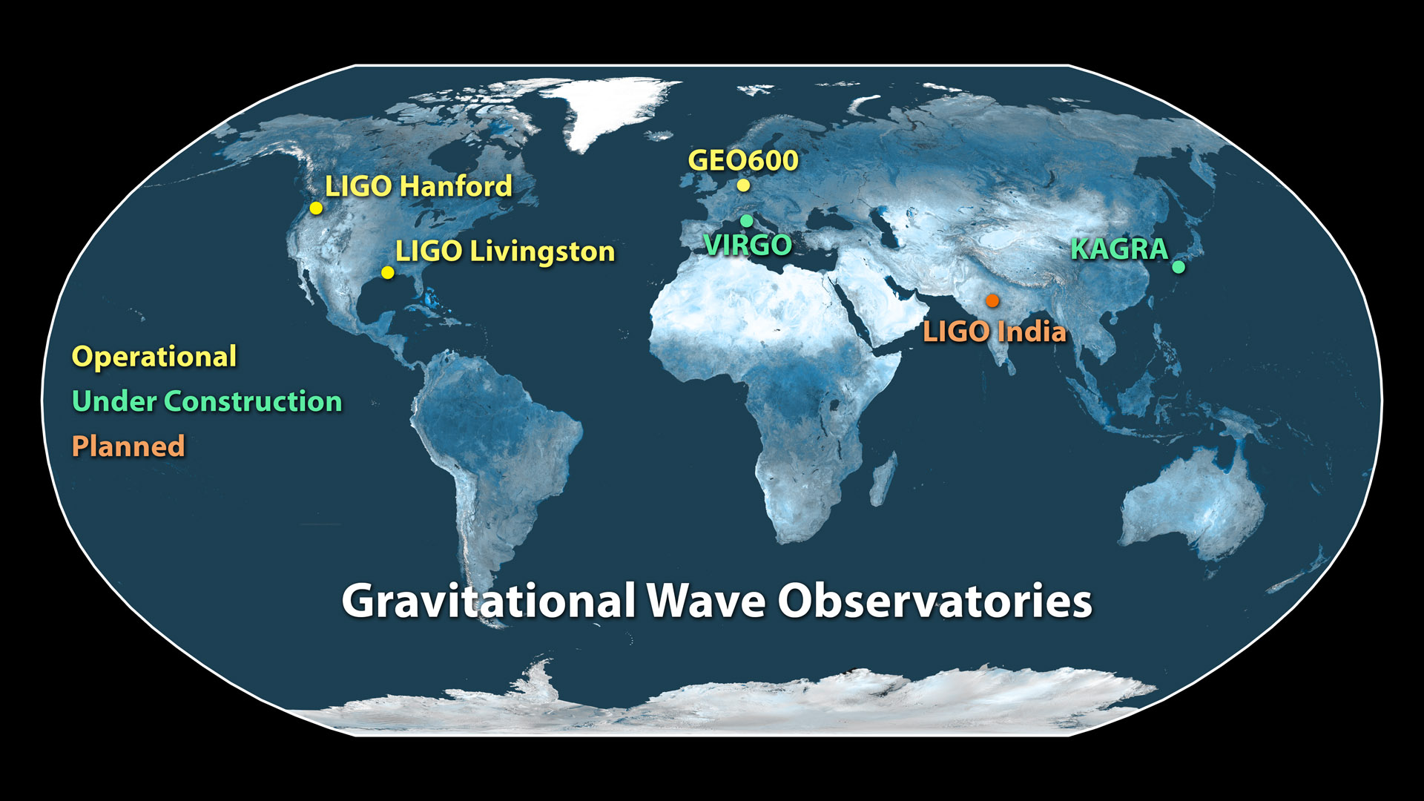
Approved!

Slide 38
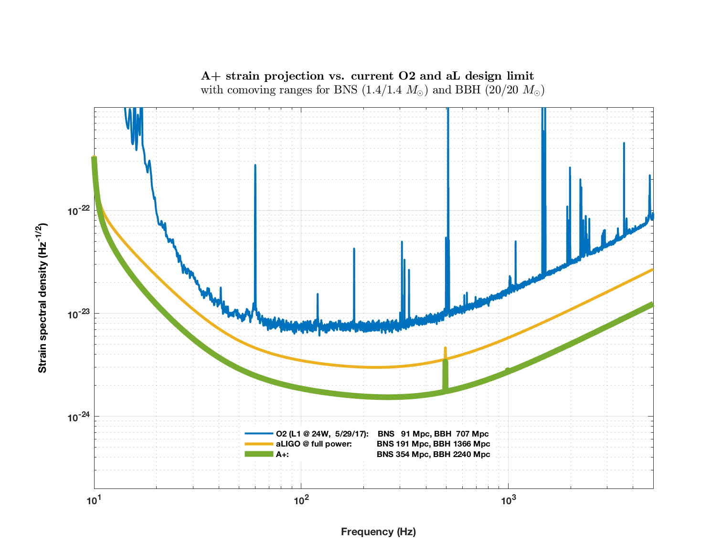
A+: a Mid-Life Enhancement for
Advanced LIGO
Near term: ‘A+’, a mid-scale upgrade of Advanced LIGO
  Improvements across all bands
Projected time scale for A+ operation: 2023 - 2025

Slide 39
Why A+?
An incremental upgrade to aLIGO that can happen in the next 5-7 years
A+ leverages existing technology and infrastructure, with minimal new investment, and moderate risk
Target improvement: factor of 1.7* increase in range over aLIGO
About a factor of 5 greater CBC event rate
Stepping stone to 3G detector technology
Can be observing within 5 years (possibly late 2022)
“Scientific breakeven” within 1/2 year of operation
Incremental cost: a small increment of the aLIGO cost
*BBH 20/20 M: 1.64x
*BNS 1.4/1.4 M: 1.85x

Slide 40
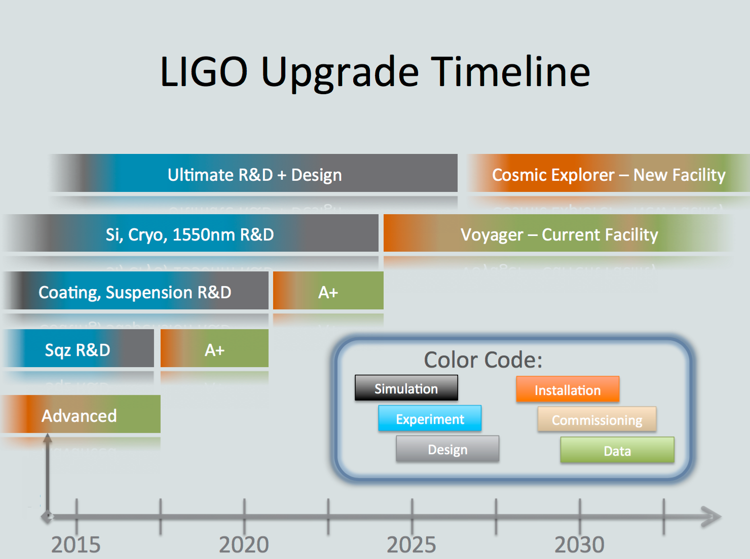
Conceptual
LSC Instrument Science White Paper 2016-2017, LIGO-T1600119–v4
  q
(b)
(a)
Today

Slide 41
Summary of Major A+ Upgrades
Coherent State
Key A+ parameters:
Frequency-dependent squeezing
  Phase squeezing at high frequencies; amplitude squeezing at low frequencies
12dB injected squeezing
  15% readout loss
100 m filter cavity
  20 ppm round trip filter cavity loss
Coating thermal noise half of aLIGO
Amplitude squeezing
│E │
Phase
squeezing
ϕ
Oelker, et al., “Audio-band Frequency-dependent Squeezing”, Phys. Rev. Lett. 116, 041102 (2016).

Slide 42
Summary of Major A+ Upgrades
Coherent State
Key A+ parameters:
Frequency-dependent squeezing
  Phase squeezing at high frequencies; amplitude squeezing at low frequencies
12dB injected squeezing
  15% readout loss
100 m filter cavity
  20 ppm round trip filter cavity loss
Coating thermal noise half of aLIGO
Amplitude squeezing
│E │
Phase
squeezing
ϕ
Oelker, et al., “Audio-band Frequency-dependent Squeezing”, Phys. Rev. Lett. 116, 041102 (2016).

Slide 43
What can be improved? aLIGO limiting noise at full power
ALIGO Parameters:
Laser Power: 125.00 Watt
SRM Detuning: 0.00 degree
SRM transmission: 0.3500
ITM transmission: 0.0140
PRM transmission: 0.0300
Finesse: 446.41
Power Recycling Factor: 40.54
Arm power: 710.81 kW
Power on beam splitter: 5.07 kW
Thermal load on ITM: 0.385 W
Thermal load on BS: 0.051 W
ALIGO Astrophysics:
BNS range: 191.04 Mpc (comoving)
BNS horizon:436.32 Mpc (comoving)
BNS reach: 272.08 Mpc (comoving)
BBH range: 1.37 Gpc (comoving, z = 0.3)
BBH horizon: 3.24 Gpc (comoving, z = 0.9)
BBH reach: 2.12 Gpc (comoving, z = 0.5)
Stochastic Omega: 2.42e-09
Slide Credit:
Mike Zucker

Slide 44
..plus squeezing with
~100m scale filter cavity
A+ Parameters with Squeezing:
Laser Power: 125.00 Watt
SRM Detuning: 0.00 degree
SRM transmission: 0.3500
ITM transmission: 0.0140
PRM transmission: 0.0300
Finesse: 446.41
Power Recycling Factor: 40.54
Arm power: 710.81 kW
Power on beam splitter: 5.07 kW
Thermal load on ITM: 0.385 W
Thermal load on BS: 0.051 W
A+ Astrophysics with Squeezing:
BNS range: 258.72 Mpc (comoving)
BNS horizon: 592.49 Mpc (comoving)
BNS reach: 370.29 Mpc (comoving)
BBH range: 1.74 Gpc (comoving, z = 0.4)
BBH horizon: 4.14 Gpc (comoving, z = 1.3)
BBH reach: 2.77 Gpc (comoving, z = 0.5)
Stochastic Omega: 9.32e-10
Slide Credit:
Mike Zucker

Slide 45
..plus coating thermal noise reduction
A+ Parameters with Squeezing/CTN:
Laser Power: 125.00 Watt
SRM Detuning: 0.00 degree
SRM transmission: 0.3500
ITM transmission: 0.0140
PRM transmission: 0.0300
Finesse: 446.41
Power Recycling Factor: 40.54
Arm power: 710.81 kW
Power on beam splitter: 5.07 kW
Thermal load on ITM: 0.385 W
Thermal load on BS: 0.051 W
A+ Astrophysics with Squeezing/CTN:
BNS range: 354.06 Mpc (comoving)
BNS horizon: 814.04 Mpc (comoving)
BNS reach: 510.28 Mpc (comoving)
BBH range: 2.24 Gpc (comoving, z = 0.6)
BBH horizon: 4.14 Gpc (comoving, z = 2.1)
BBH reach: 2.77 Gpc (comoving, z = 1.1)
Stochastic Omega: 6.78e-10
Slide Credit:
Mike Zucker

Slide 46
Challenge: Thermal Noise in Optical Coatings
ω₀
Δx
Y. Levin Phys. Rev.
D 57 659 (1998)
<Δx(ω)>²
low Q
signal
band
∝ 1/Q
high Q
ω /ω₀
Simple picture: kT of energy per mechanical mode, viscous damping
For coating dominated noise and structural damping:
coating thickness
coating elastic loss
beam radius
Compare: Bulk Silica φ ~ 10⁻⁶-10⁻⁸
Slide Credit:
Marty Fejer

Slide 47
Probing the Horizons of the Gravitational-wave Universe:
Voyager & Cosmic Explorer
2025 - 2035+

Slide 48
Conceptual
LSC Instrument Science White Paper 2016-2017, LIGO-T1600119–v4
  q
(b)
(a)
Today

Slide 49
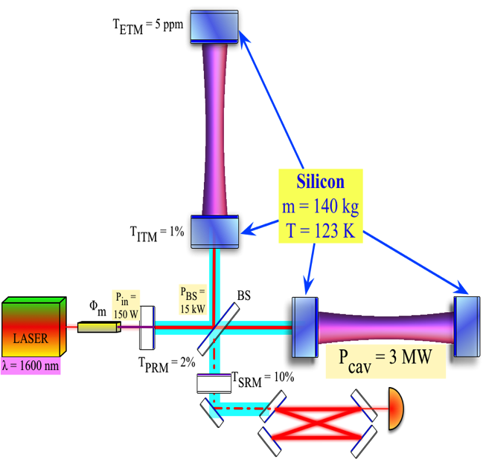
LIGO Voyager:
Fully Exploiting the Current LIGO Facilities
Si optics, > 100 kg
Si or AlGaAs coatings
(Mildly) Cryogenic
λ~2 µm, 300 W
BNS Range = 740 Mpc
aLIGO
Voyager
BNS R < 800 Mpc
BBH z < 5 (@10 M)
~100M$
https://dcc.ligo.org/LIGO-T1400226,
https://dcc.ligo.org/LIGO-T1200031,
https://dcc.ligo.org/LIGO-T1200099
https://dcc.ligo.org/LIGO-T1600140

Slide 50
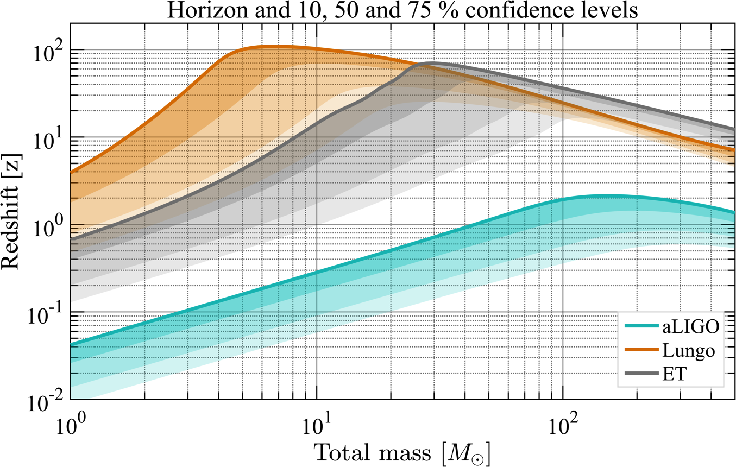
Einstein Telescope, Cosmic Explorer:
New Observatories
Cost ~ G$/G€
First Stars Formed
High SNR Signals!
CE
BNS
NSBH
BBH
POP3?
T1600140;T1500491;
P1400147; ET-0106C-10

Slide 51
How to Get From Here to There?
GWIC (Gravitational Wave International Committee)
Body formed in 1997 to facilitate international collaboration and cooperation in the construction, operation and use of the major gravitational wave detection facilities world-wide
Affiliated with the International Union of Pure and Applied Physics
  From 1999 until 2011, GWIC was recognized as a subpanel of PaNAGIC (IUPAP WG.4).
  In 2011, GWIC was accepted by IUPAP as a separate Working Group (WG.11).
Links to the:
International Astronomical Union (IAU)
International Society for General Relativity and Gravitation (ISGRG)

Slide 52
Who is GWIC?
The membership of GWIC represents all of the world’s active gravitational wave projects*, as well as other relevant communities, covering gravitational wave frequencies from nanohertz to kilohertz. Each project has either one or two members on GWIC depending on size.
ACIGA Bram Slagmolen
AURIGA Massimo Cerdonio
Einstein Telescope Michele Punturo
European Pulsar Timing Array Michael Kramer
GEO 600 Karsten Danzmann, Sheila Rowan (Chair)
IndIGO Bala Iyer
KAGRA Yoshio Saito, Takaaki Kajita
LIGO Dave Reitze, David Shoemaker
LISA Neil Cornish, Bernard Schutz,
Ira Thorpe, Stefano Vitale,
*no CMB community membership
NANOGrav Xavier Siemens
NAUTILUS Eugenio Coccia
Parkes Pulsar Timing Array George Hobbs
Spherical Acoustic detectors Odylio Aguiar
Theory Community Clifford Will
Virgo Fulvio Ricci, Jean-Yves Vinet
IUPAP AC2 (ISGRG) Beverly Berger
IAU D1 Vacant
Executive secretary : David Shoemaker
Co- secretary: Stan Whitcomb

Slide 53
GWIC’s role in coordinating 3G detector development
GWIC Subcommittee on Third Generation Ground-based Detectors
GWIC subcommittee purpose and charge:
With the recent first detections of gravitational waves by LIGO and Virgo, it is both timely and appropriate to begin seriously planning for a network of future gravitational-wave observatories, capable of extending the reach of detections well beyond that currently achievable with second generation instruments.
The GWIC Subcommittee on Third Generation Ground-based Detectors is tasked with examining the path to a future network of observatories/facilities

Slide 54
Membership
Co-Chairs: Michele Punturo – ET/David Reitze - LIGO
Federico Ferrini – European Gravitational Observatory
Takaaki Kajita - KAGRA
Vicky Kalogera – Northwestern (co-opted)
Harald Lueck, AEI (co-opted)
Jay Marx, LIGO (co-opted)
David McClelland, ACIGA (co-opted)
Sheila Rowan - GWIC Chair
Bangalore Sathyaprakash – Penn State (co-opted)
David Shoemaker – Executive Secretary

Slide 55
Goals
Science Drivers for 3G detectors: (Kalogera, Sathyaprakash + subcommittee)
commission a study of ground-based gravitational wave science from the global scientific community, investigating potential science vs architecture vs. network configuration vs. cost trade-offs, recognizing and taking into account existing studies for 3G projects (such as ET) as well as science overlap with the larger gravitational-wave spectrum.
2) Coordination of the Ground-based GW Community: (Lueck, McClelland + subcommittee
develop and facilitate coordination mechanisms among the current and future planned and anticipated ground-based GW projects, including identification of common technologies and R&D activities as well as comparison of the specific technical approaches to 3G detectors. Possible support for coordination of 2G observing and 3G construction schedules.
3) Networking among Ground-based GW Community: (Punturo, Reitze)
organize and facilitate links between planned global 3G projects and other relevant scientific communities, including organizing:
town hall meetings to survey the community
dedicated sessions in scientific conferences dedicated to GW physics and astronomy
focused topical workshops within the relevant communities

Slide 56
Goals (cont’d)
4) Agency interfacing and advocacy: (Rowan)
identify and establish a communication channel with funding agencies who currently or may in the future support ground-based GW detectors; communicate as needed to those agencies officially through GWIC on the scientific needs, desires, and constraints from the communities and 3G projects (collected via 1) – 3) above) structured in a coherent framework; serve as an advocacy group for the communities and 3G projects with the funding agencies.
5) Investigate governance schemes: (Ferrini, Marx + subcommittee)
by applying knowledge of the diverse structures of the global GW community, propose a sustainable governance model for the management of detector construction and joint working, to support planning of 3rd generation observatories.
The subcommittee should provide a preliminary report and set of proposed actions recommendations to GWIC no later than the 2017 GWIC meeting.
Subsequent reports should be delivered future GWIC meetings.

Slide 57
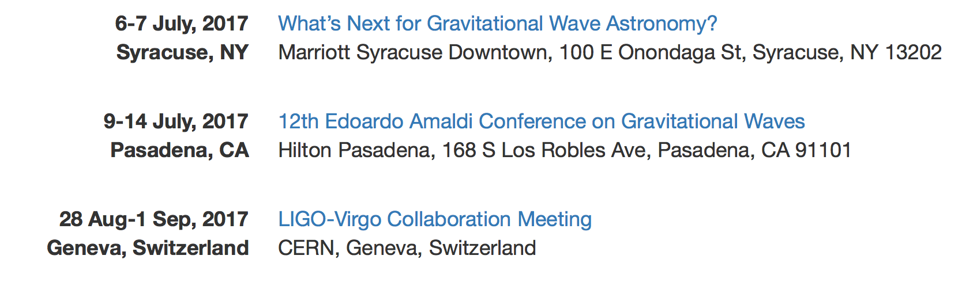
Upcoming Near Term Meetings of Interest
The committee will need your input and help to develop
the proper path forward!
gwic-3g@sympa.ligo.org

Slide 58

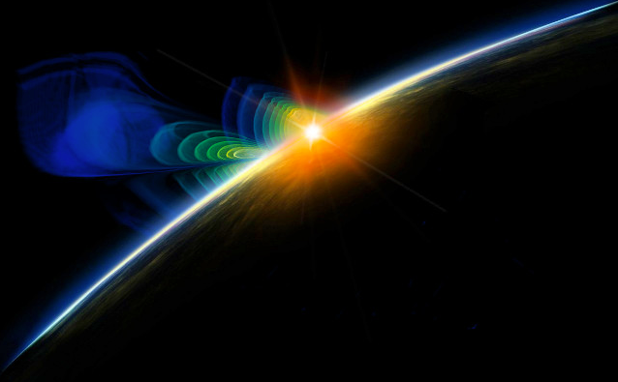
The Dawn of Gravitational-waves Physics and Astronomy
LIGO’s second observing run O2 is underway!
  Began November 30, 2016, slated to end on August 25, 2017
  L1 detector is more sensitive than in O1; H1 is slightly less sensitive
  One more confirmed black hole merger: GW170104!
12- 15 month break planned for Fall 2017
  Sensitivity goal for O3: H1, L1 > 120 Mpc binary neutron star inspiral range
  Substantial work planned at both Hanford and Livingston
Planning and R&D underway to upgrade Advanced LIGO detectors
The next few years will be very interesting ones for the field of gravitational-wave science!
Stay Tuned…

Slide 59

















































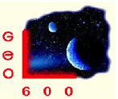




























LIGO Scientific Collaboration

Slide 60
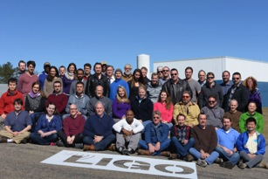
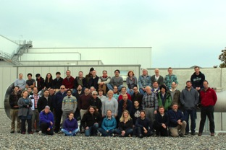
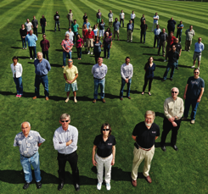
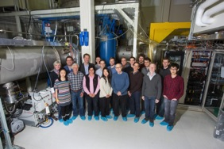
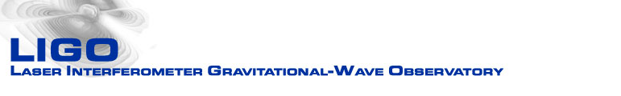

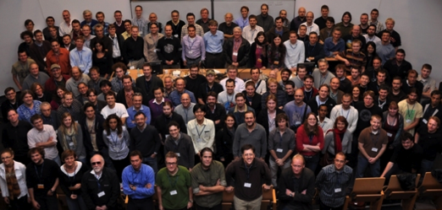

Acknowledgments
LIGO Livingston Observatory
LIGO Hanford Observatory
Thanks to:
ligo.caltech.edu
www.ligo.org
Support: National Science Foundation
Mike Zucker,
Peter Fritschel
Terra Hardwick
Sheila Rowan
Marty Fejer
Rana Adhikari
Salvo Vitale
Matt Evans
LIGO Caltech
LIGO Caltech
LIGO MIT
LSC

